Slide 1
A Sustainable Living Solution For Southern Minnesota
By: Ben Schwarz

Slide 2
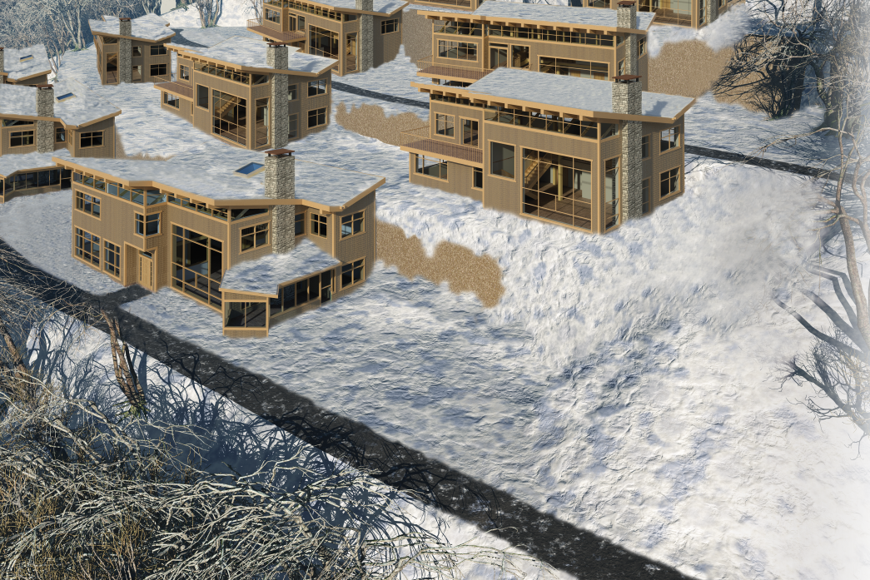
Project Typology:
Single family townhome development.
(20 homes in total)
Claim:
The definition of sustainable architecture and all areas of sustainable design for that matter, do change in terms of technical application from region to region, and climate to climate; however, the underlying concepts and general goals remain the same.
Supporting Premises:
Sustainable design is currently practiced in many different regions and climates.
Change in application of sustainable design techniques will be directly related to change in either region or climate.
The basic goals will remain the same regardless of region or climate change.

Slide 3
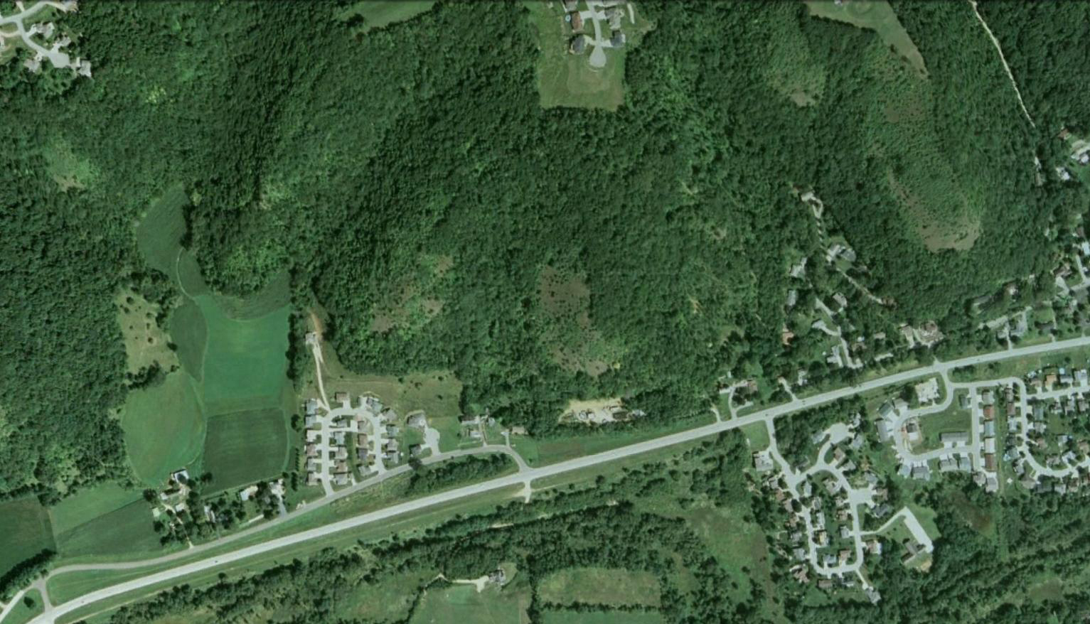

General site information and analysis:
Location:
Southeast corner of Minnesota
City:
Winona, MN

Slide 4
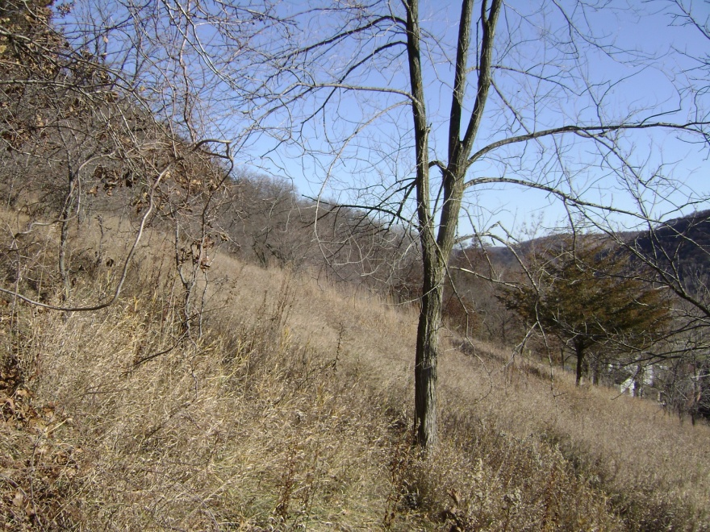
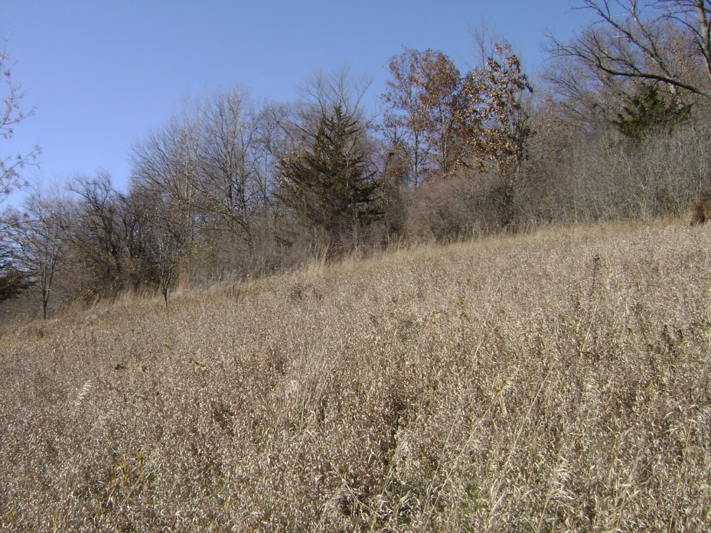
General site information and analysis:
Slope 30%-40%

Slide 5
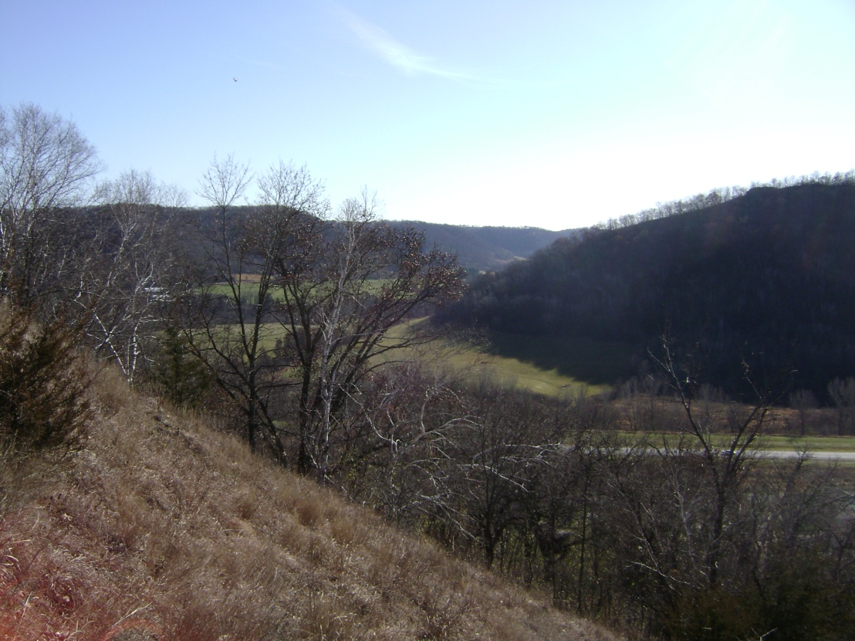
General site information and analysis:
Due to extreme site slope an alternative mode of transportation is necessary to get to and from the proposed housing units.
An inclined elevator system will be employed and shown in later slides.
Slope 45%-50%

Slide 6
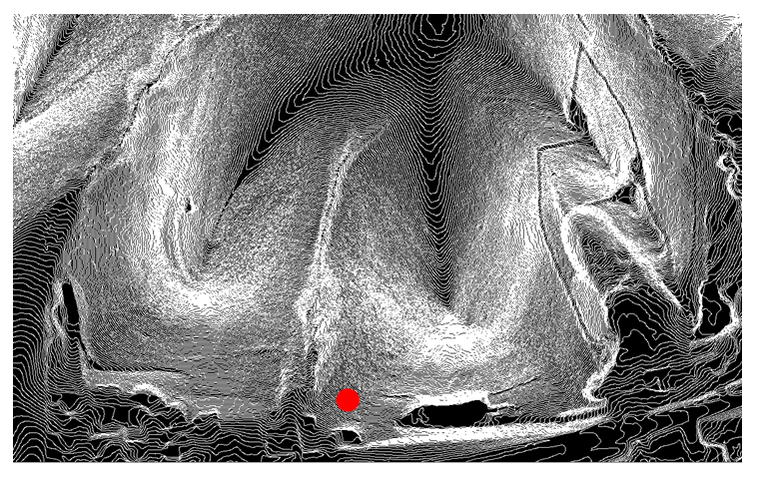
General site information and analysis:
A closer, more accurate representation of the site topography. Each contour is equal to 2’-0” of elevation gain.
The red dot represents where a preliminary rendering of the site is taken from.

Slide 7
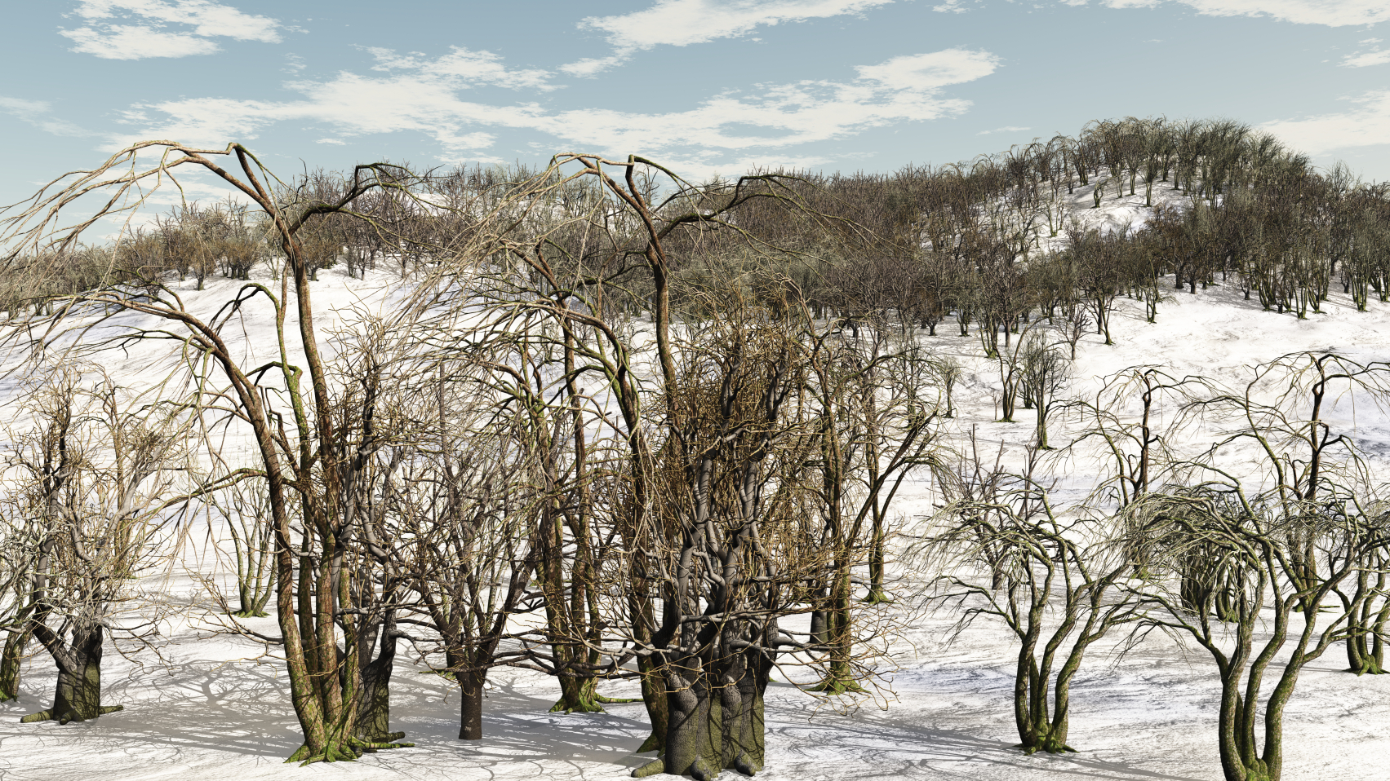
General site information and analysis:

Slide 8
General site information and analysis:
Site Choice Rational:
Geographically Winona’s vast seasonal extremes provide a challenging climate in which to design sustainably.
South facing bluffs were chosen to allow for maximum solar gain.
An inclined landscape was chosen to harbor natural protection from the elements for the homes to the north.
The large amounts of existing deciduous trees on site will provide for further protection from the wind and summer sun.

Slide 9
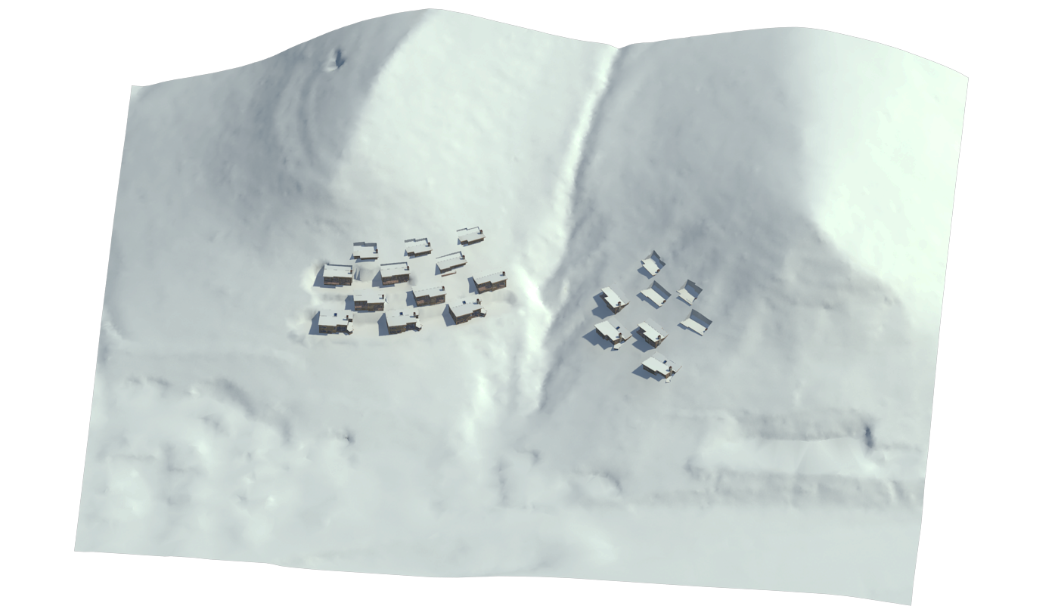
Site grading and development:
Building footprint placement:

Slide 10
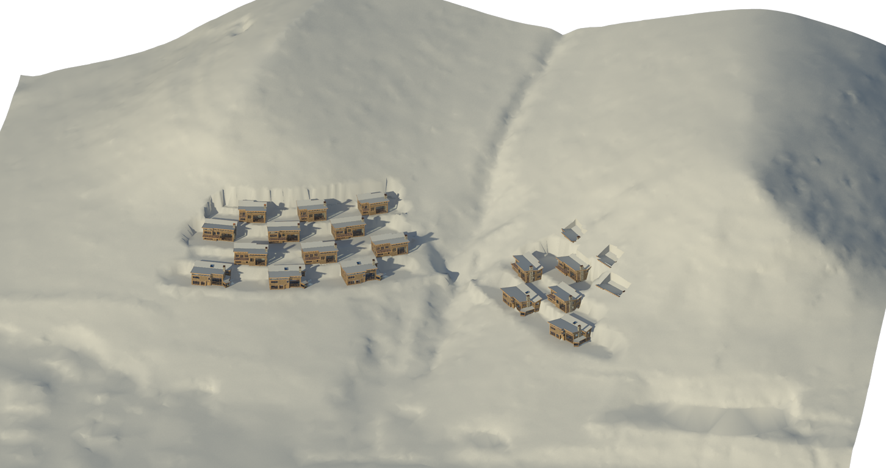
Site grading and development:
Grading site around buildings:

Slide 11
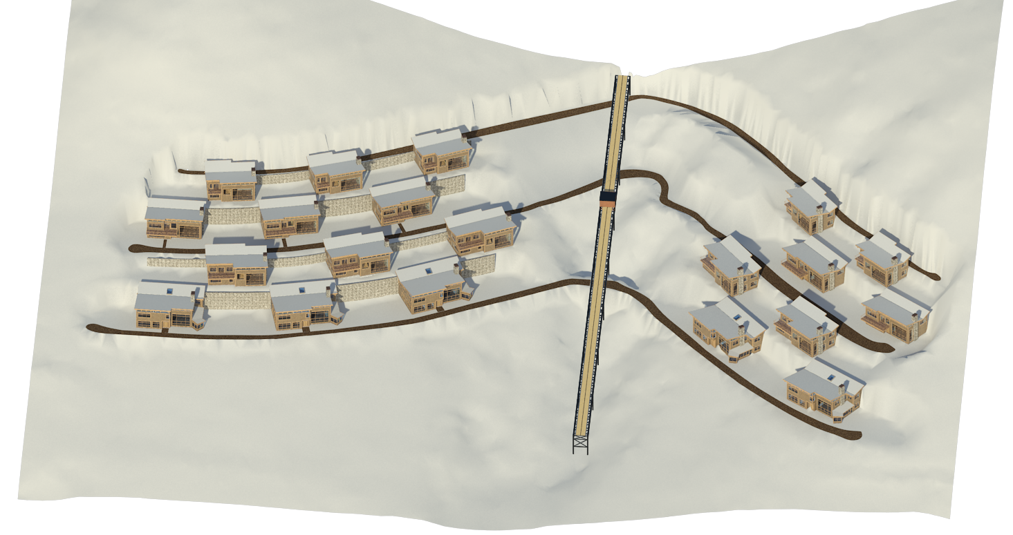
Site grading and development:
Placing retaining walls, roads, and inclined elevator system:

Slide 12
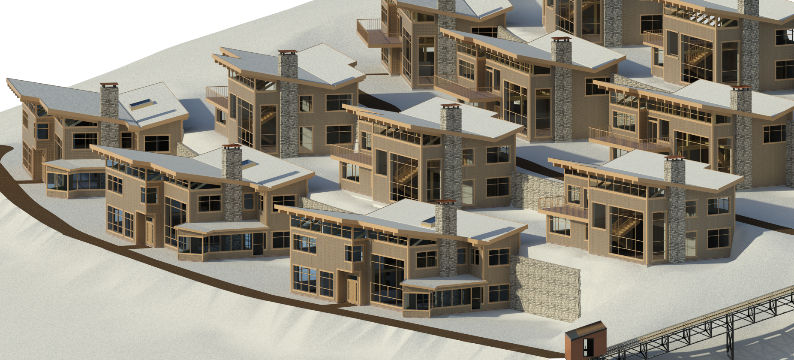
Site grading and development:
Inclined elevator system begins at community parking facility and continues up through the top level of housing units. The parking facility is also where a series of solar collection panels and photovoltaic trackers will be housed, providing the development’s main source of power.

Slide 13
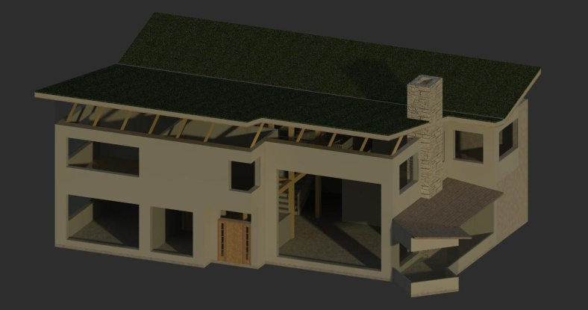
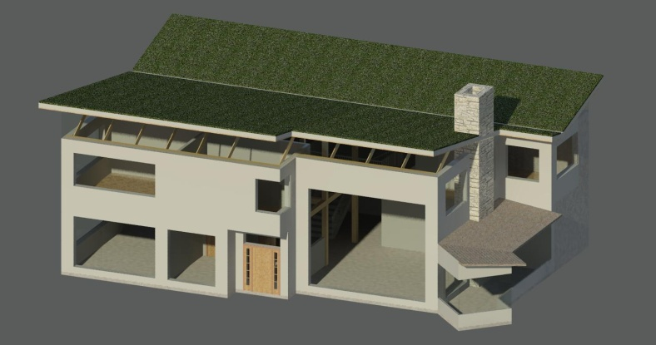
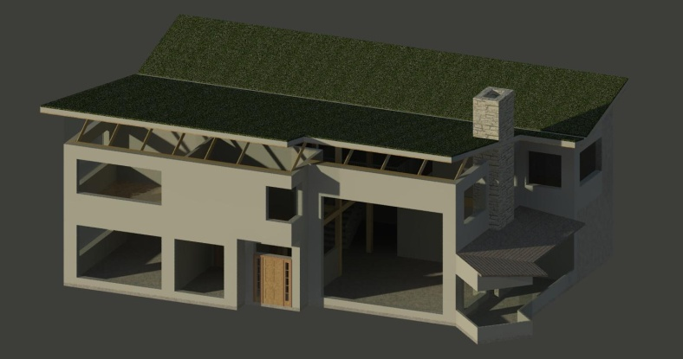
Unit sun studies:
A series of sun studies was conducted, testing various roof overhang pitches and lengths to determine which combination would produce the largest amount of solar gain during the winter months and the greatest amount of protection during the summer.
The combination that was most advantageous was a 5’-0” overhang at a 25° angle to horizontal.
January 21st 9 AM
January 21st 12 PM
January 21st 3 PM

Slide 14
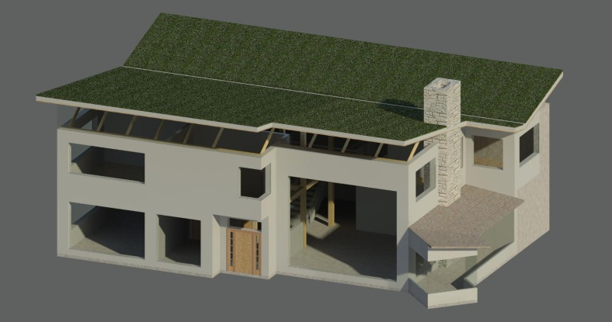
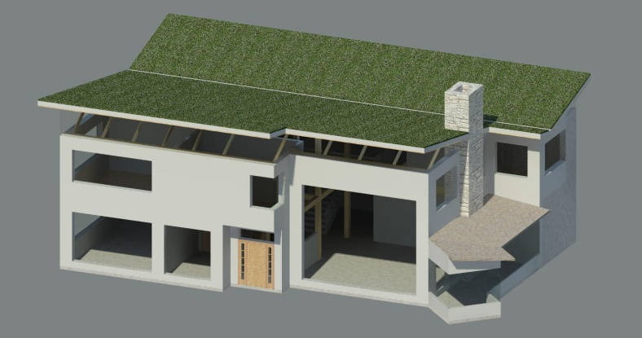
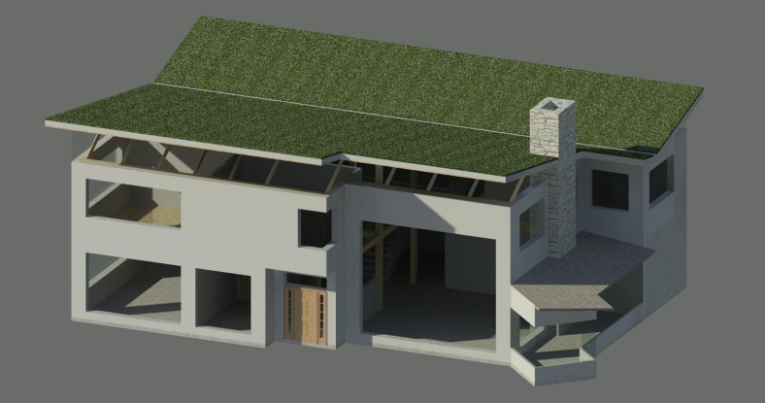
Unit sun studies:
March 21st 9 AM
March 21st 12 PM
March 21st 3 PM

Slide 15
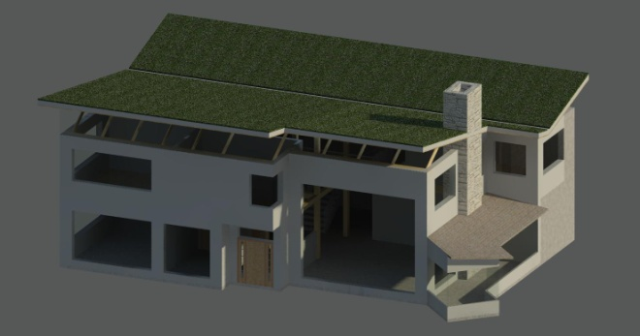
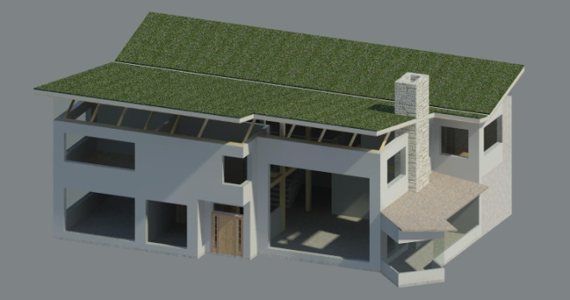
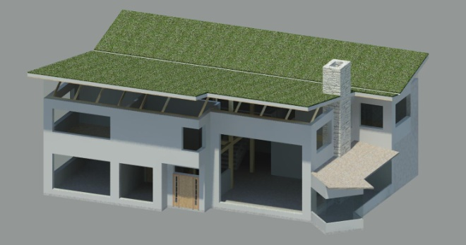
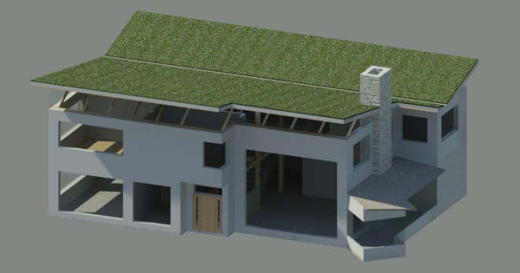
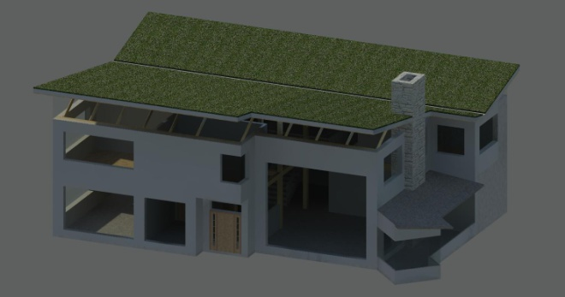
Unit sun studies:
June 21st 7 AM
June 21st 9 AM
June 21st 12 PM
June 21st 3 PM
June 21st 5 PM

Slide 16

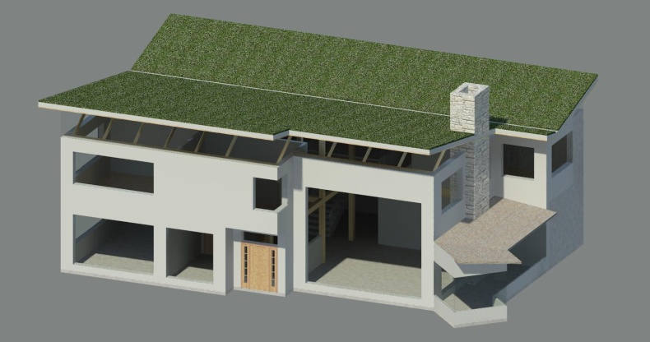

Unit sun studies:
September 21st 9 AM
September 21st 12 PM
September 21st 3 PM

Slide 17
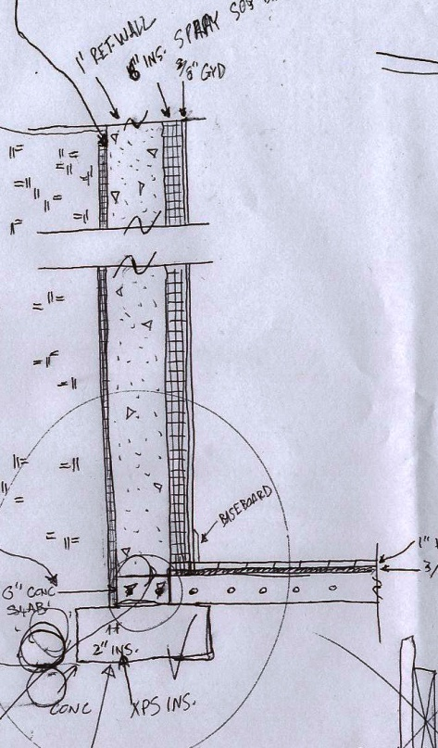
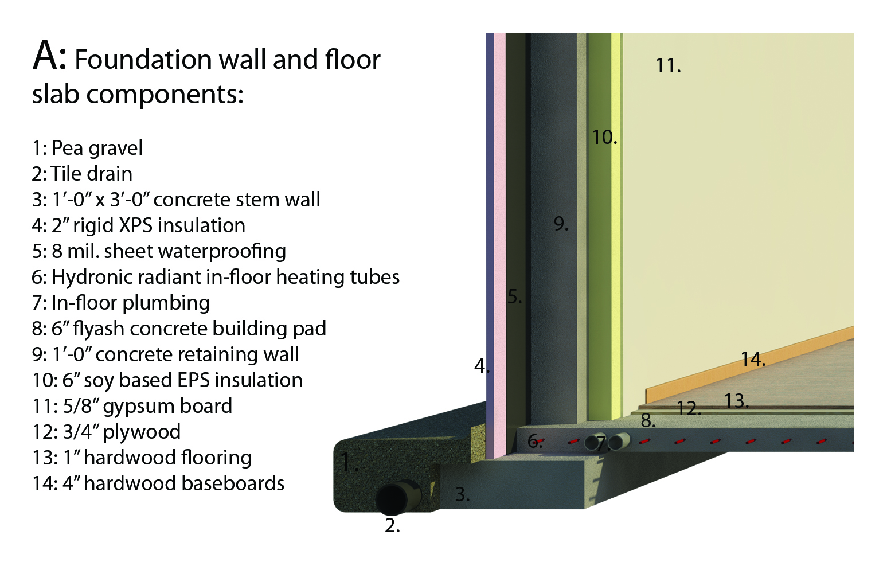
Sustainable features, structural, and detail development:

Slide 18
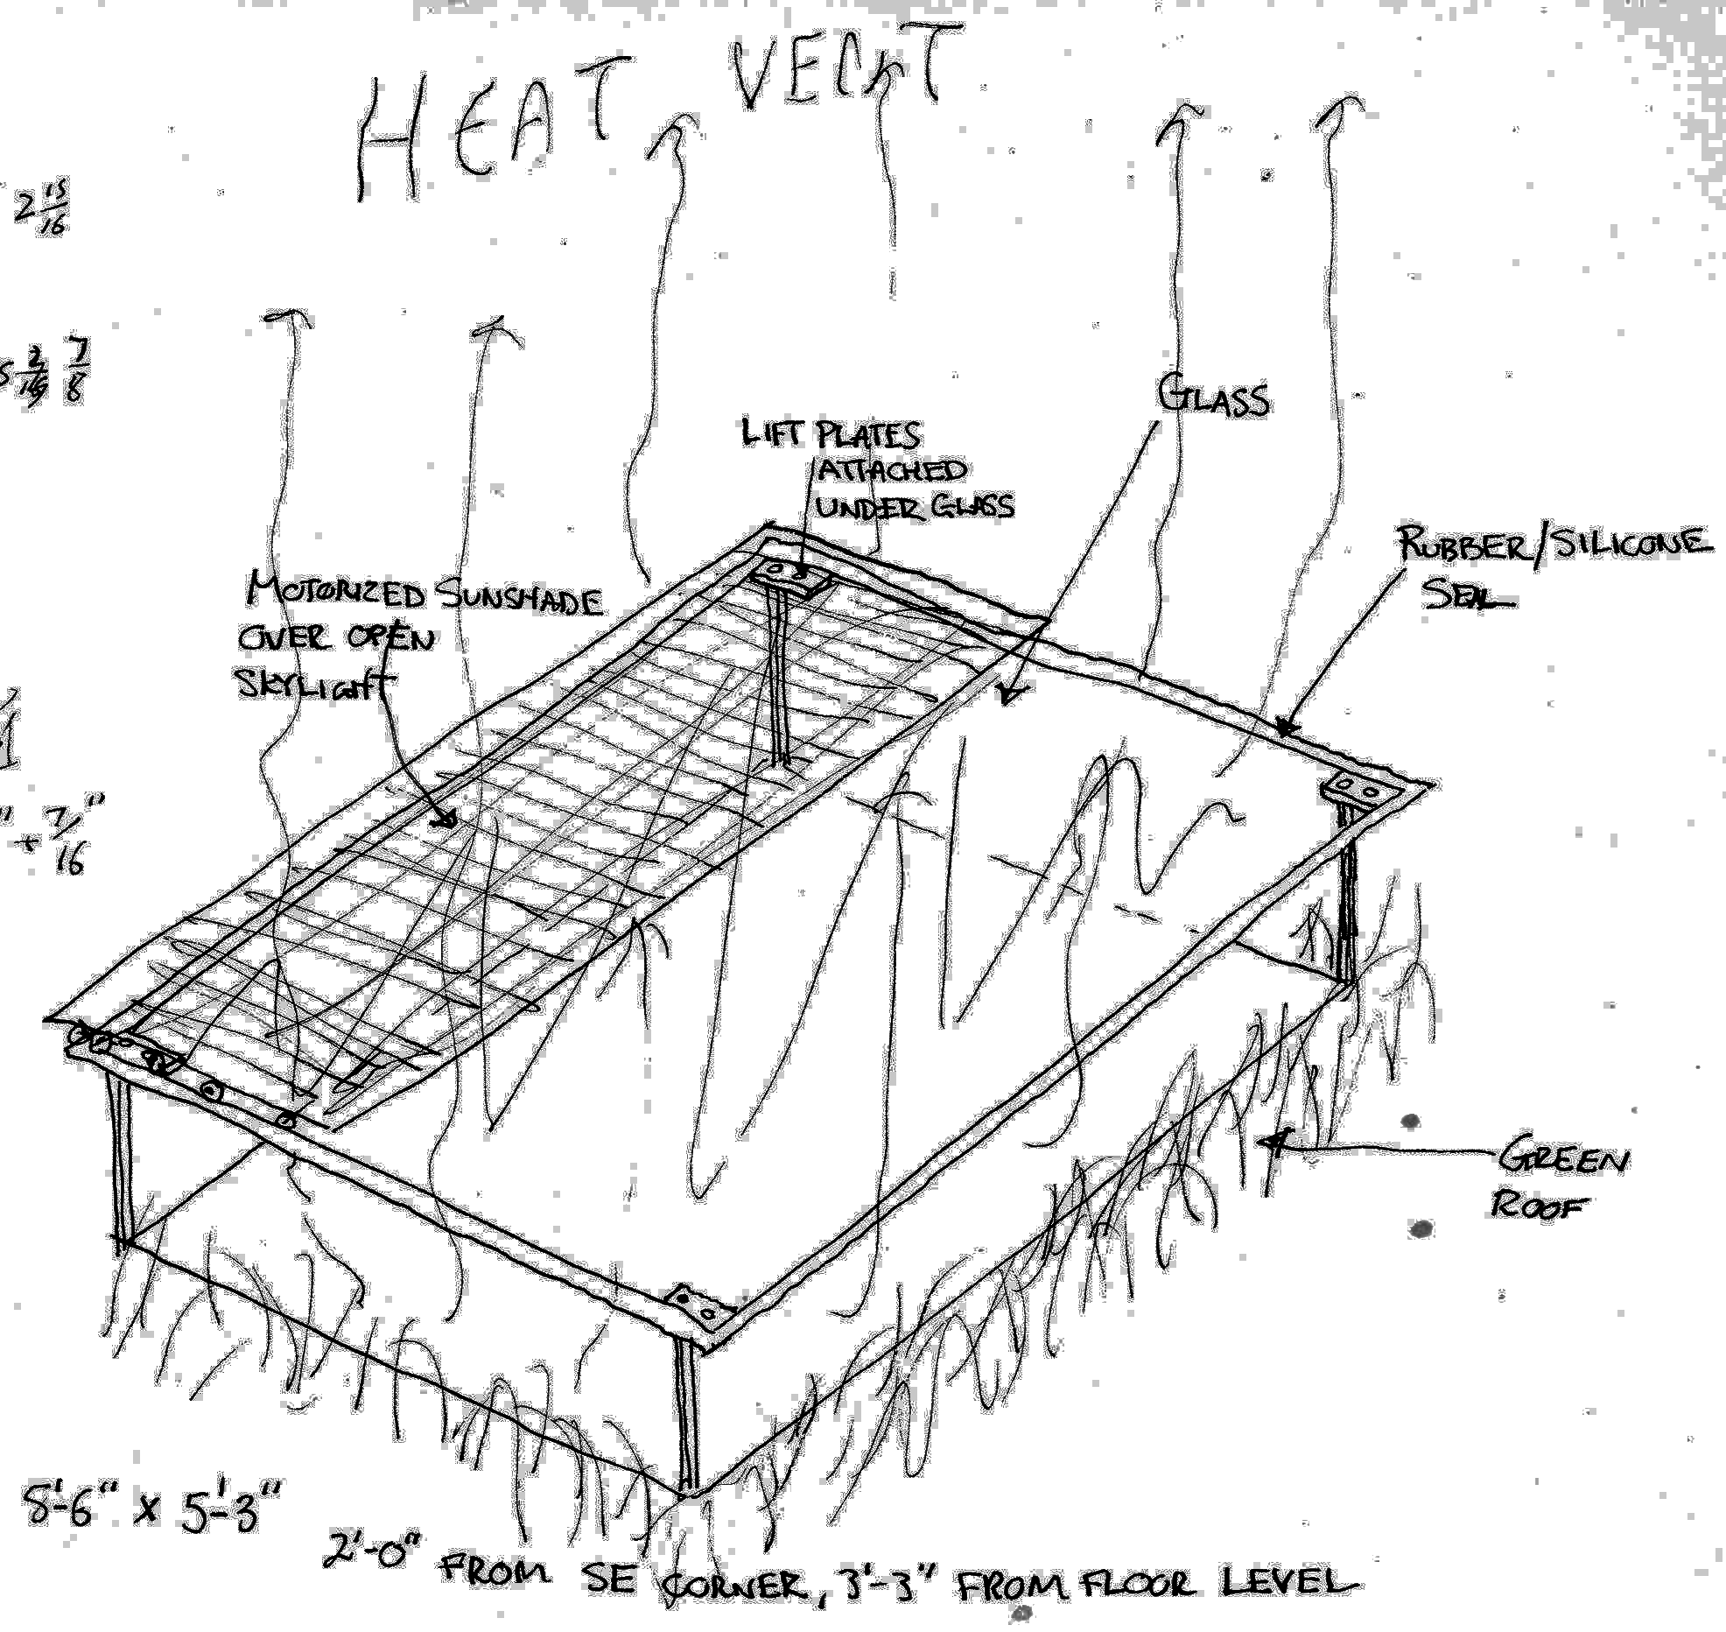
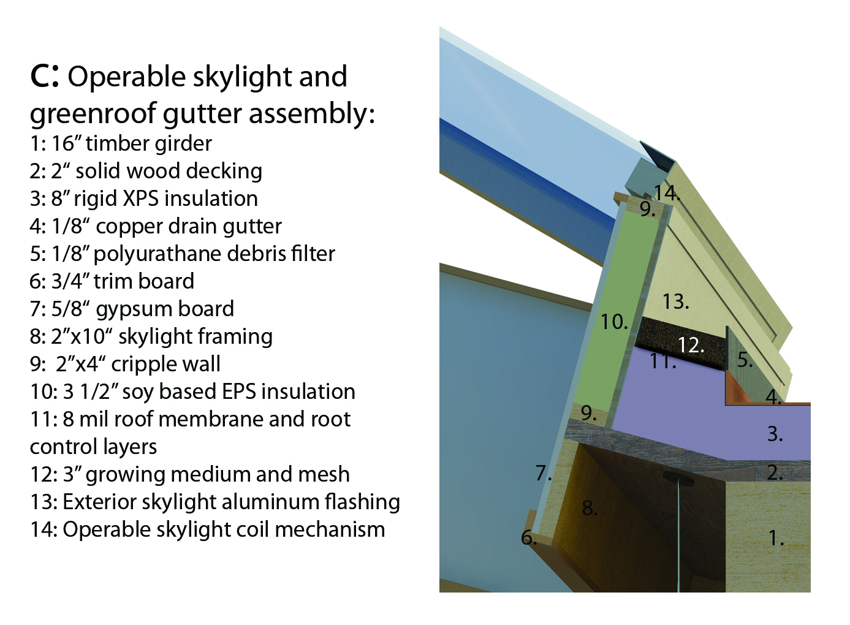
Sustainable features, structural, and detail development:

Slide 19
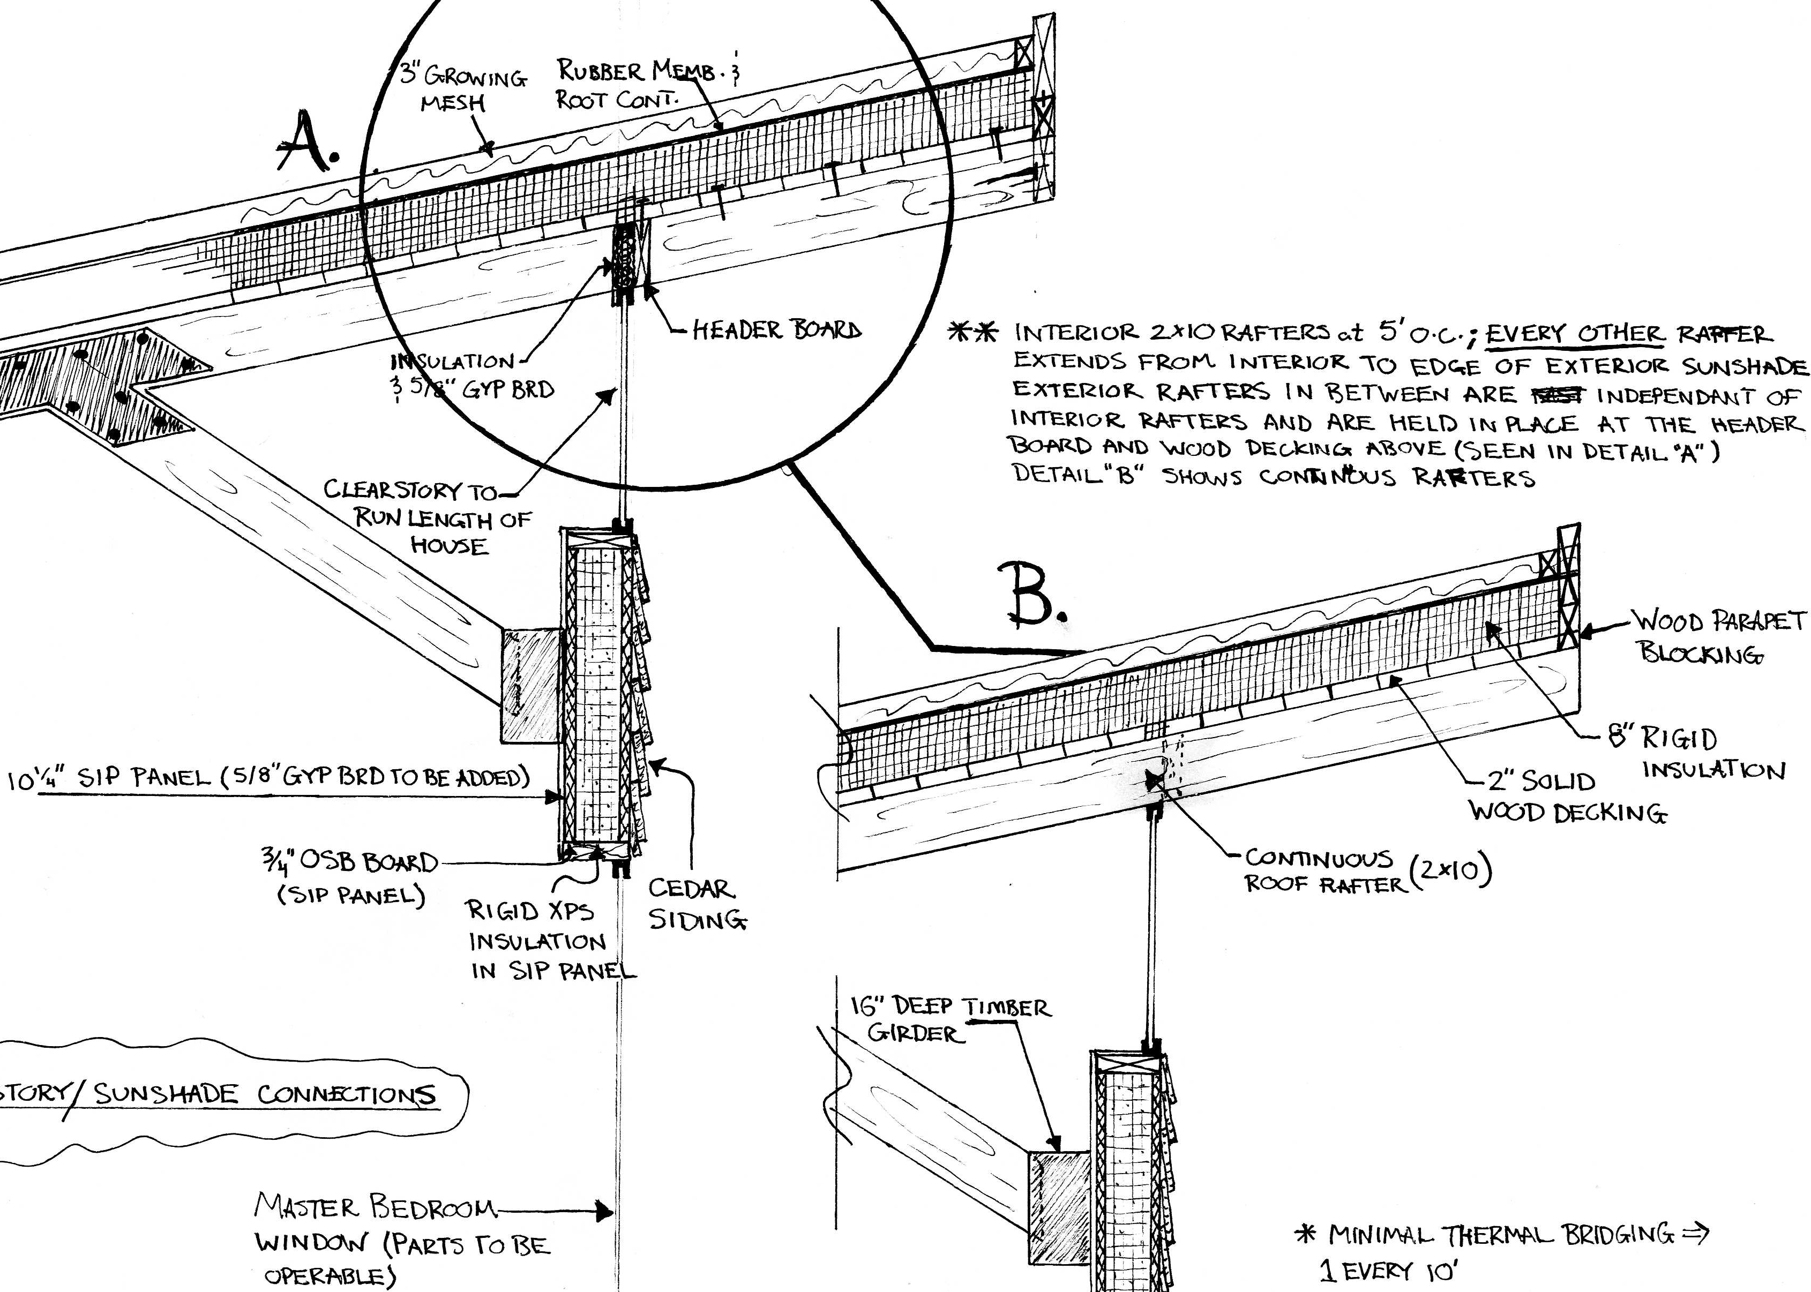
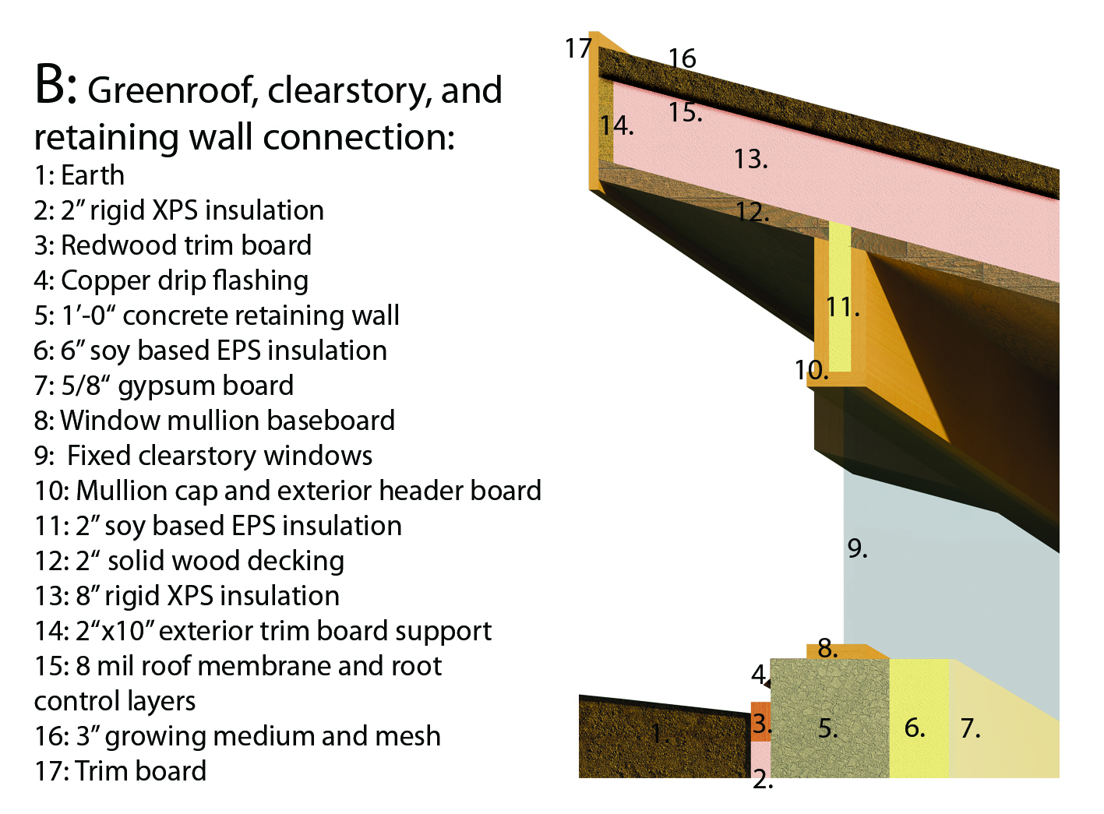
Sustainable features, structural, and detail development:

Slide 20
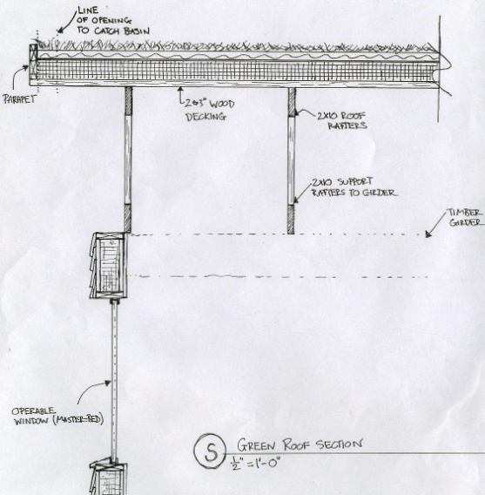
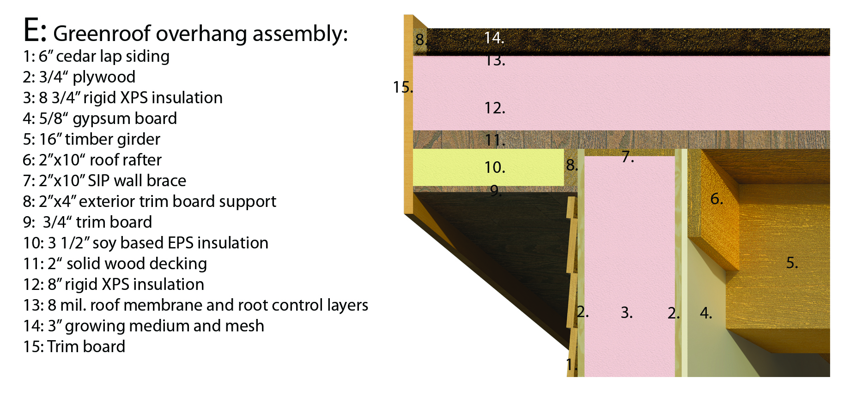
Sustainable features, structural, and detail development:

Slide 21
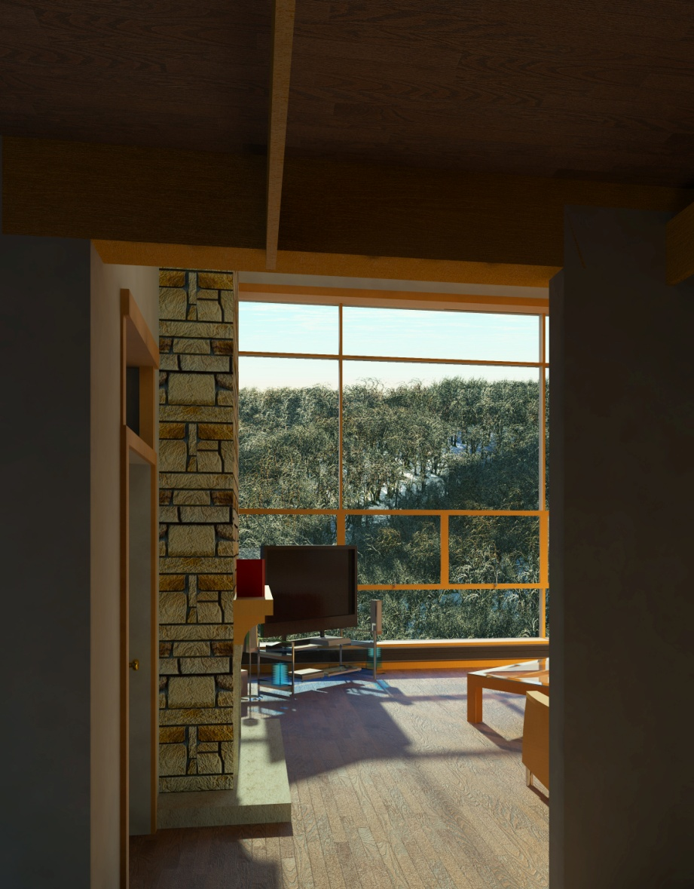
Interior renderings of a typical 5 person unit:
View from den looking south through family room.

Slide 22
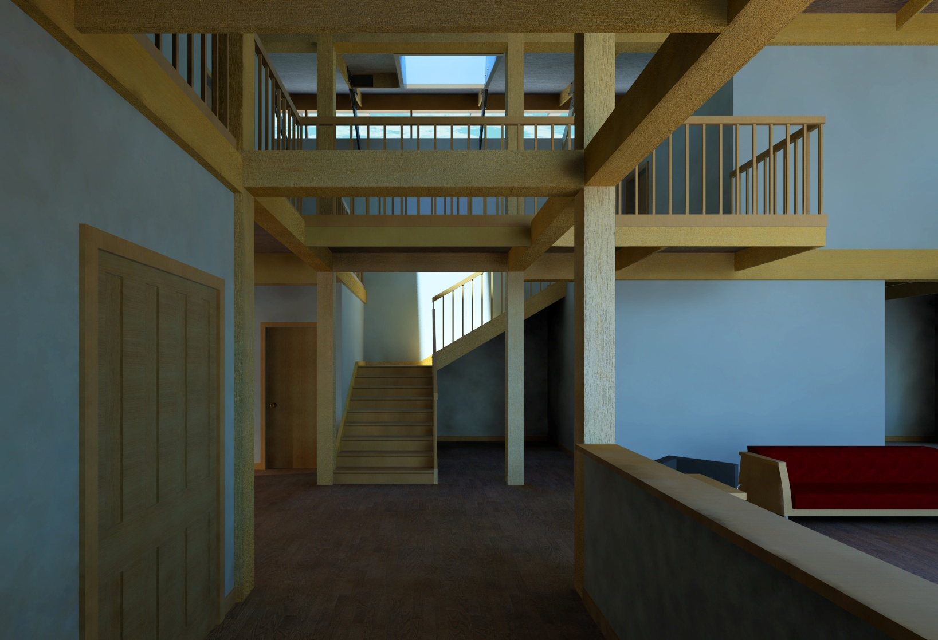
Interior renderings of a typical 5 person unit:
View from front entryway looking north.

Slide 23
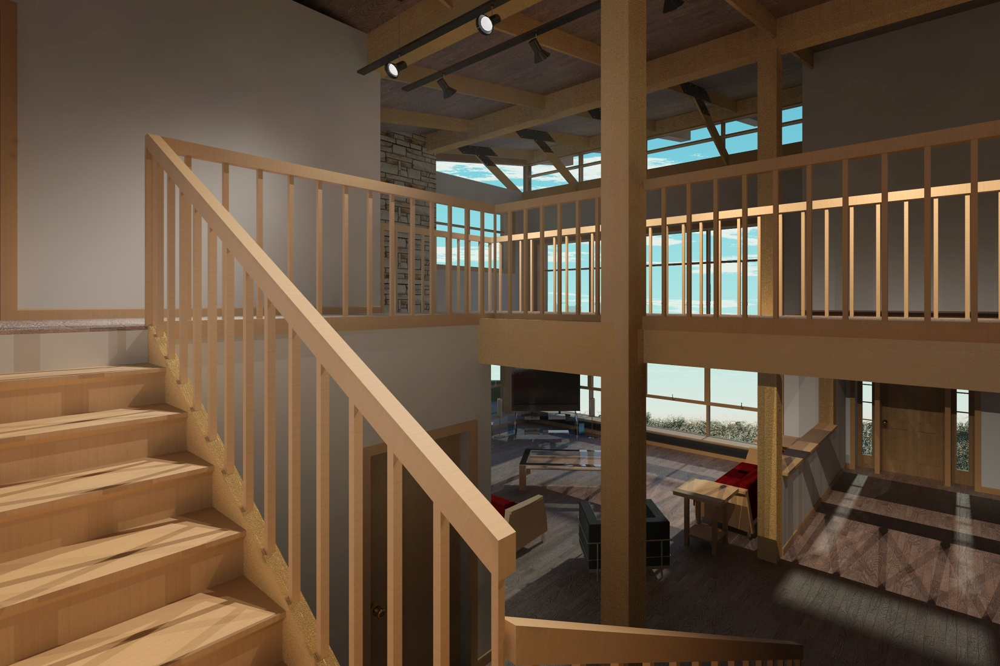
Interior renderings of a typical 5 person unit:
View from stairway landing looking south.

Slide 24
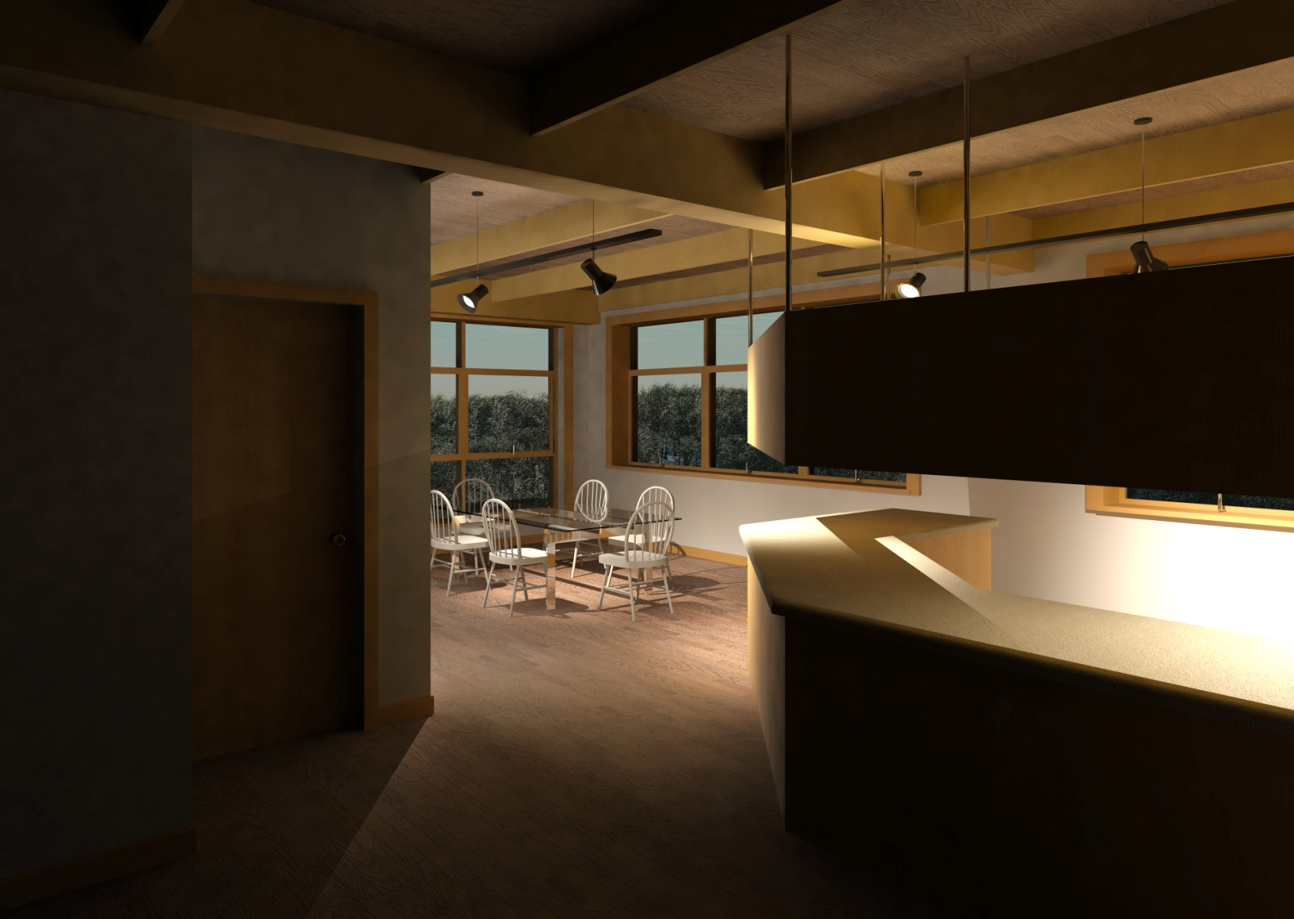
Interior renderings of a typical 5 person unit:
View looking south at the kitchen and dining room

Slide 25
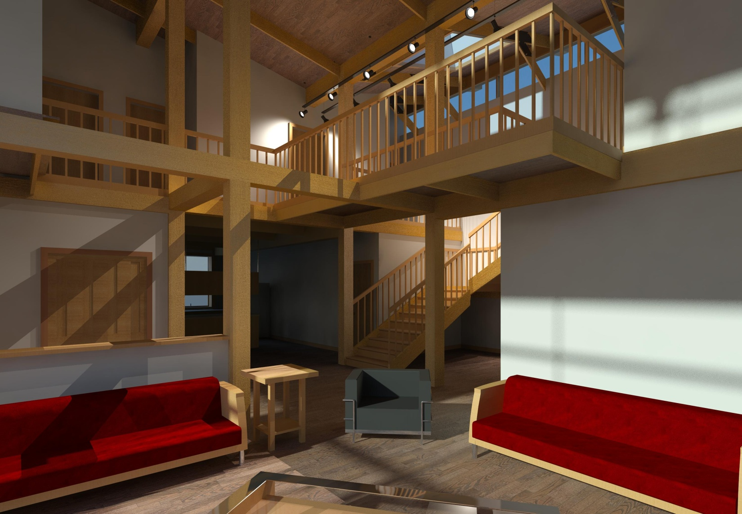
Interior renderings of a typical 5 person unit:
View from family room looking northwest at open staircase and second floor corridor.

Slide 26
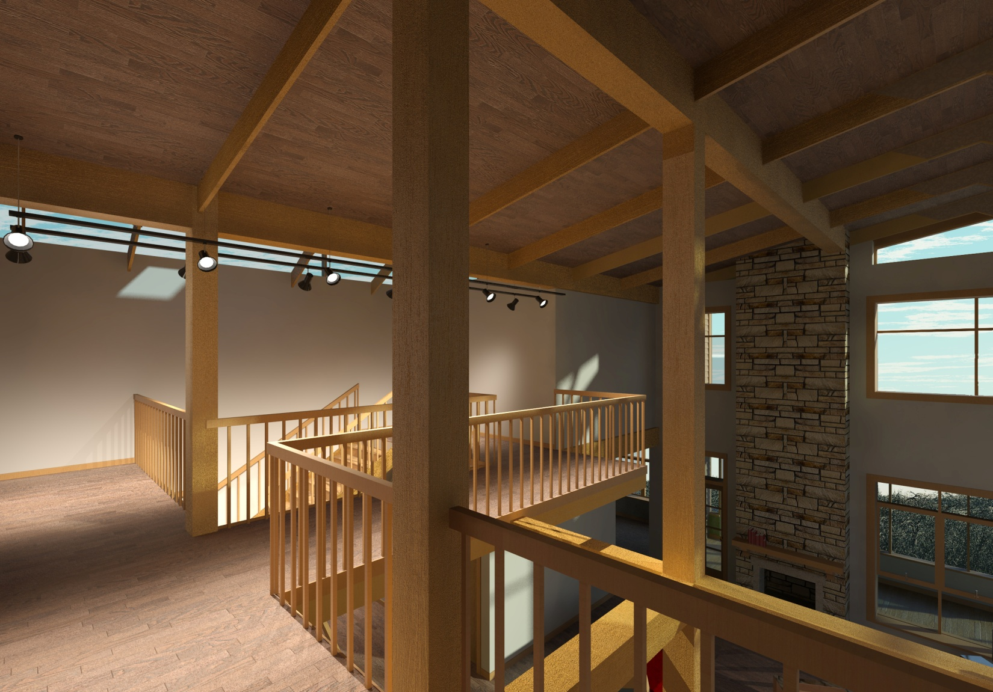
Interior renderings of a typical 5 person unit:
View from second floor corridor looking over family room.

