Slide 1
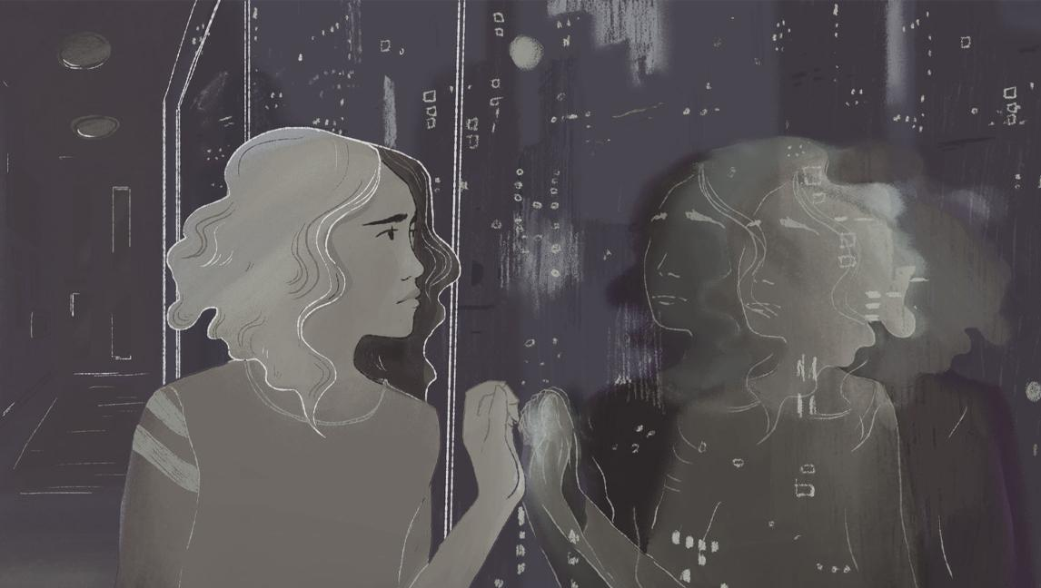
DESIGNING FOR OUTSIDERS

Slide 2
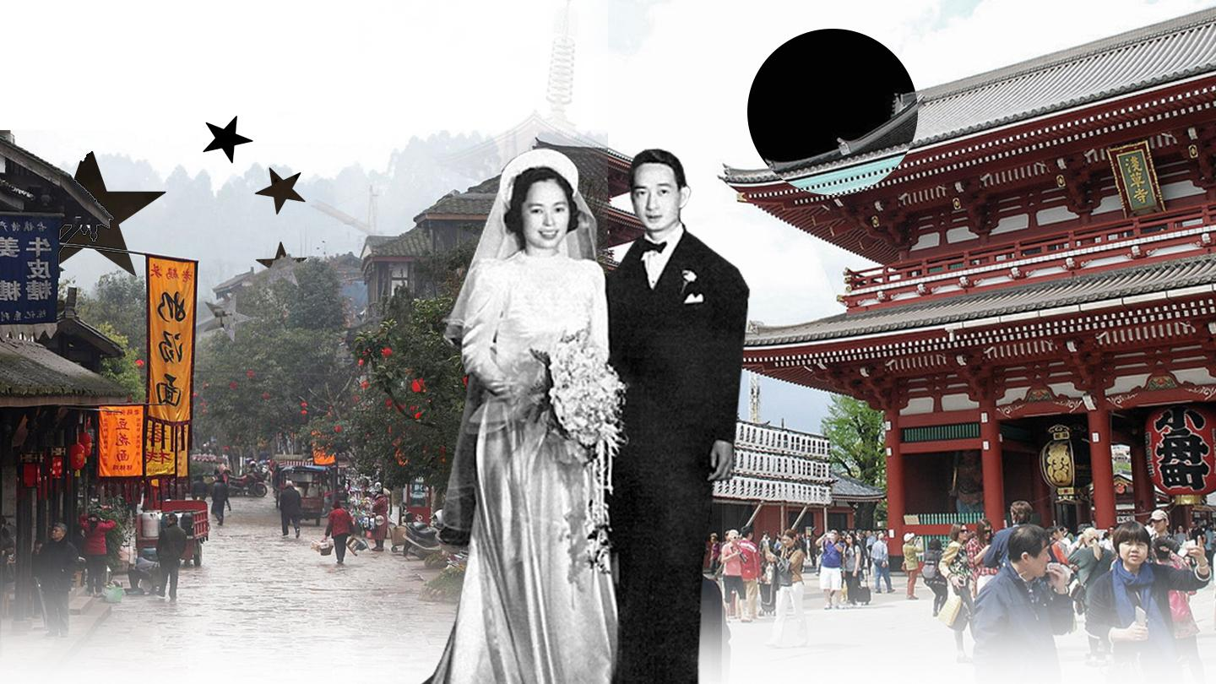
Notes:
Why do we feel the need to separate ourselves from others? Why do we feel the need to differentiate between ‘us’ and ‘them’? Instinctively, our ancestors did it out of survival, when we relied on ‘our tribe’ for individual and group success. Society did it for control, as a way to establish rules and expectations for its citizens as well as establish a hierarchy within the group to prove dominance. Culture can drive us to alienate others and its study can lead us to either learn from its pitfalls, or it can validate our beliefs and reinforce our behavior.

Slide 3
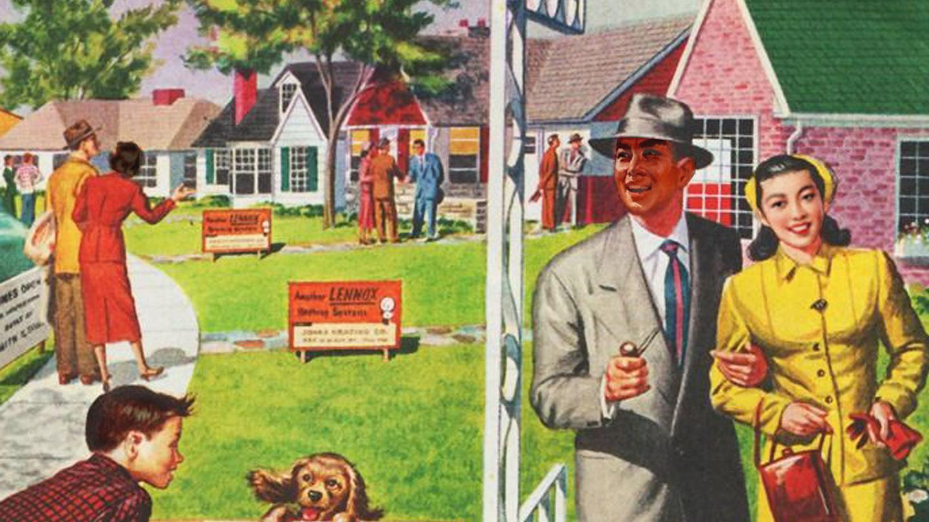
Notes:
We as human beings want to feel safe, we want to know and trust the people who surround us and leave a legacy for our descendants. Progressing our kind by engulfing ourselves within an environment that is predictable, comfortable, and offers protection against the alien and unknown.

Slide 4


Notes:
An insider can be defined as:
A person who is a member of a group, organization, society, etc.
A person who is accepted and wanted within a group.
A person belonging to a limited circle of people who understand the actual facts in a situation or share private knowledge
Outsider can be defined as:
A person who does not belong to a group.
An undesirable member to a specific group whose members do not want or accept them.
And someone who stands outside the group, looking in.

Slide 5
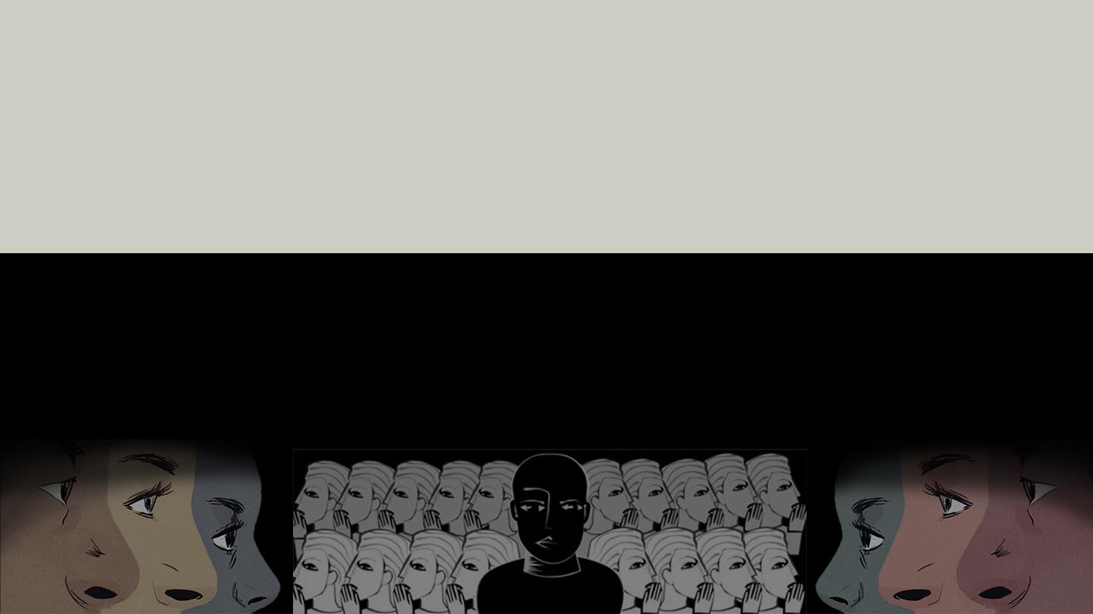
Notes:
It is our language that determines whether we are an insider or an outsider. What I mean by language is our actions, thoughts, ideas and perceptions determined by our “pre knowledge” or the influence from our instincts, society and culture.
To fully interpret the intent behind human language one must recognize how their biological, sociological and cultural factors play a part in both perceiving and interacting with the physical world. We tend to associate our experiences with our environment. It is from this association that we subconsciously categorize others as insiders and outsiders.

Slide 6
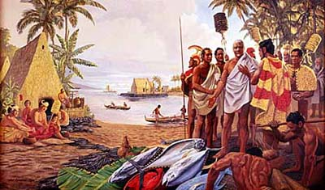
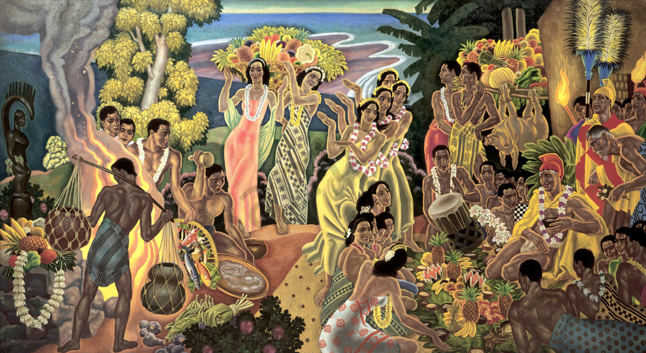
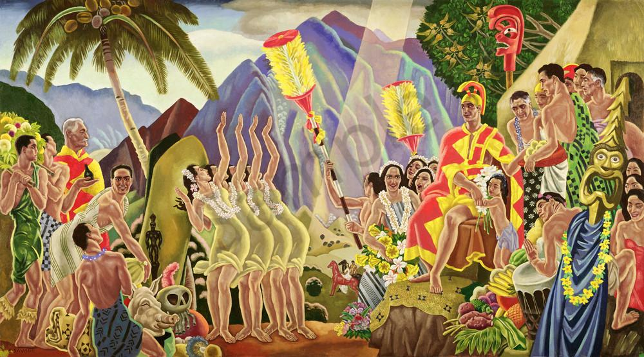
Notes:
It starts with our biological drive to survive. Our instincts drive us to strive for an environment that provides nourishment, safety, and prosperity. If our needs are met, we associate and treat the environment and the others who are in it with positivity, if they are not met then the environment and its people are viewed and met with negativity.
Society then reinforces these needs. It gives us an environment that allows for understanding between its people, through the creation of standards and values. These standards are then enforced by rules that validate the thoughts and feelings of its members. We are then able to account someone for their actions, subconsciously reinforcing the positive and negative association of experience and environment.
Finally our actions are justified by our culture, which drives us to act a certain way to increase our cohesion within our group. Our culture gives us meaning and a greater purpose to continue building towards a common goal, beyond the rules and regulations we have collectively decided upon. This ultimately solidifies and intensifies our reasoning for our actions on the notion of insider and outsider.

Slide 7
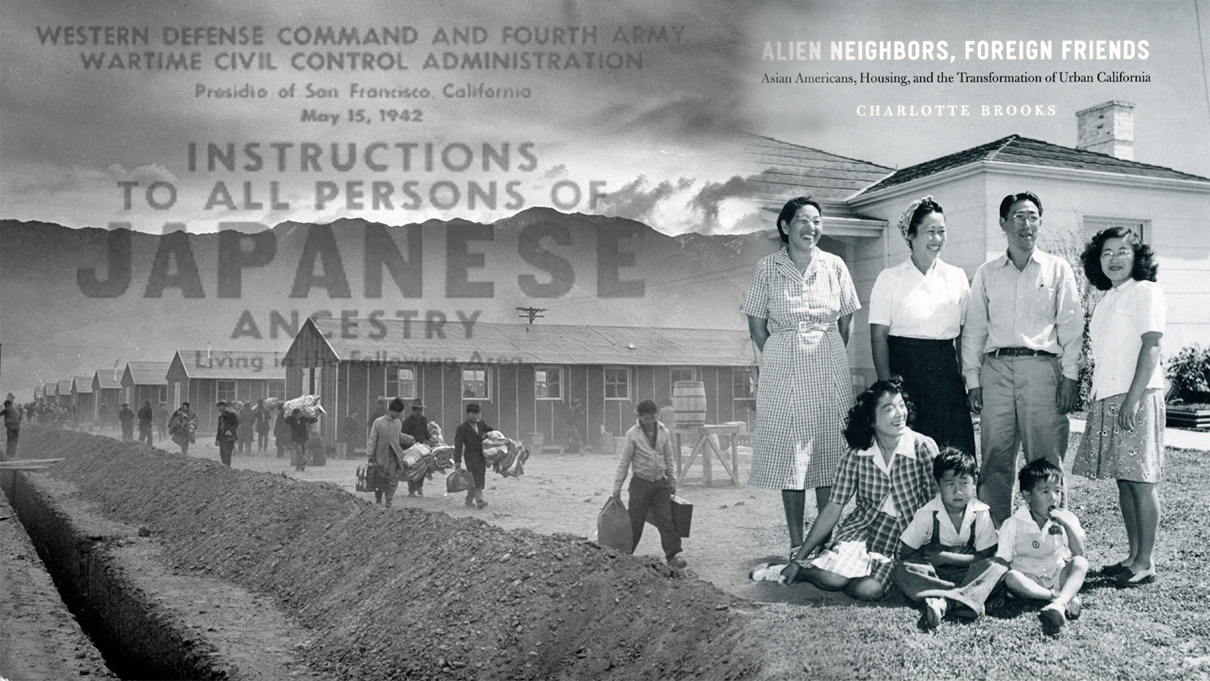
Notes:
Our language with one another is still emphasized on a positive and negative scale that is undoubtedly driven by our ]need for security and explains our reaction to the unknown.
If you can connect or fit in with a group then you are seen as an insider. The tone of the language from the group will be welcoming and inclusive because you are viewed as an asset to their society and culture.
If you cannot connect with the group members, you are seen as an outsider. The language towards you will be exclusive and demeaning because you are seen as a liability.
These perceptions and assumptions that we have created have made an impact on how we manipulate the physical world. The way humans perceive and subsequently portray one another influences their actions and ideas for the tangible and intangible future.

Slide 8
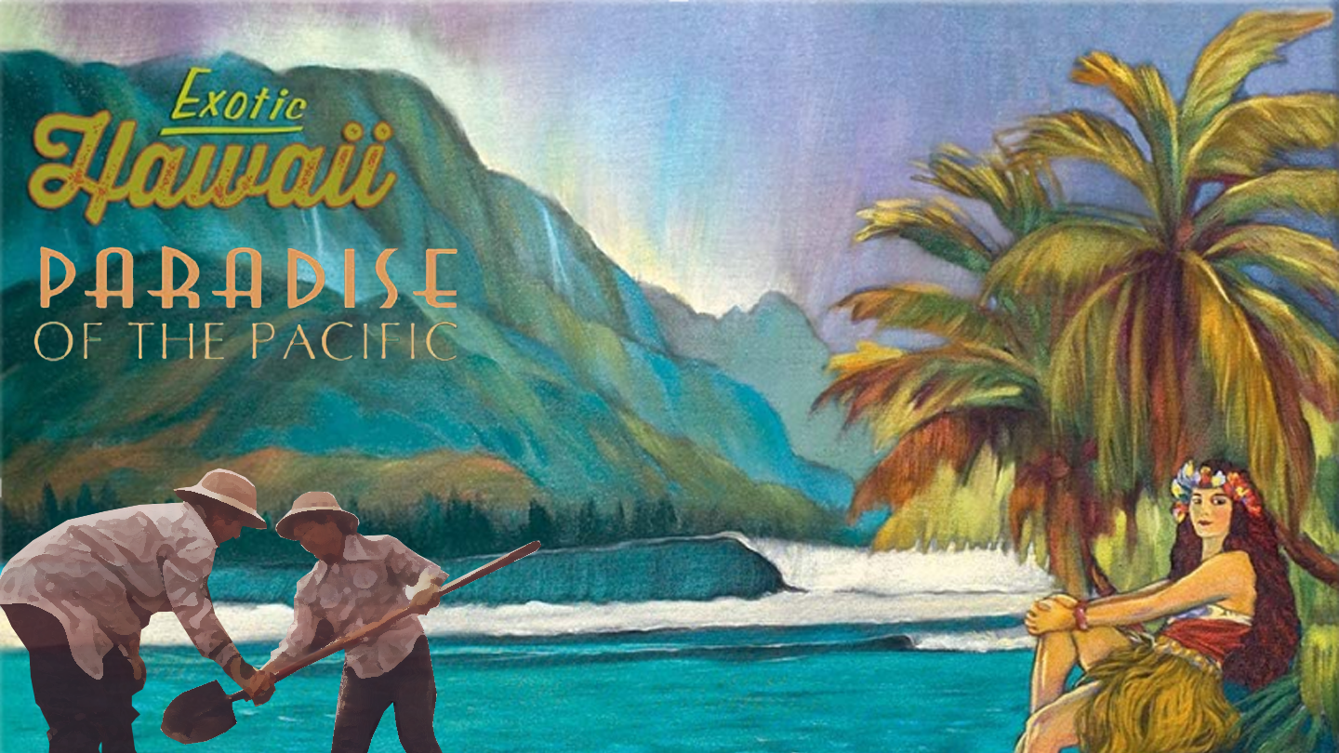
Notes:
Perception of one another, whether it is benefiting one or many, has intentional and unintentional forms of inclusion and exclusion. These ideas are then reinforced by our actions with in the physical world we have created for ourselves, normalizing the concept of insider and outsider.

Slide 9
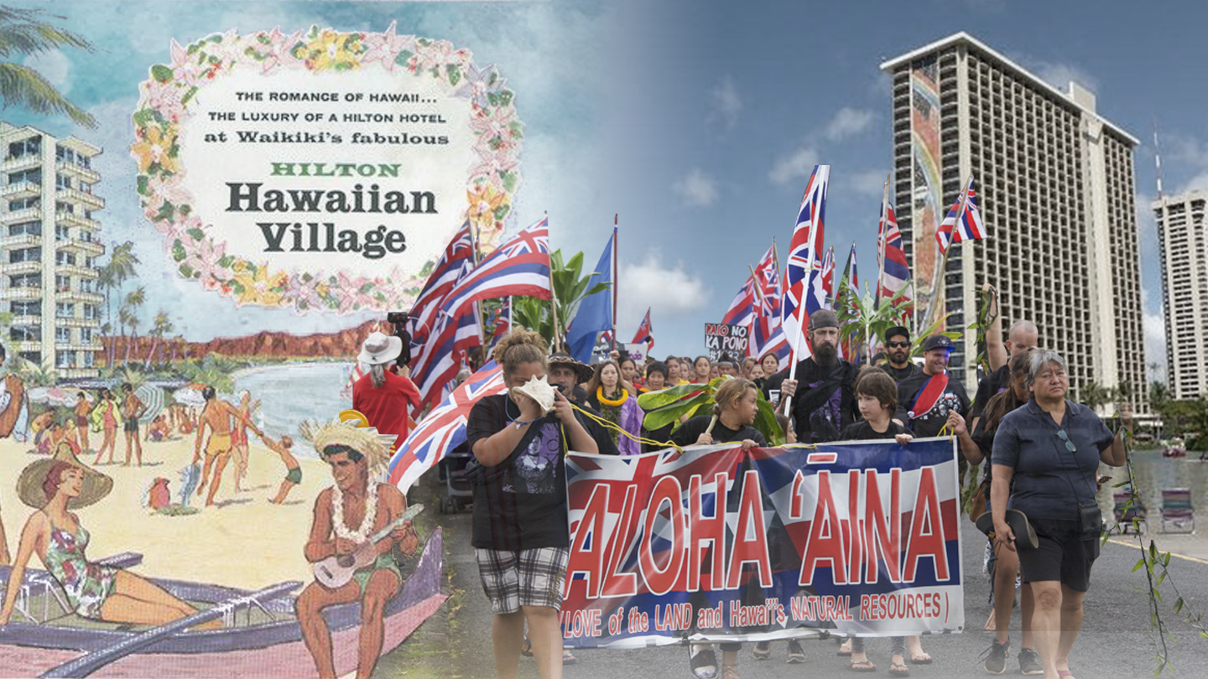
Notes:
In the Architectural and urban planning world, design is centered around growth by “improving the area”. Progress is fueled by the desires of the most powerful group, who often overlook the overall community's needs. They seek to get a firmer foothold for their group, rather than helping their wider organization and fail to understand the full impact of their vision.

Slide 10
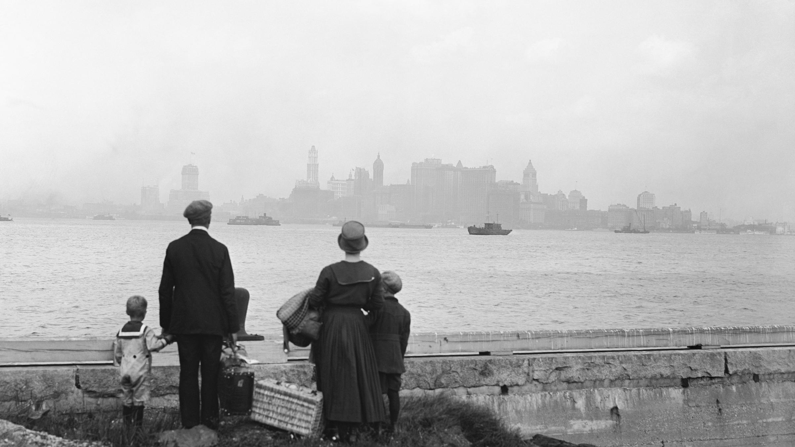
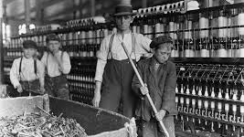
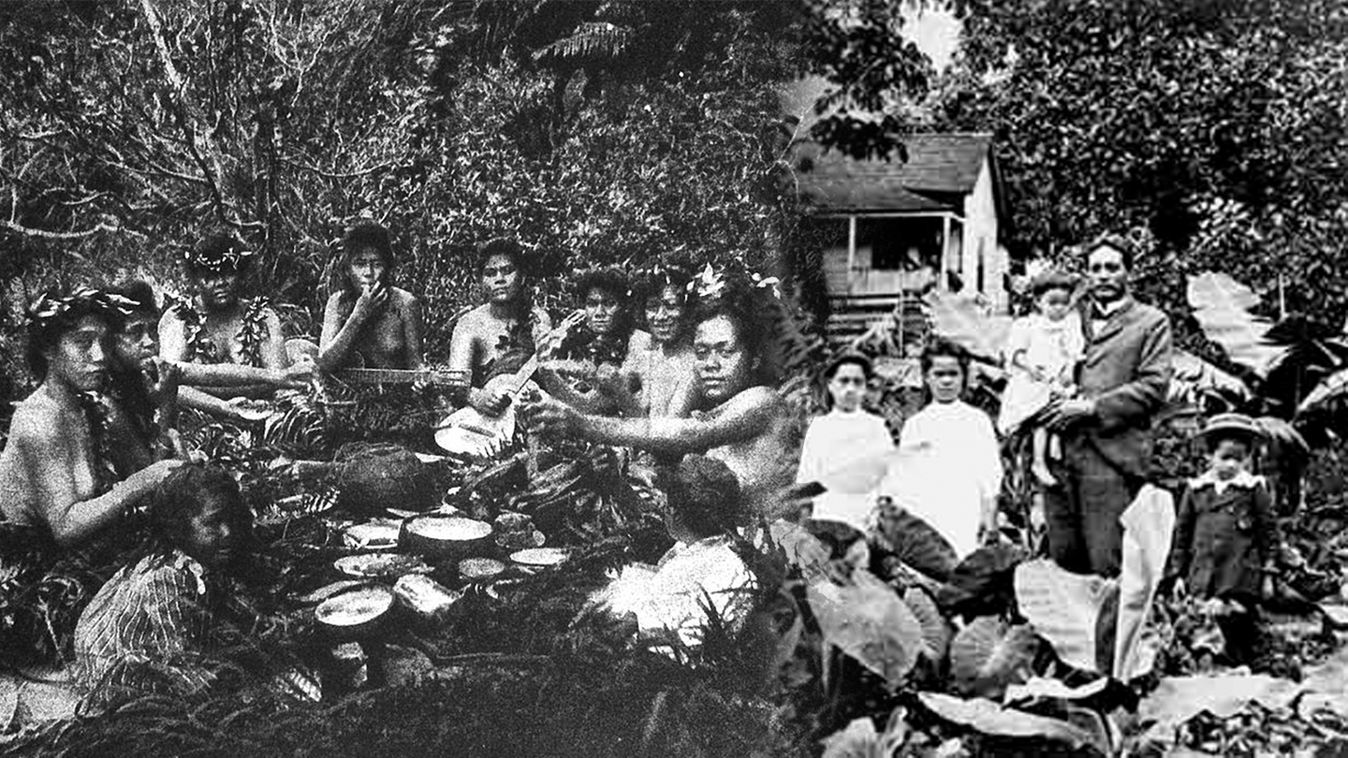
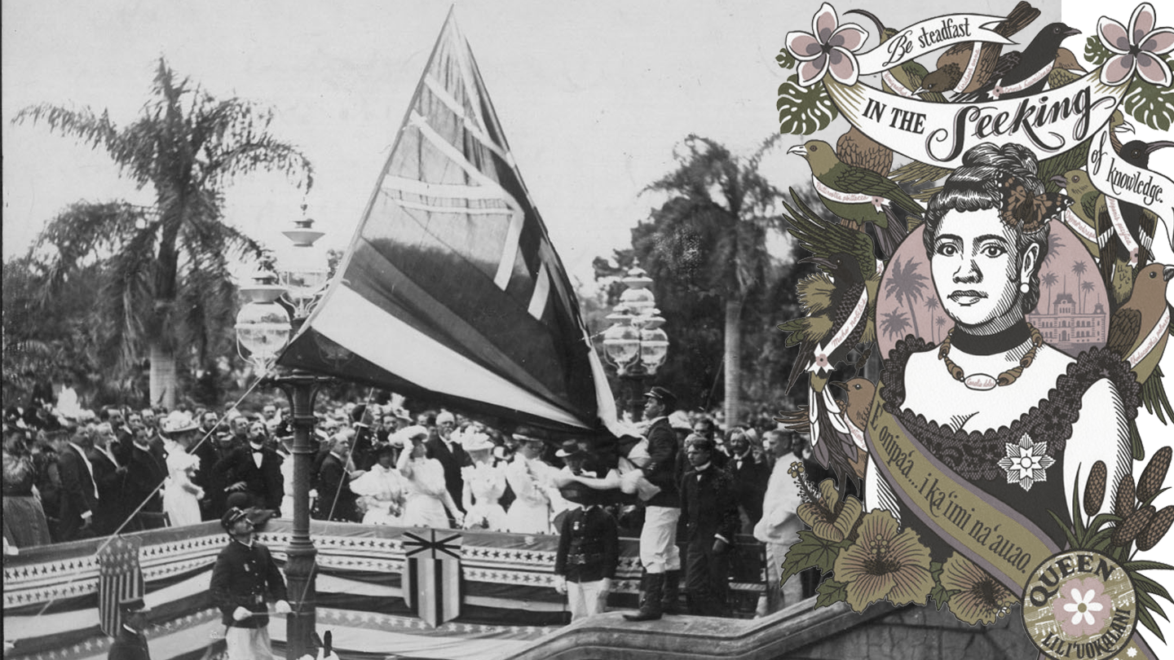
Notes:
If we examine modern America, it was built upon the back of outsiders, with many of today's citizens being descendants of immigrants. Many were considered outsiders in their own countries and they came to chase the American dream and seek acceptance.
But, while searching for community they would often create exclusive groups and look down on all others outside of it, creating an environment for others exactly like the one they themselves were trying to escape.
The newcomers were looked on with fear, as unknown aliens bringing different traditions that conflicted so heavily with what was previously thought of as American society. Viewed as rivals willing to work for a fraction of the cost of their neighbors in aim of grasping a bit of the American dream.
This mentality led many Americans to discriminate against the new immigrants and cast out the outsiders from their communities, isolating them in the hope that doing so would cause them to disappear. A theoretical wall was built between the two, them and us.

Slide 11
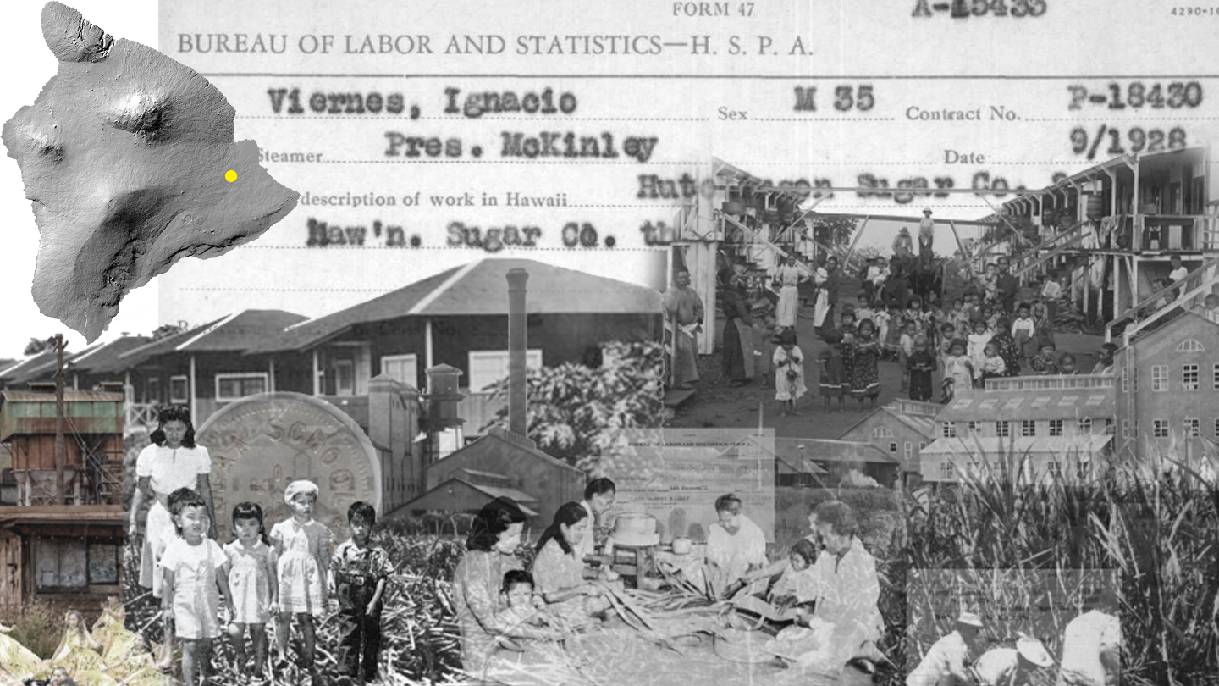
Notes:
This is very apparent on the island of Hawaii, in the city of Keaau.
Due to its fertile land and its proximity to the Export harbor in Hilo Hawaii, an LA based entrepreneur ceased the opportunity to start a sugar cane plantation and factory. His goal was aiding in the industrial colonization of Hawaii and becoming the largest producer of American made sugar.
During the infancy of Hawaii’s industrial economy, many places of employment hired masses of people from poor countries with promises of a fair wage, a work visa, and benefits like free medical attention, recreational facilities, and “modern housing communities”.

Slide 12
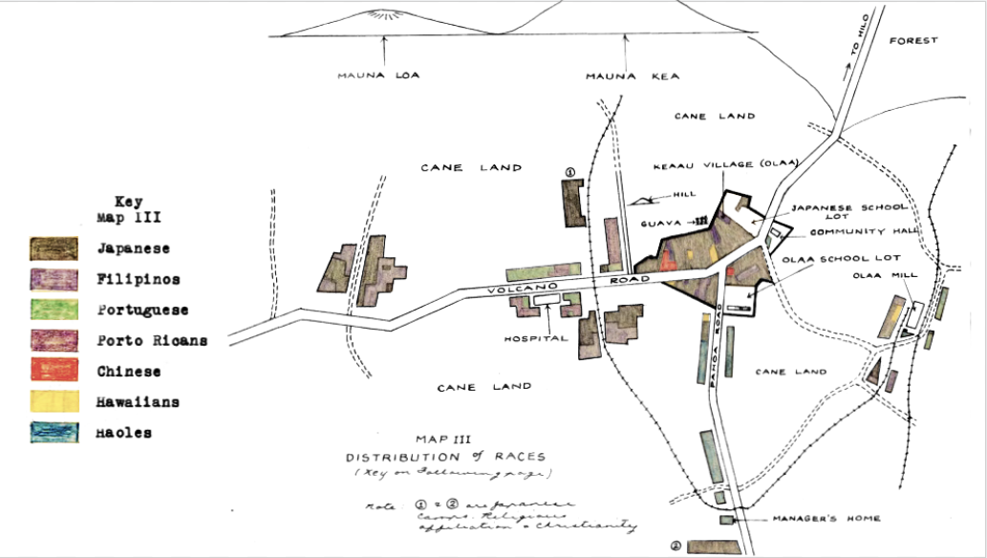
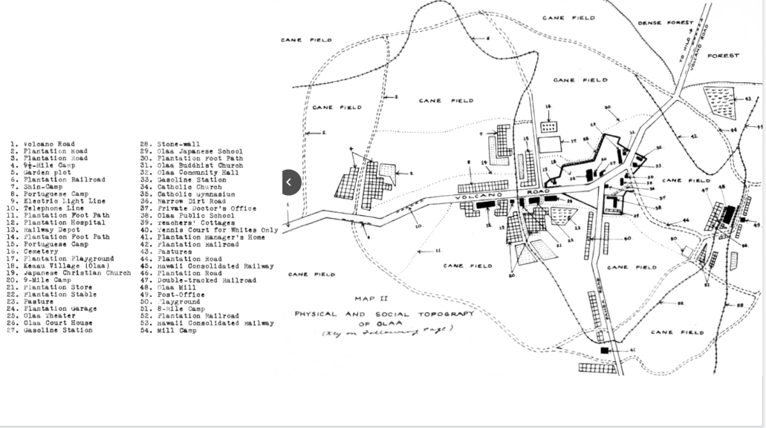
Notes:
These incentives drove over 4,000 Asian immigrants to Ola’a Sugar Co. Upon their arrival they were assigned to one of nine camps, which were organized by nationality, and to a house that would be their new place of residence.
In so doing , the separation helped to make the transition to their new lives easier and more familiar.
However, this also unintentionally caused these communities to close themselves off to others and self isolate, causing stereotyping of these communities from those on the outside.
The factory owners viewed the immigrant workers as cheap labor and according to The “Ecological Study of the Community of ola’a, the author describes the different ethnic groups of plantation and village by their socioeconomic status and demographics he stated:

Slide 13
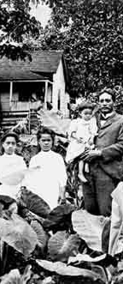
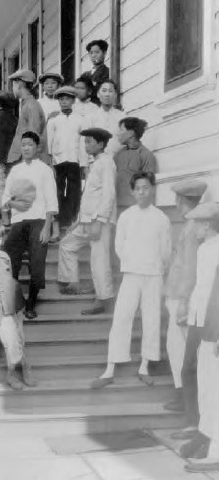
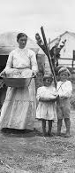
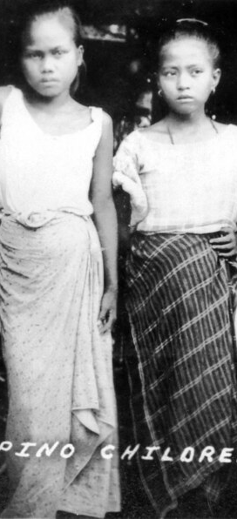
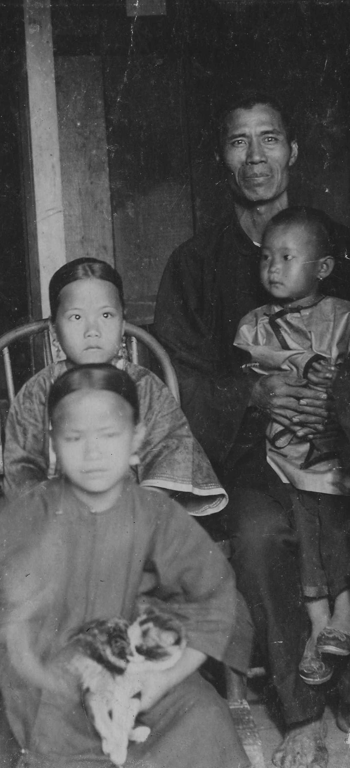
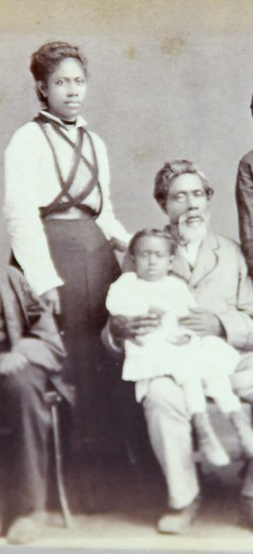
Notes:
-The Haole or whites represent the “upper crust” of the plantation community, holding the best jobs, and living apart from everyone else. Initiating the economic growth in the area, they are the reason for the success of Keaau.
The Japanese work in the fields, in stores, and in the mill, with the second-generation Japanese seen to pursue “good jobs.” In the village, the Japanese had the largest families, but having five children per family could comprise the play groups and bring in gangs.
The Portuguese are “conservative” and the “least mobile” because many have not left the plantation since they immigrated, but they continue to expand into different and higher positions within the workplace of the plantation.
The Filipinos work in the field and their socioeconomic status is “low”. bringing “vice, juvenile delinquency, and crime”, they will most likely never change their ways.
The Chinese and Hawaiians are small or “insignificant” in number. There are three Chinese families who live in the village and operate stores. The “only important Hawaiian” is the village sheriff. There are few who are significant who add to the city.

Slide 14
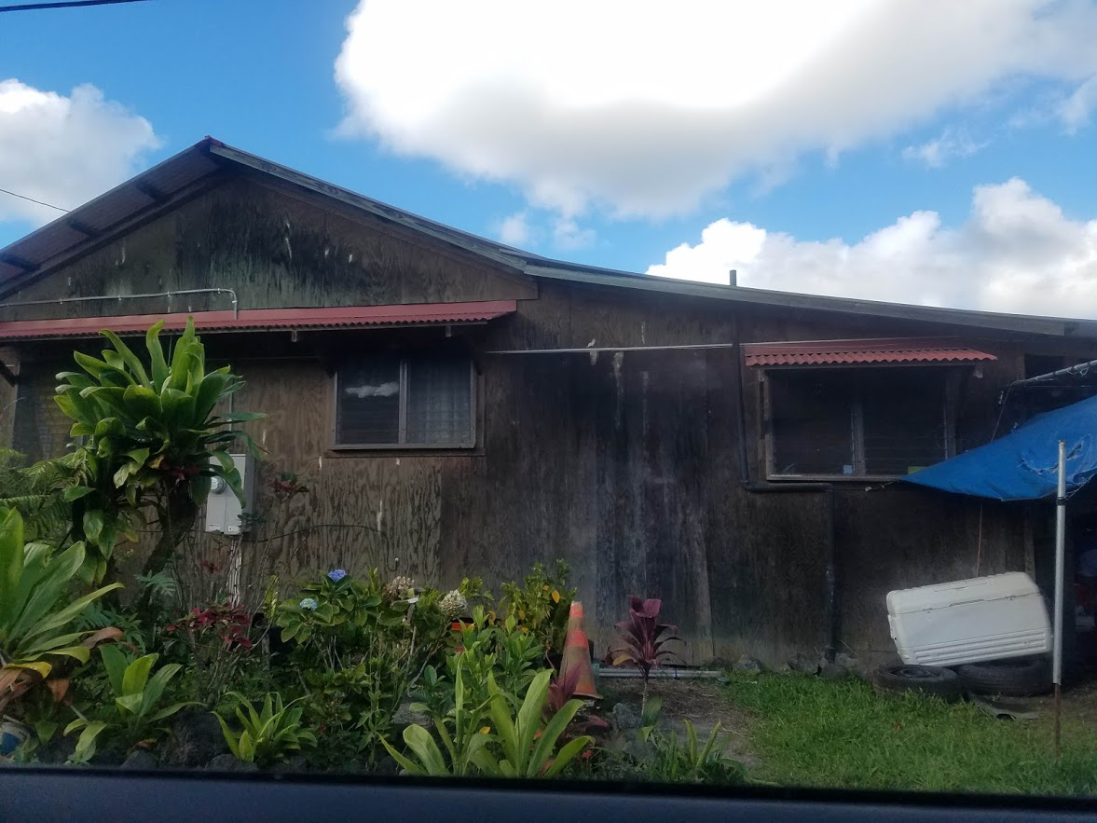
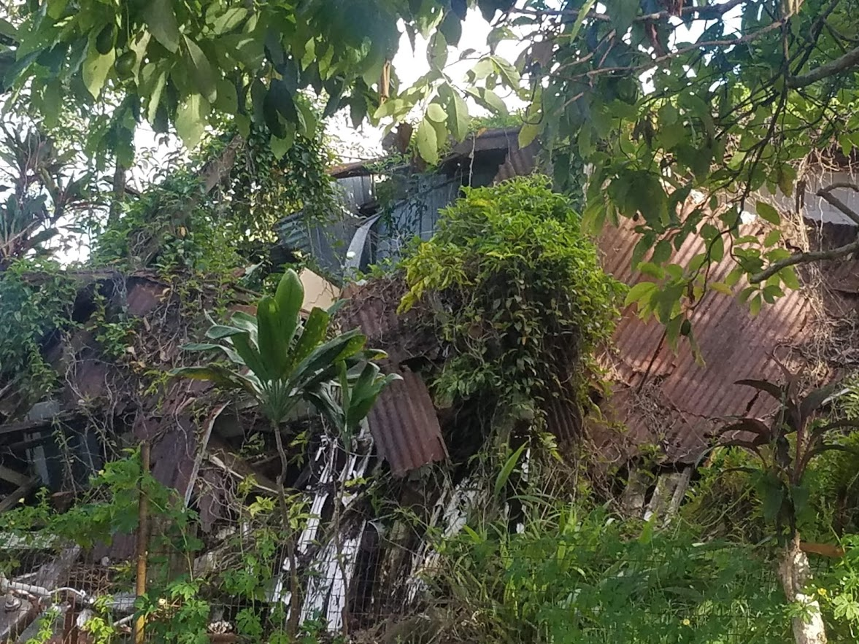
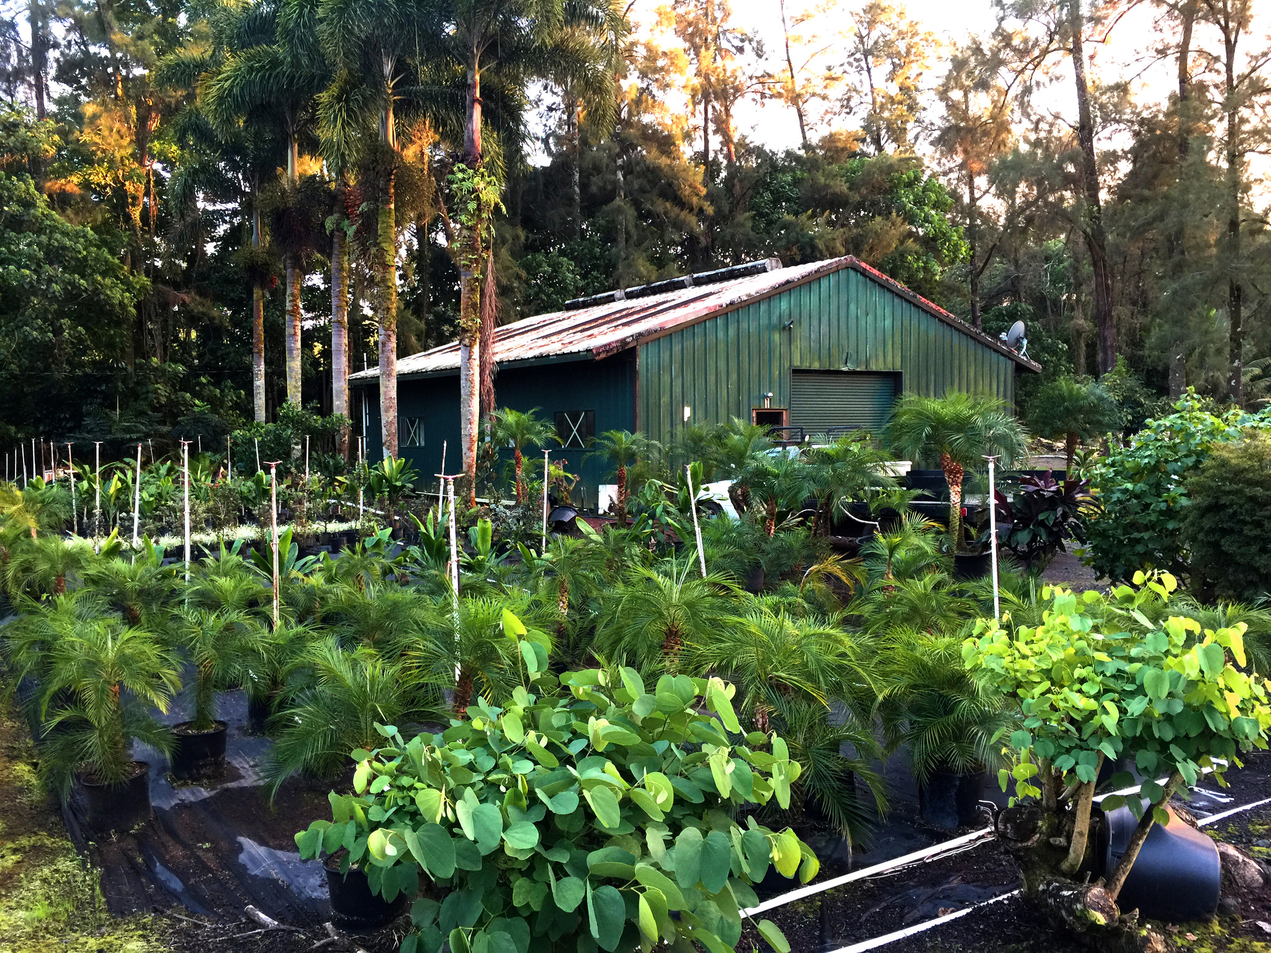
Notes:
As time progressed, the demand for sugar from Hawaii went down, the plantation and factory closed, and many of the descendants of the original workers moved out of the immigrant camps.
The land began reclaiming what once was hers, and eventually the few people who still resided in the original camps were evicted and the structures were destroyed. That is all except for the Filipino camp, 9 ½ mile camp.
The camp was lost both physically and socially. Overgrowth buried the camp while nearby Keaau grew into a thriving city. While the city grew, their outside neighbor camp fell into obscurity, but it never lost its reputation of being filled with the low and insignificant. It is viewed by Filipino descendants as a glaring example of the negative cultural stigma that was placed upon them.

Slide 15
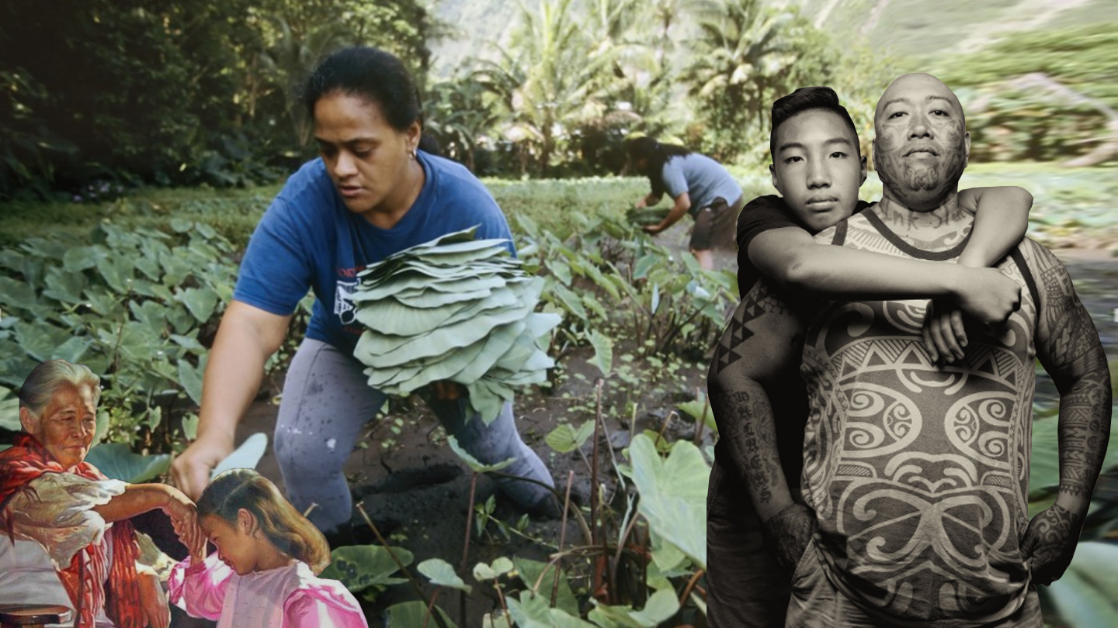
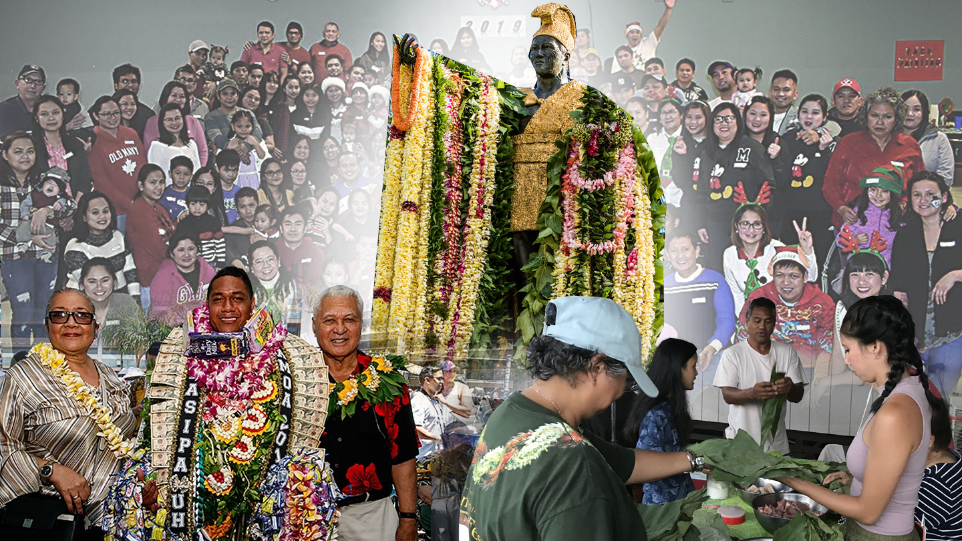
Notes:
Hawaiian culture has also changed and evolved. Today Hawaii is a melting pot of culture, with prominent influences being Polynesian, Eastern Asian, and Western, with the culture being a mix of tradition and modernism.
Prosperity, family, and health are the core beliefs which are emphasized through their cultural action. The intention of their thoughts and actions are for the benefit of others, which is apparent in their emphasis on sustainability and family, all community members are treated like family and all elders are treated with deep respect. The people of Hawaii have created a culture that is its own.

Slide 16
How do we as designers change the language and perception of insiders and outsiders?
Notes:
How do we as designers change the language and perception of insiders and outsiders?
Our design language needs to be centered around creating a sustainable space for the present and future community.

Slide 17
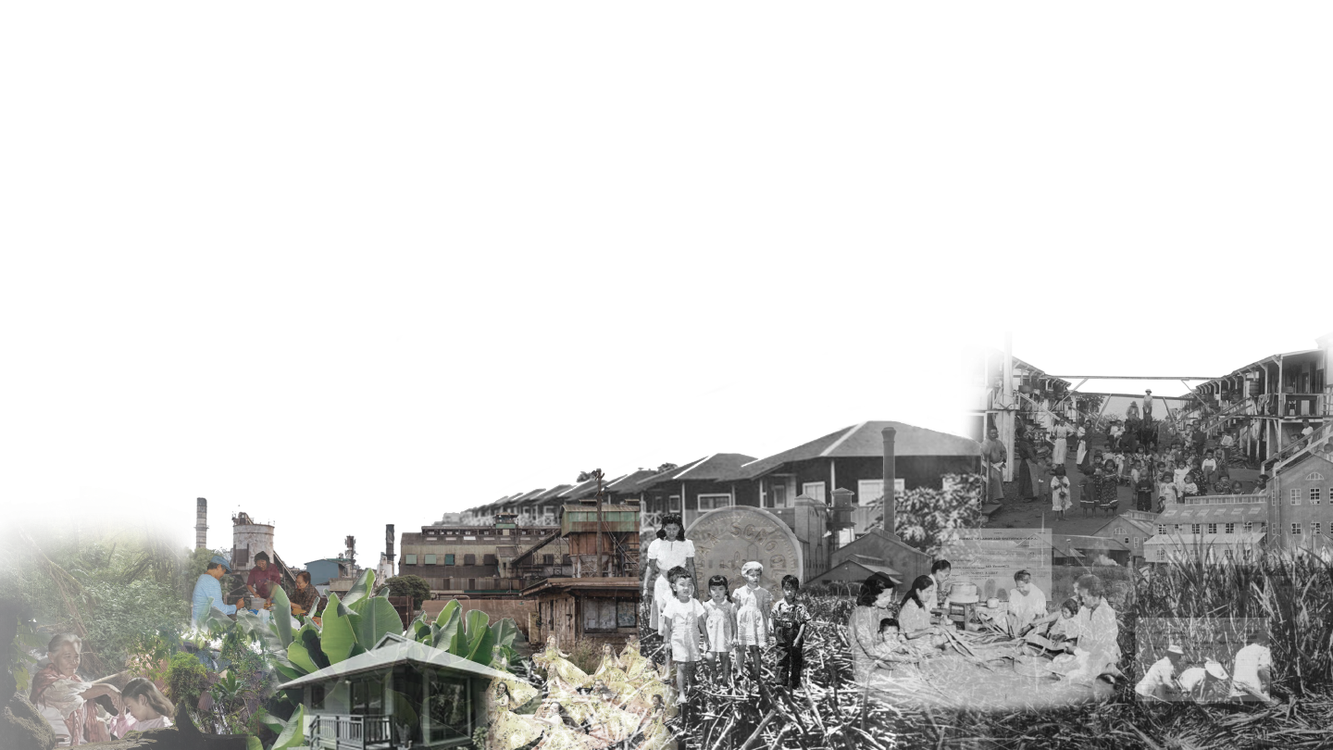
Volcano (Main)
Road Built
Ola’a Sugar Co. Founded
Total of 51 Workers
Reconstruction of
the town
Total of 6,000 Workers
Town Renamed Keaau & Sugar Co. Renamed Puna Sugar Co.
Total of 10,000 workers
Addition of Jr. High and High schools,
Total of 9,000 Workers
Expansion of
the Town
Total of 8,000 workers
Closure of the
Sugar Co.
Total of 2,000 Workers
Today Keaau is a suburb of Hilo. Total 2.6 SQ Miles with a population of 2,200
1899
1905
1930
1951
1960
1968
1982
2019
Notes:
Sustainability should be more than just green design, the design should be tailored to the goals and culture of the community, resonating with its people, ensuring that the residents, both present and future, view the long-lasting addition as a form of growth and a part of themselves.
For the city of Keaau I believe that giving the citizens a sense of community through neutral spaces speaks to everyone. Providing them with both public and private spaces that foster natural interactions. These spaces should center around the melting pot of identities that make up the complex culture of Hawaii

Slide 18
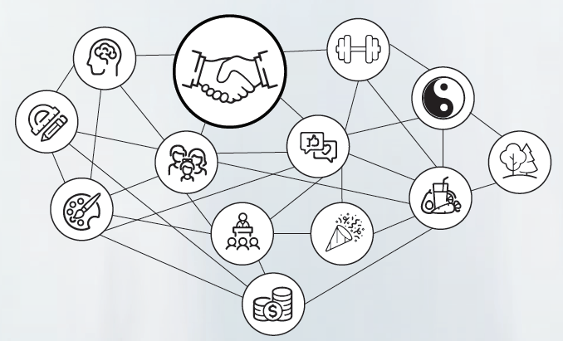
Notes:
Focusing on the essence of Keauu’s culture: family, teaching,learning, and their spiritual connection to nature, the creation of transcultural spaces (or neutral spaces involving, encompassing, or extending across two or more cultures) gives the city a representative, equitable, and accessible community.

Slide 19
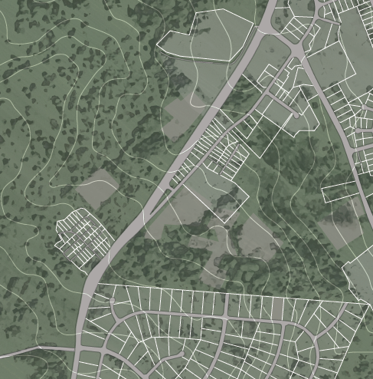
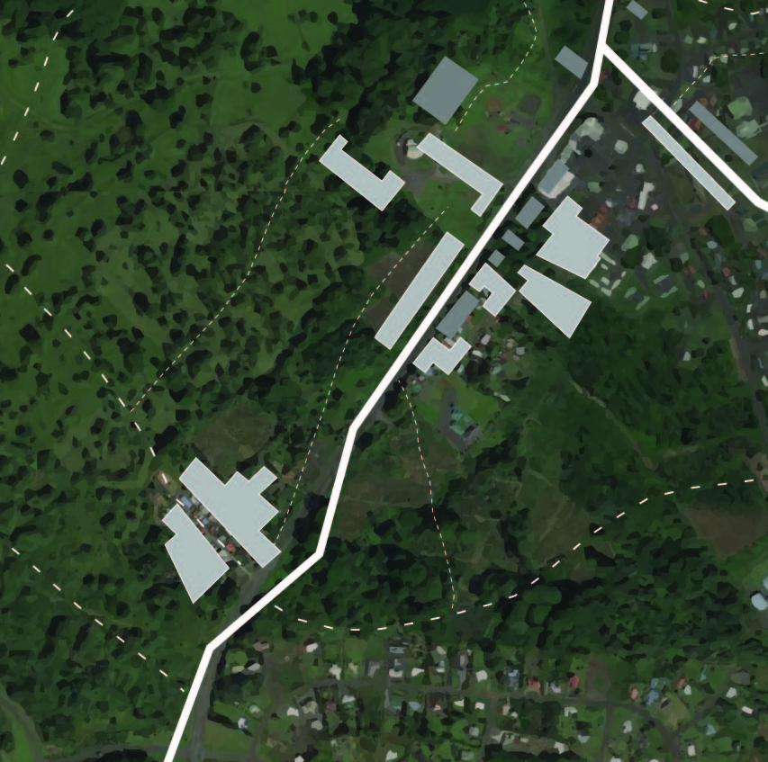
Historic Map
2019 Map
Notes:
emphasising these aspects helped facilitate the creation of complex spaces which seek to change the disconnected language and perception of others to a unified one.

Slide 20
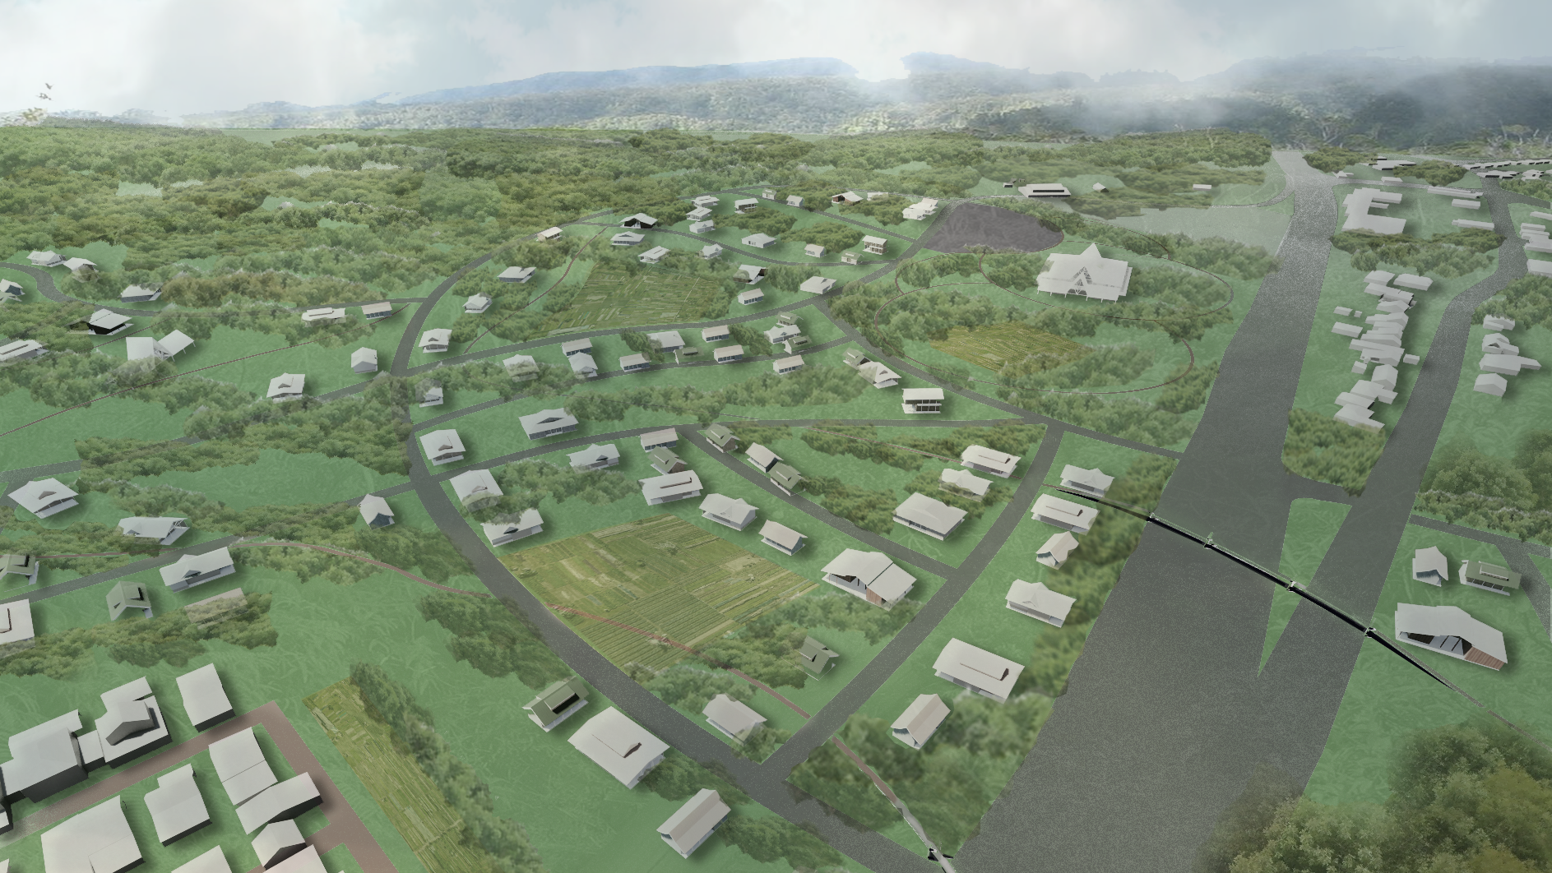
Notes:
With the intent of bringing people together without any predisposition of one another, the design solution persuades the residents to view each other as equals and for who they are, breaking down physical, cultural, and socio economic barriers to merge the two communities. This will blur the lines that separate them and create a gradient between the existing and future community of Keaau. The new city will be flexible enough for the people of today and tomorrow.

Slide 21
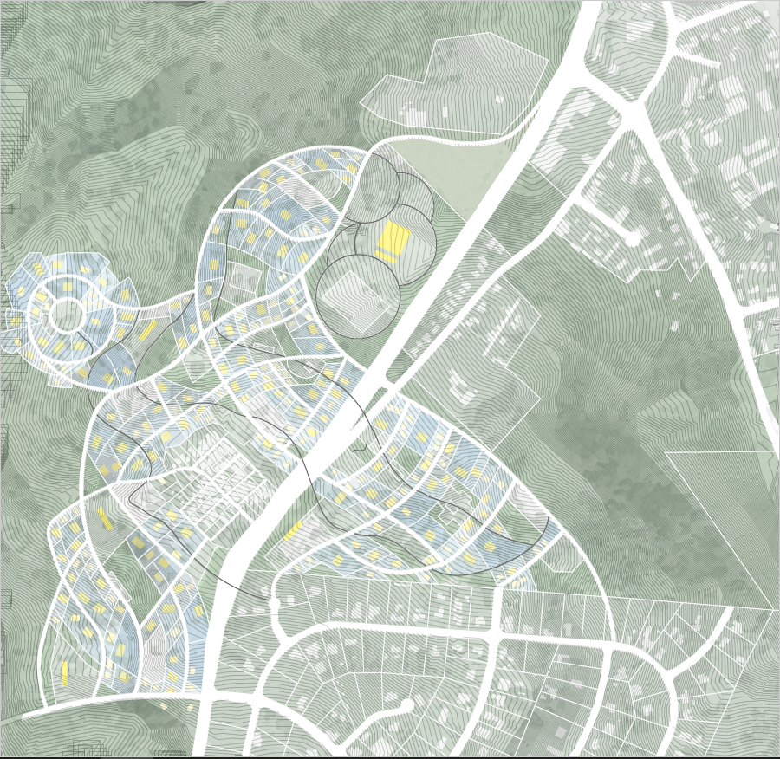


Notes:
The removal of the overgrowth that has buried the camp will physically open it up to the Keauu natives, allowing them to visit their re-discovered neighbors by means of walking paths and transcultural nodes.
These nodes will act as communal hubs where all people can come to learn, share, and express ideas with one another and in so doing form new connections and bonds. These nodes will contain community gardens, meditation gardens, and pagodas that will allow the residents to connect, celebrate and learn with one another.
Lastly, the development of the area and its transition from a small jungle to a large village will help to bridge the gap between the camp, the modern neighborhood, and the city itself. By placing the them in more familiar territory as it acquires some of the style and polish of the city, while still retaining the heart and feel of the camp.

Slide 22
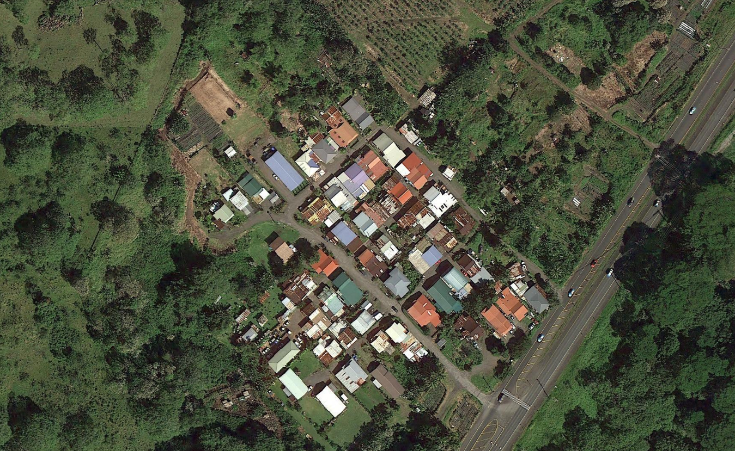
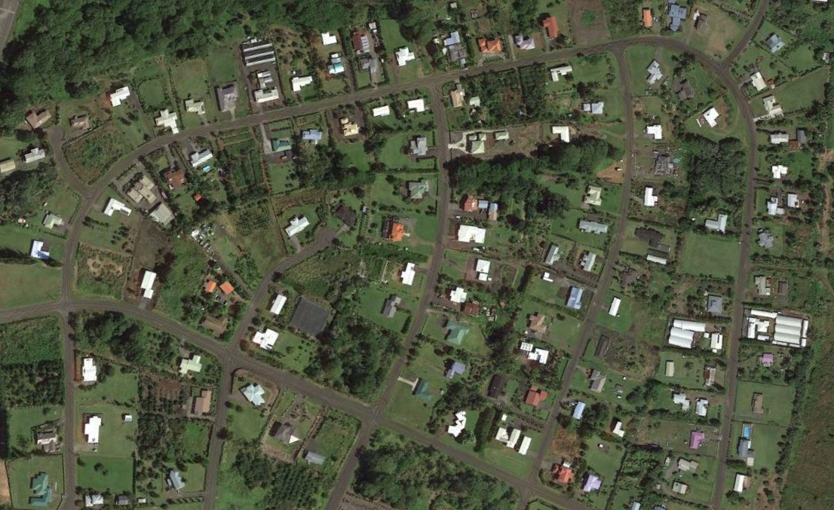
Notes:
The plots within 9 1/2 mile camp were designed small and tightly compacted, squeezing in as many workers into the small space without taking away any of the cane fields. This layout still exists and forces the neighbors to interact with one another due to their proximity, but it is so densely populated it's hard to have any privacy.
Across the street the modern neighborhood is expansive giving people their own individual space, but the layout and the size of the plots emulate a sense of entitlement and exclusivity, lacking the authentic Hawaiian feel

Slide 23
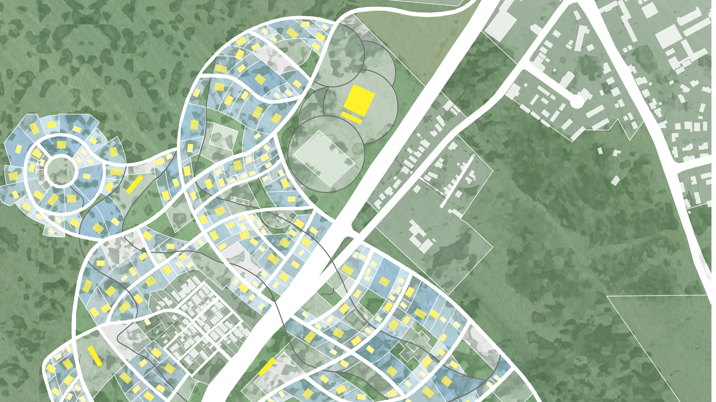
Notes:
Needing to bridge the divide between the small and outdated camp, the new addition contains smaller plots that will surround the old camp and gradually grow in size outwards. In doing to not overshadow the current residents and their legacy.

Slide 24
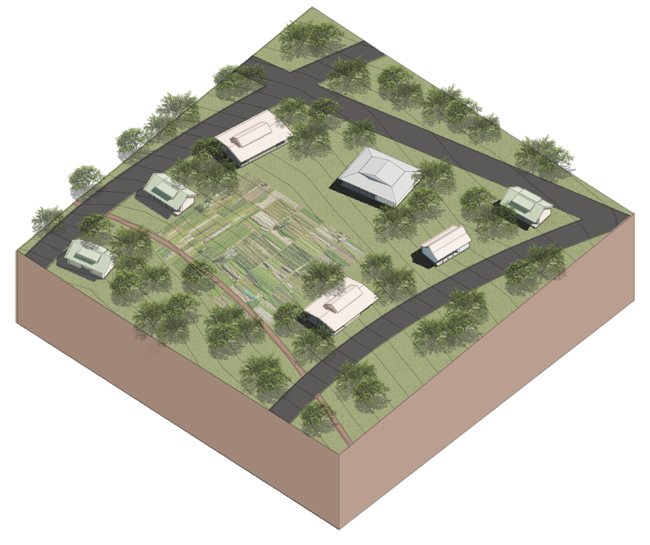
Notes:
The backyards of the new additions will connect to one another and center around a community node, allowing neighbors to interact in a productive neutral setting, which will cause residents to subconsciously associate the interaction with others as positive. The new plots act as a special link creating a gradient between the two instill the sense of community.

Slide 25
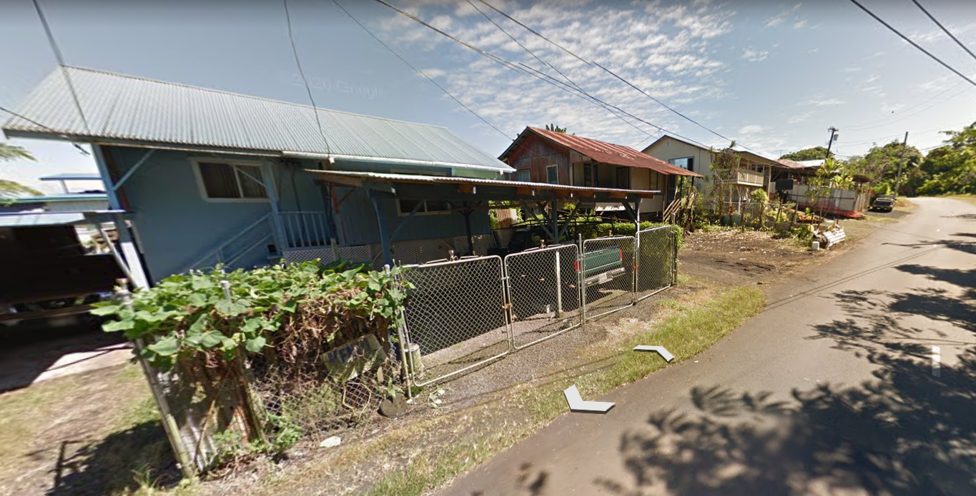
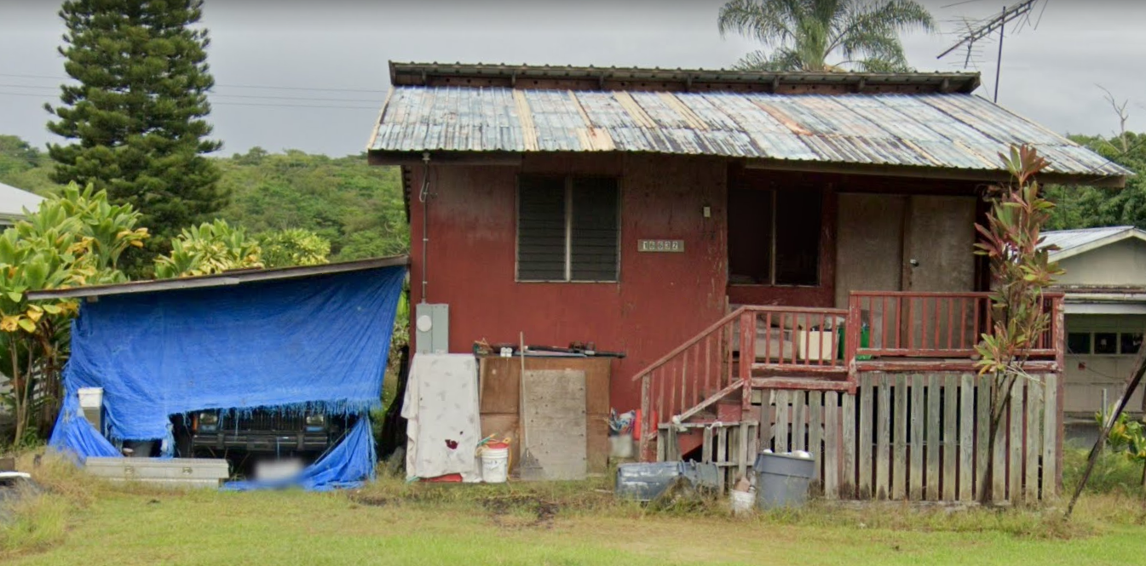
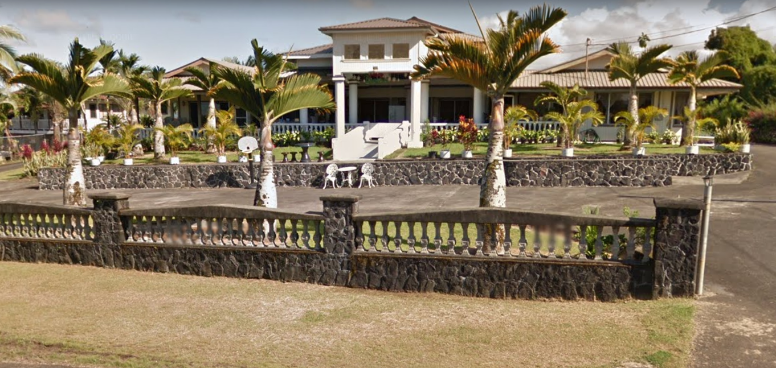
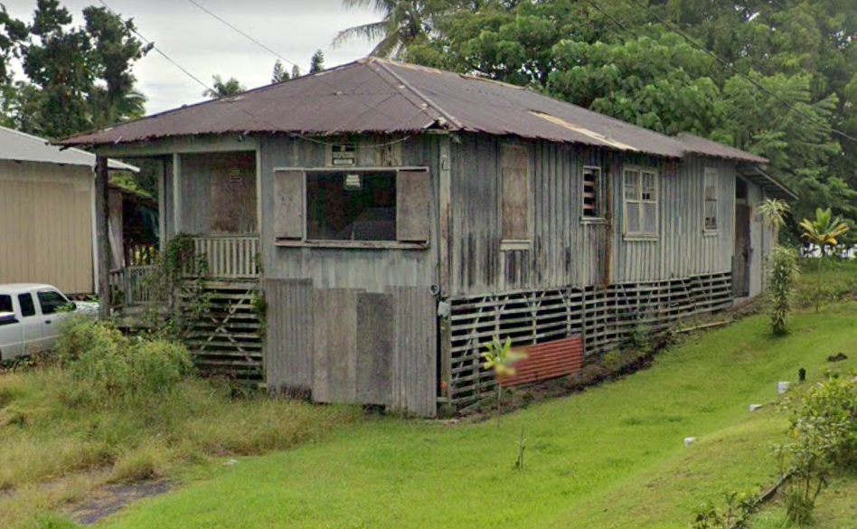
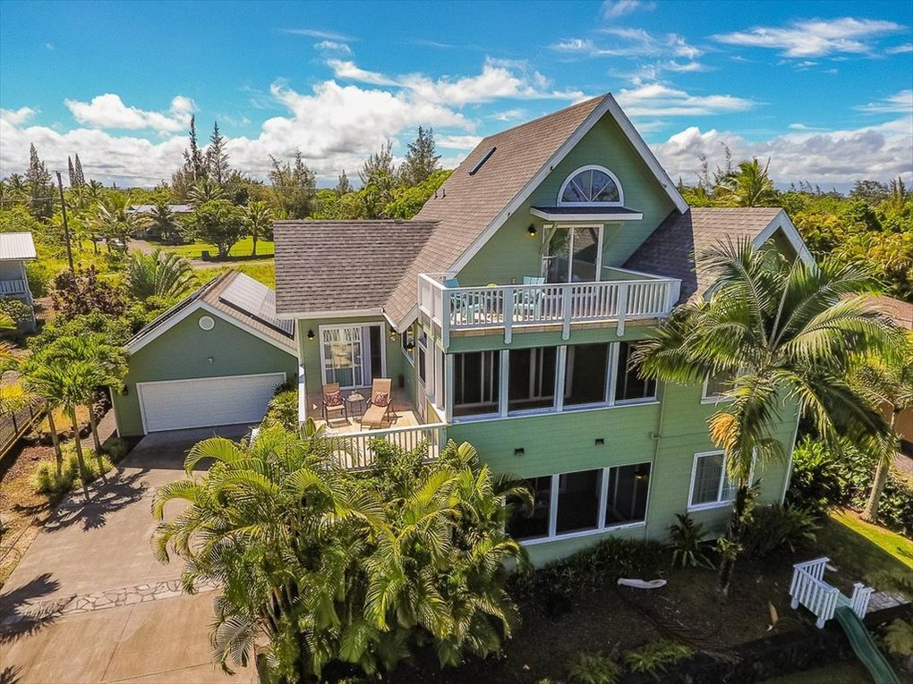
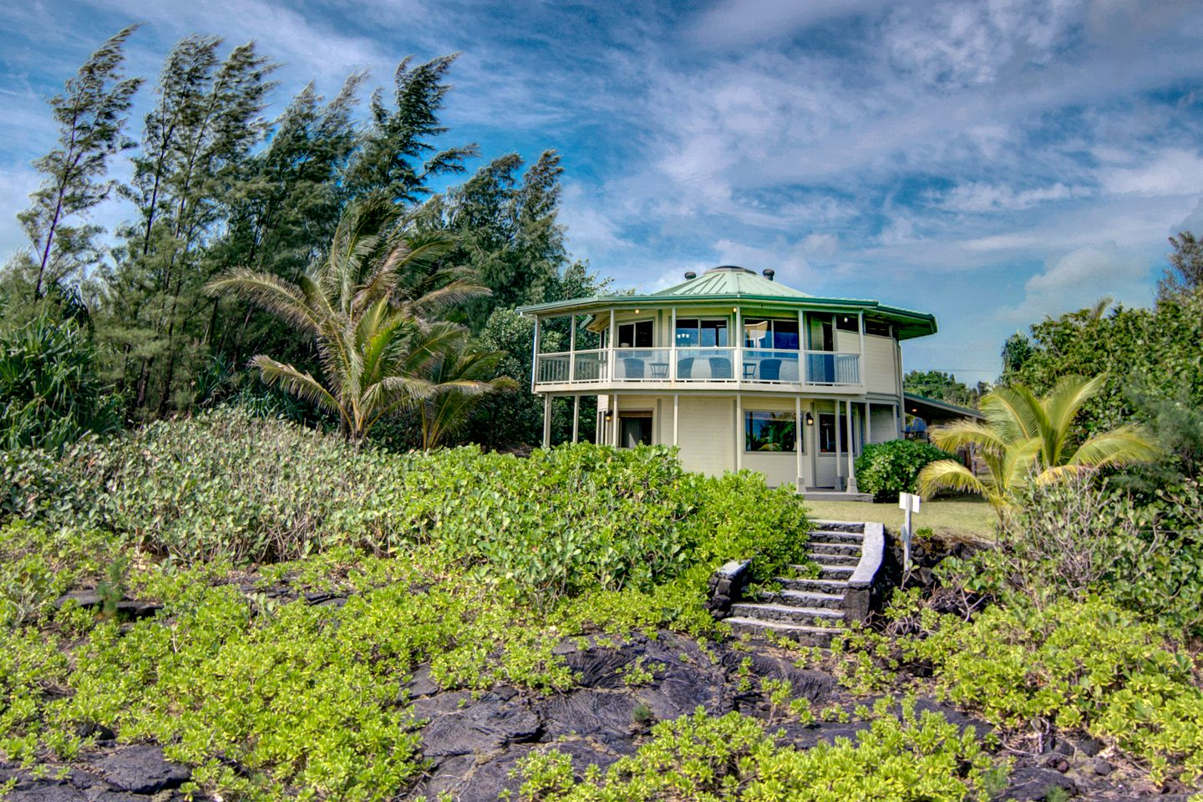
Notes:
The present houses of both communities do not address the local climate conditions. Due to the lack of upkeep, the houses within the camp still contain some of the original design elements that are ill fitting for the humid environment. Termite infested wood and rusting tin roofs are both a result of a failure to account for the tropical climate, while the dense compaction of the houses underutilized the islands best cooling system of cross ventilation.
On the opposite end of the design spectrum, the houses within the modern neighborhood take inspiration from extravagant western design, containing mainland building techniques and styles. The materials used result in costly upkeep and a gaudy and an ill fitting islander look, instead of being inspired by the environment in which it resides.

Slide 26
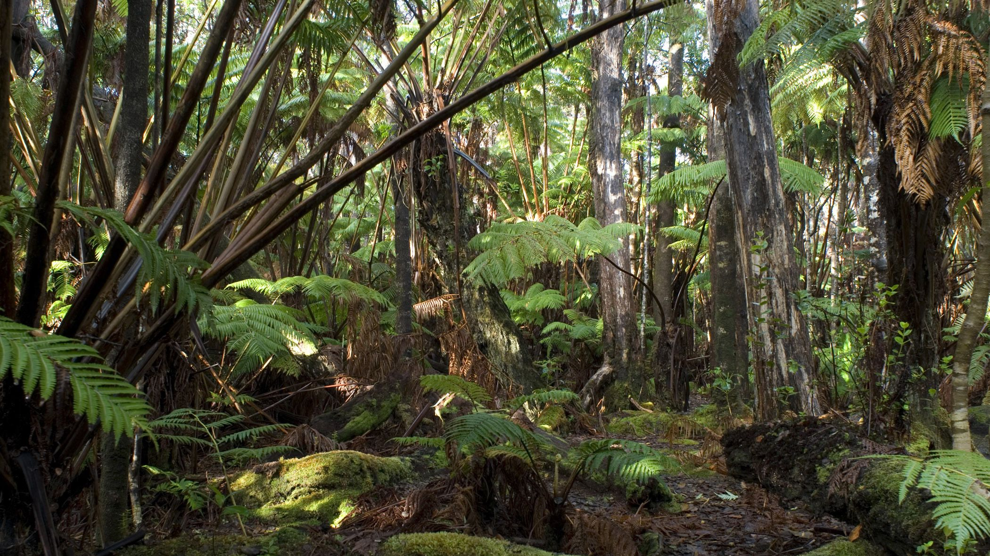



CROSS VENTILATION
LAYOUT AND SPACING
COMPACT COURTYARD PLANNING
OPEN SPACE FOR BREEZE Penetration
OPENINGS
PERMANENT VENTILATION
NORTH AND SOUTH WALLS 40 - 80%
PROTECT FROM DIRECT SUNLIGHT
AVERAGE ANNUAL TEMPERATURE:
HIGH: 80° F
LOW: 65° F
AVERAGE ANNUAL HUMIDITY:
75%
AVERAGE ANNUAL PRECIPITATION:
149”
MATERIALS AND CONSTRUCTION
WALLS AND FLOORS
LIGHT AND LOW HEAT CAPACITY
ROOF
LIGHT WITH REFLECTIVE
SURFACE AND CAVITY
PRECIPITATION PROTECTION
RAIN PROTECTION
ADEQUATE DRAINAGE SYSTEM
PROTECTION FROM HEAVY RAIN FOR OPENINGS
Notes:
The new houses are driven by climate design based on the Mahoney tables to be best suited for the island environment. With a hot, humid, and wet area the design and construction of the houses are centered around providing adequate cooling and protection from the elements.

Slide 27
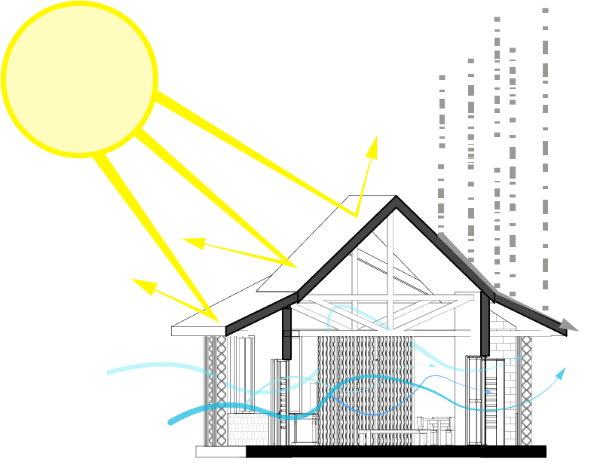
Notes:
The new houses will utilize low heat capacity materials, a reflective roof, an open floor plan, and an organized community layout for ample cross ventilation opportunities. Protection from the elements utilized concrete as the material of choice for a strong base resistant to water and insect damage along with adequate drainage systems.

Slide 28
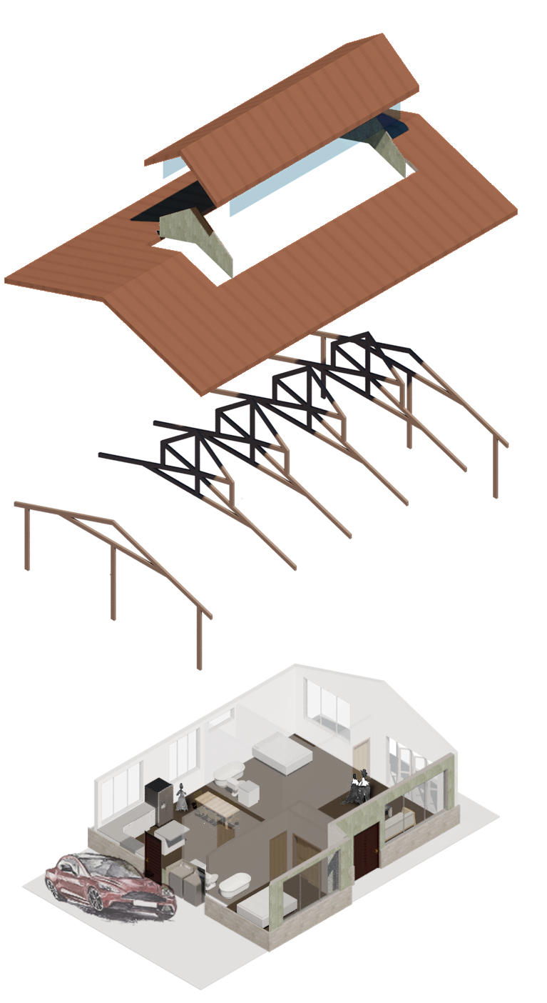
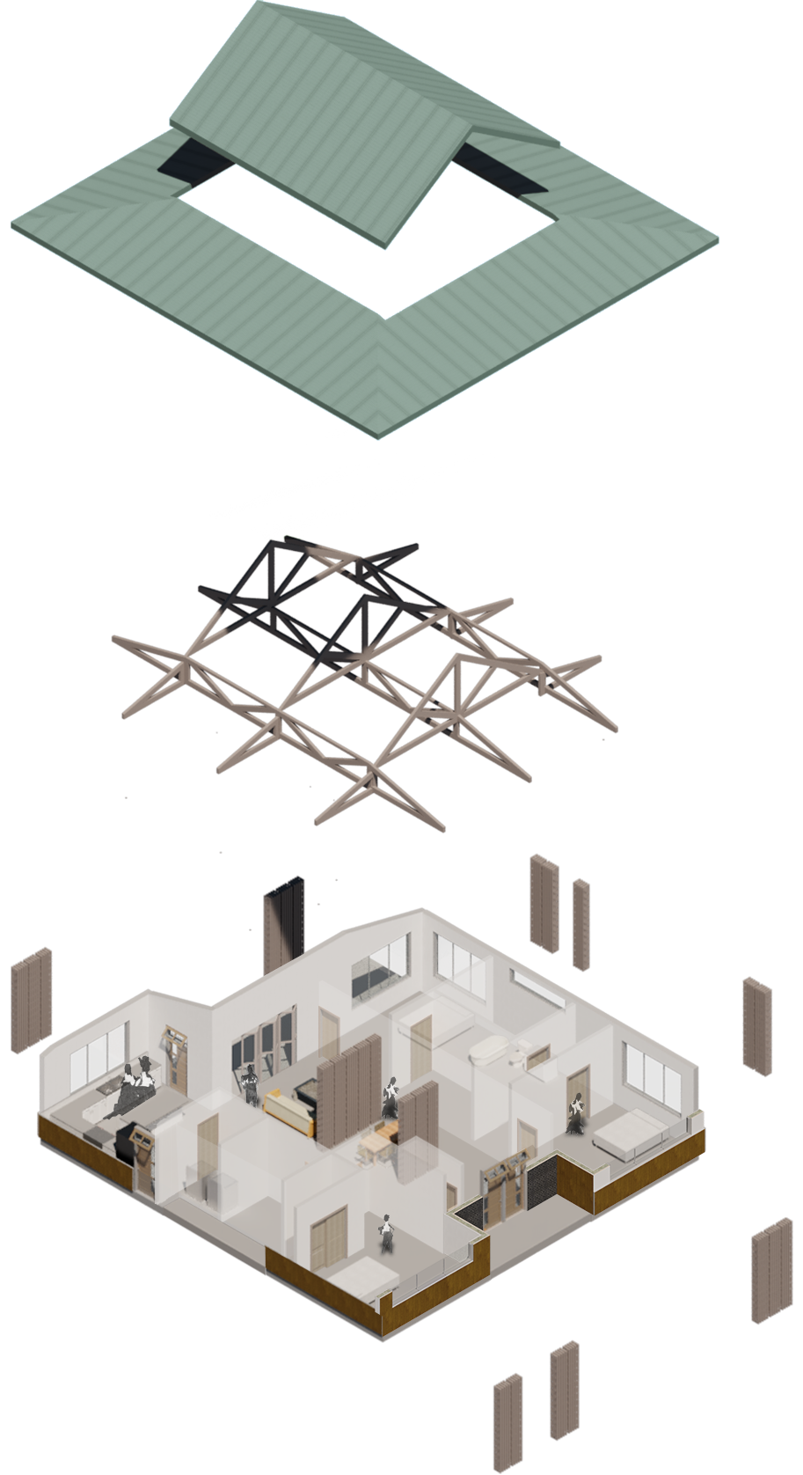
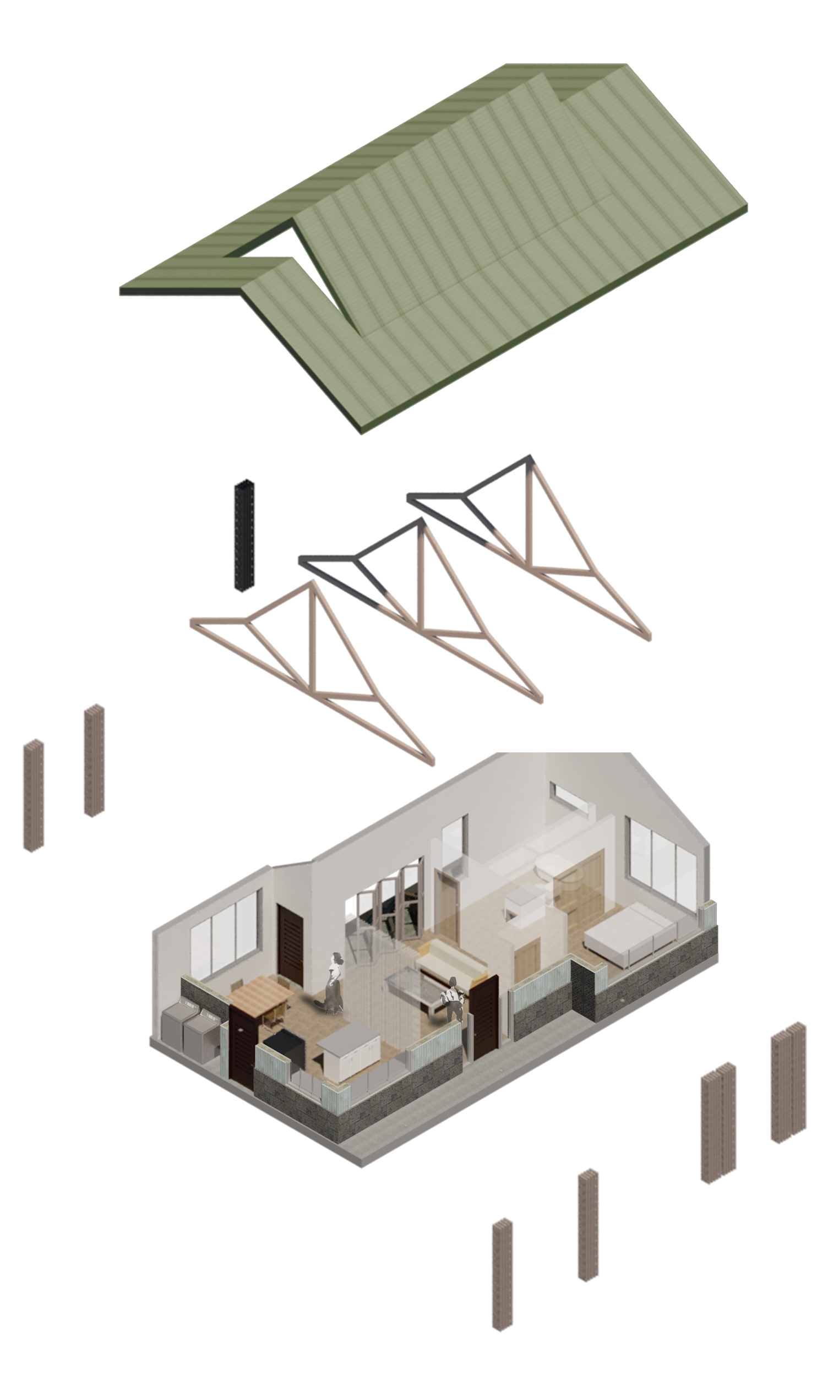
Notes:
The houses are based on a prefabricated kit of parts allowing the owners to create modular houses while still having a sense of individuality.

Slide 29
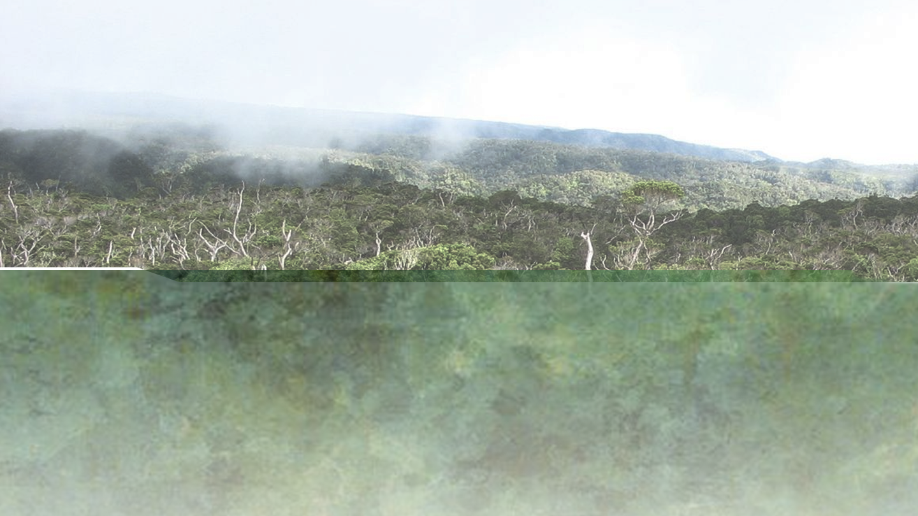

Notes:
The new development includes a community center that allows for 70% of the community to come together at one time and is based on the same design principles as the houses were. The center allows for an abundance of transcultural spaces that allow for a community wide, small group, and individual interest, gatherings and celebrations .

Slide 30

1. Makerspace
Wood Shop
2. Small Breakout Space
3. Large Multipurpose Space
Covered Arcade
Cafeteria
Kitchen
Worship Area
Gallery
Office
Pagoda
Notes:
The spaces within the center can change to fit the needs through movable walls and varying room sizes .There are rooms for eating, cooking, crafts, music, markets and dance that can all be refitted and moved when needed for the creation or expansion of activities that are important to its users.

Slide 31





Notes:
This allows for chance interactions that help facilitate positive relationships between different cultures, nationalities, ages, etc and allow residents to view and interact with one another without any predispositions, building a sustainable future together. The concept of insiders and outsiders have dissolved and the community is able to progress as a single unit.

Slide 32

Notes:
By bridging the community of Keauu and 9 ½ mile camp I hope to break down the cultural barrier between the two and create a larger sense of community among the local Hawaiian’s. Through the construction of shared spaces, and a reshaping of a shared landscape I seek to remove the negative social stigma attached to the camp by the surrounding community and instead replace it with a joint sense of destiny and pride. In time, it is my goal that the success of the camp and its merging with the city will act as a shining example of the need for better acceptance and a re-evaluation of personal and social biases. so that this community might once again look around and find please and salvation with one another.

