Slide 1
Value of CyberInfrastructure Access in Leech Identification
Deborah J. Hunter
Turtle Mountain Community College

Slide 2
Taxonomic Keys to the North American Hirudinida and Acanthobdellida
Chapter 12. Annelida (Clitellata, Oligochaeta, Branchiobdellida, Hirudinida, and Acanthobdellida. Fredric R. Govedich, Bonnie A. Bain, William E. Moser, Stuart R. Gelder, Ronald W. Davies, and Ralph O. Brinkhurst
Ecology and Classification of North American Freshwater Invertebrate. Third Edition. 2010 Editors: James H. Thorp and Alan P. Covich. Elsevier Press

Slide 3
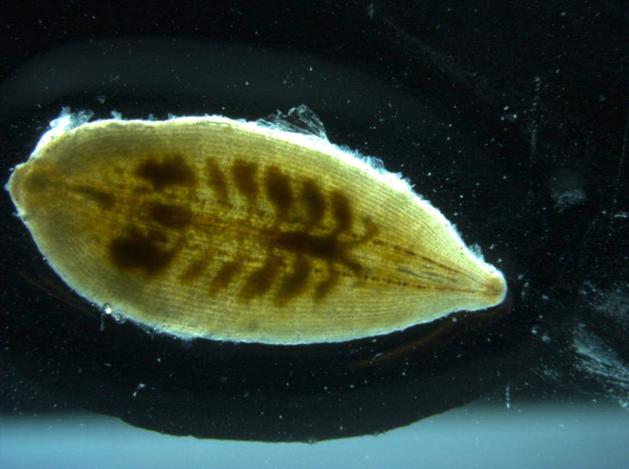
Glossiphonia complanata

Slide 4
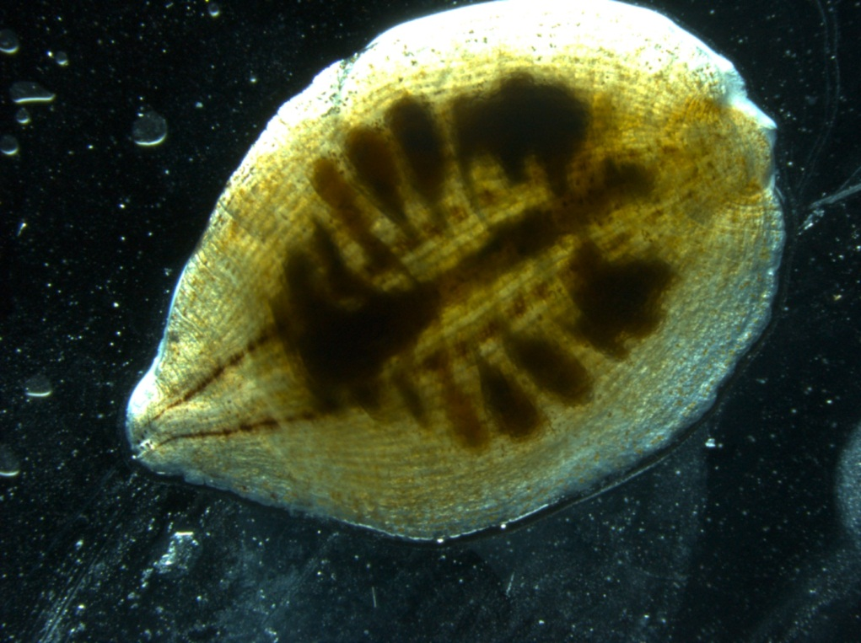
Glossiphonia complanata ?

Slide 5
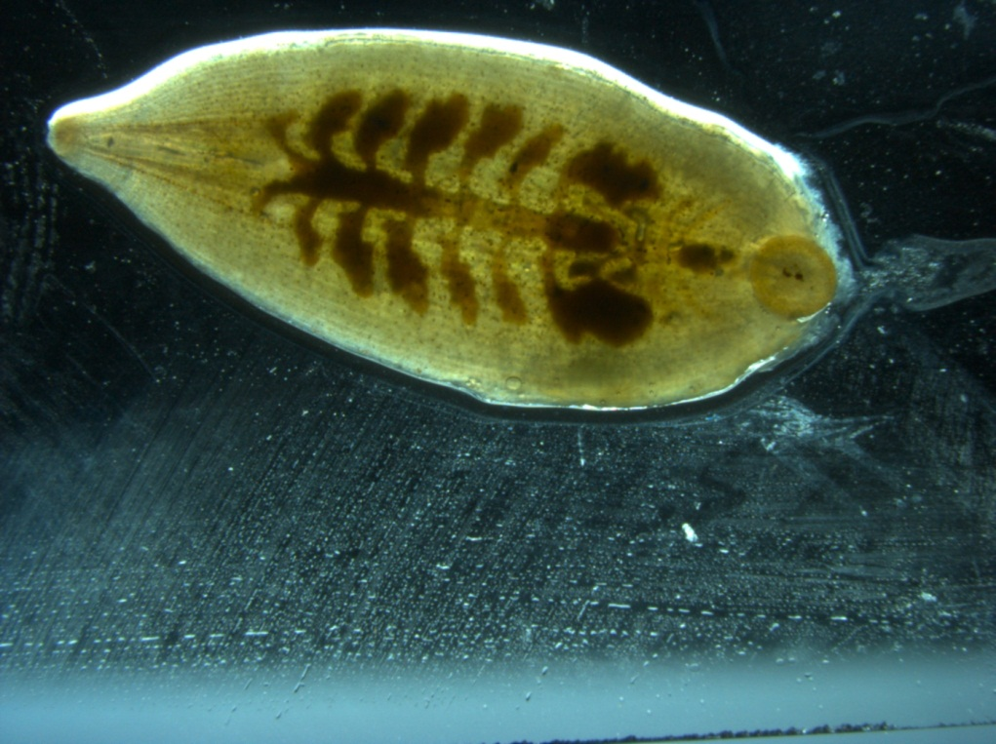
PHYLUM: Annelida
CLASS: Hirudinida
Taxonomic Key
1. Presence of a pharyngeal proboscis → ORDER Rhynchobdellida

Slide 6

PHYLUM: Annelida
CLASS: Hirudinida
ORDER: Rhynchobdellida
Taxonomic Key
1. Body flattened dorsalventrally and much wider than head

Slide 7
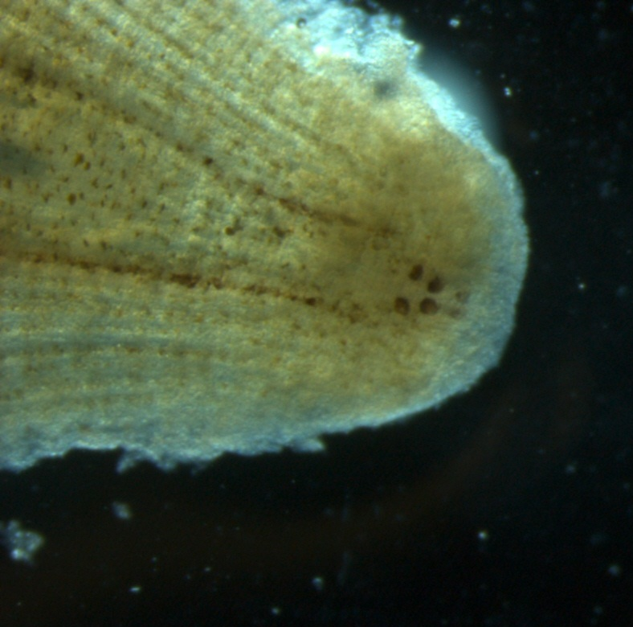
PHYLUM: Annelida
CLASS: Hirudinida
ORDER: Rhynchobdellida
Taxonomic Key
1. Body flattened dorsalventrally and much wider than head
2. Two, three, or four pair of eyes → FAMILY Glossiphoniidae

Slide 8

PHYLUM: Annelida
CLASS: Hirudinida
ORDER: Rhynchobdellida
FAMILY: Glossiphoniidae
Taxonomic Key
1. Posterior sucker without a circle of glands
Body firm
Three or four pair of eyes
4. Eyes in two paramedial rows

Slide 9
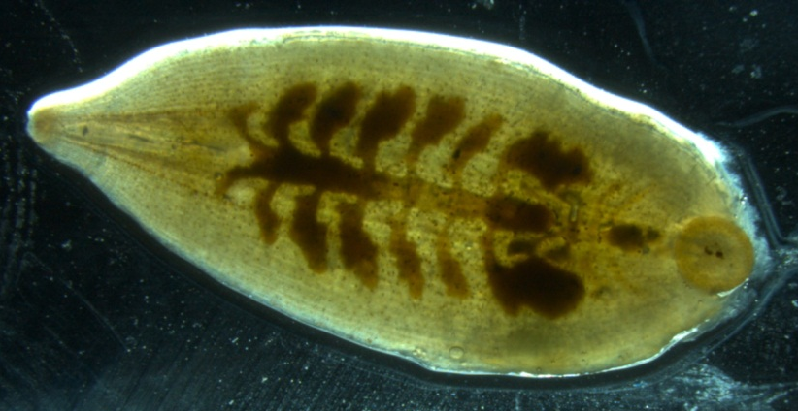
PHYLUM: Annelida
CLASS: Hirudinida
ORDER: Rhynchobdellida
FAMILY: Glossiphoniidae
Taxonomic Key
5. Pair of paramedial stripes on dorsal and ventral surface
6. Six pair of crop caeca
Four pair of simple caeca
Characteristic of Glossiphoniidae
Dorsal Ventral

Slide 10
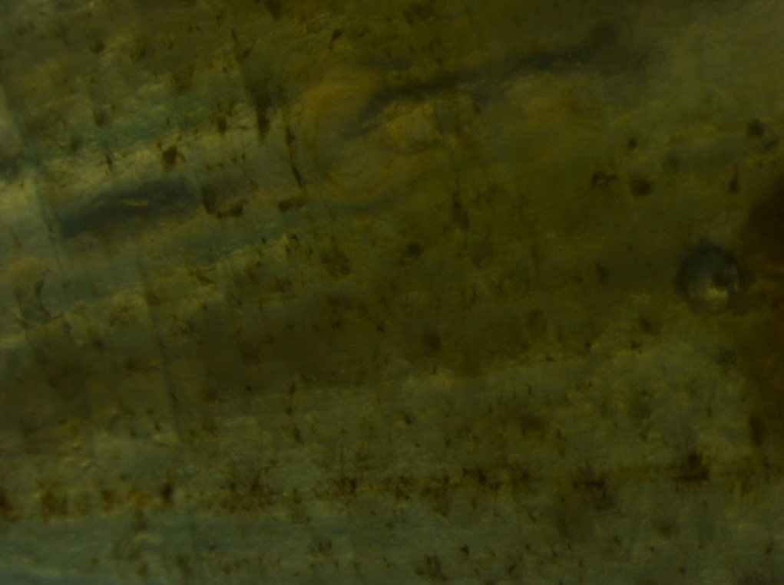
PHYLUM: Annelida
CLASS: Hirudinida
ORDER: Rhynchobdellida
FAMILY: Glossiphoniidae
Taxonomic Key
7. Gonopores separated by two annuli → Glossiphonia complanata
Annuli

Slide 11
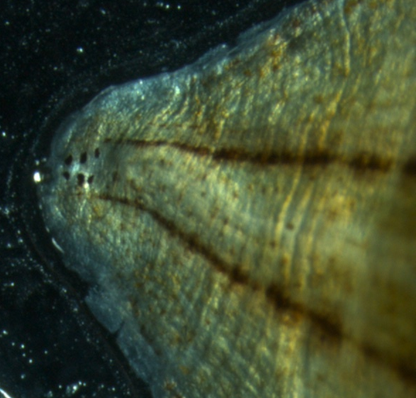
PHYLUM: Annelida
CLASS: Hirudinida
Taxonomic Key
Presence of a pharyngeal proboscis → ORDER Rhynchobdellida
Body flattened dorsalventrally and much wider than head
3. Two, three, or four pair of eyes → FAMILY Glossiphoniidae

Slide 12
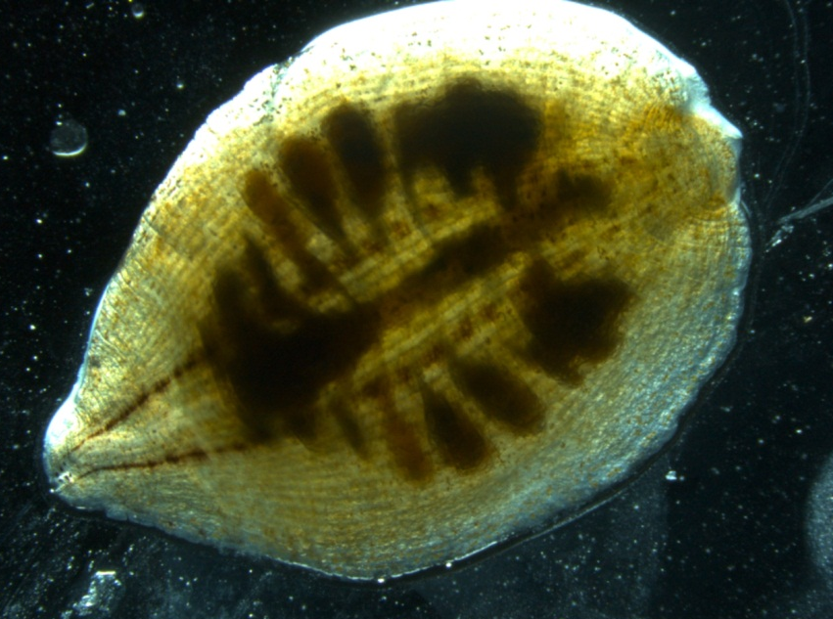
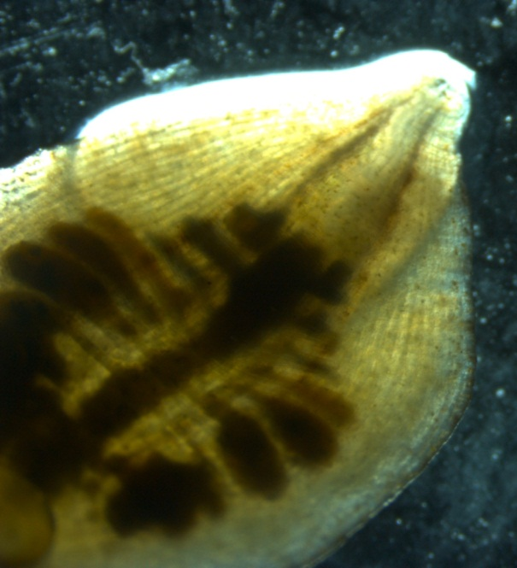
PHYLUM: Annelida
CLASS: Hirudinida
ORDER: Rhynchobdellida
FAMILY: Glossiphoniidae
Taxonomic Key
Posterior sucker without a circle of glands
2. Body firm
3. Eyes in two paramedial rows
4. Pair of paramedial stripes on dorsal and ventral surface
5. Six pair of crop caeca → SEVEN PAIR? → Boreobdella verrucata
Dorsal Ventral

Slide 13
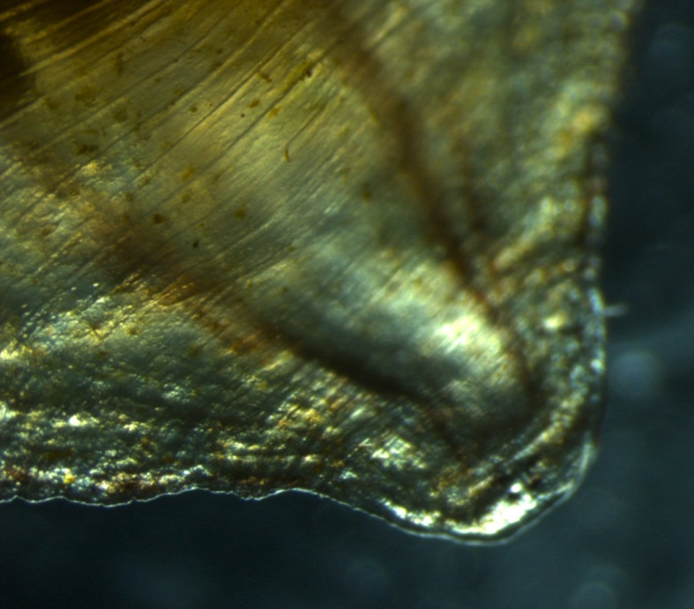
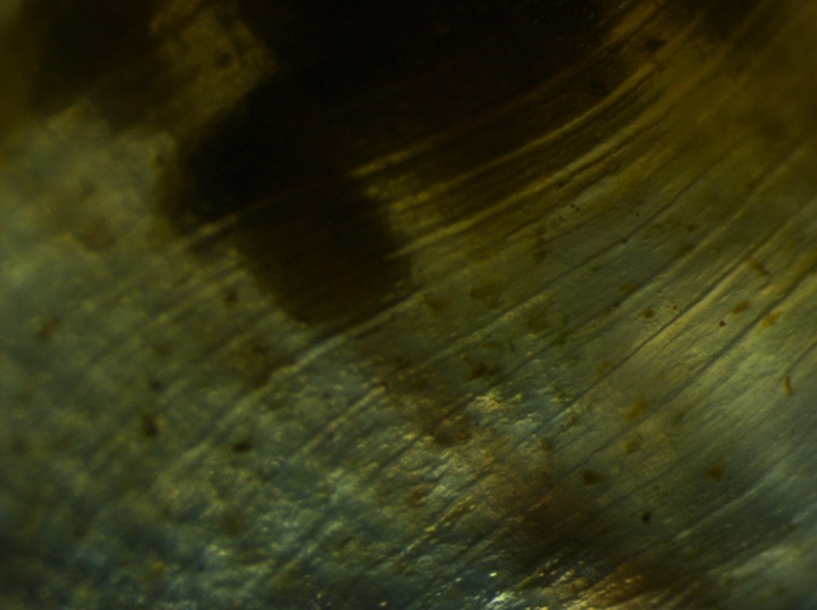
PHYLUM: Annelida
CLASS: Hirudinida
ORDER: Rhynchobdellida
FAMILY: Glossiphoniidae
Taxonomic Key
7. Gonopores separated by two annuli → ?

Slide 14
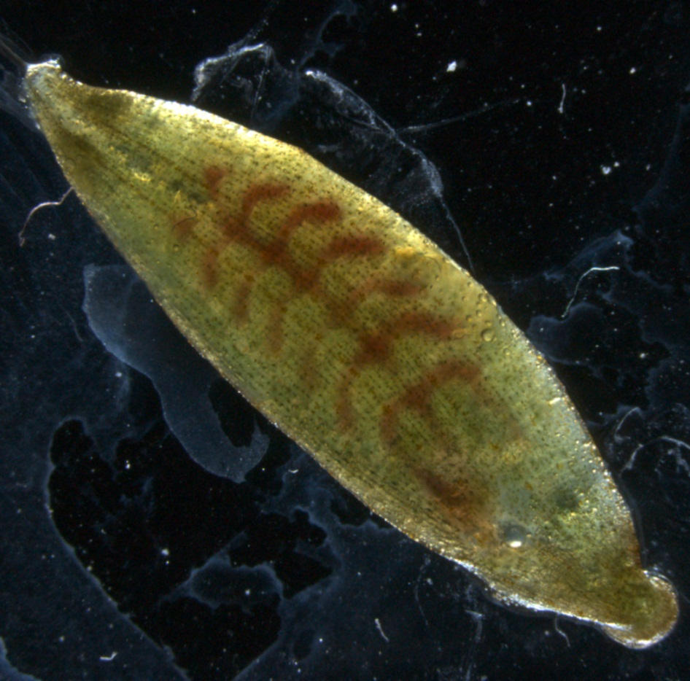

Slide 15
CONCLUSION
CyberInfrastructure access would allow Dr. Govedich and Dr. Bain to directly participate in the identification of these leeches.

Slide 16
Acknowledgements
Dr. Fredric Govedich – Southern Utah University
Dr. Bonnie Bain – Southern Utah University
Dr. Tristan Darland – University of North Dakota
Dr. Scott Hanson – Turtle Mountain Community College
Tribal Colleges and Universities Program (TCUP)
Dr. Carol Davis – Experimental Program to Stimulate Competitive Research (EPSCoR)
Tyland Lafontaine – EPSCoR student
Jenny Houle – TCUP student
Summer of 2009 and 2010 EPSCoR and TCUP students
University of North Dakota

