Slide 1
Epscore Report

Slide 2
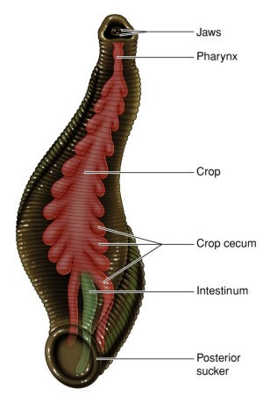
Introduction

Slide 3
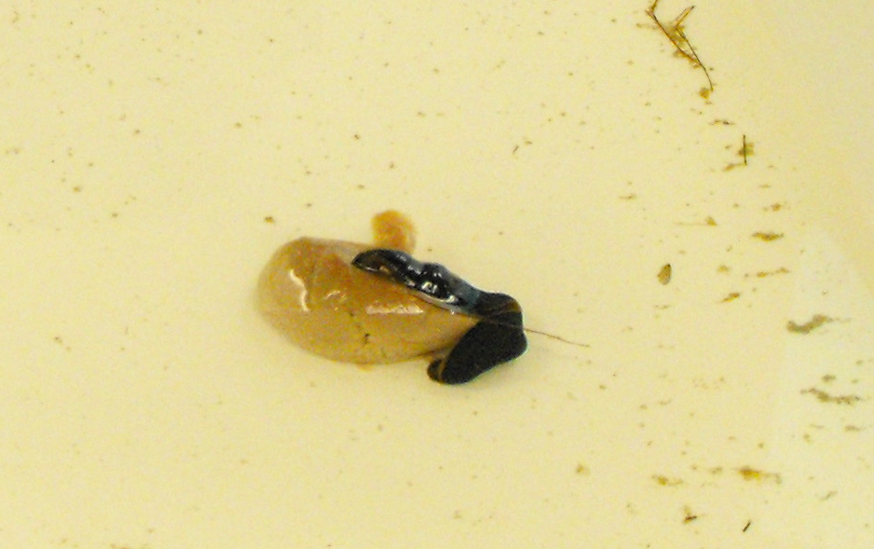
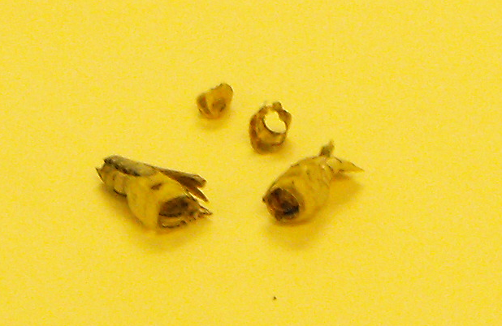
To the left is a photo of a leech
feeding on a piece of beef kidney
To the right is a photo of a
Grasshopper’s exoskeleton
That has been cleaned out by
The E obscura.

Slide 4
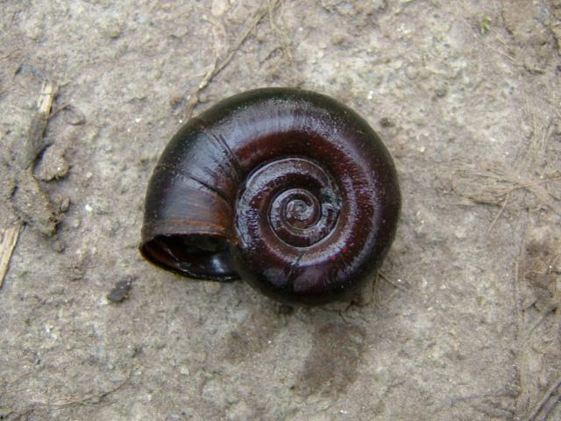

Slide 5
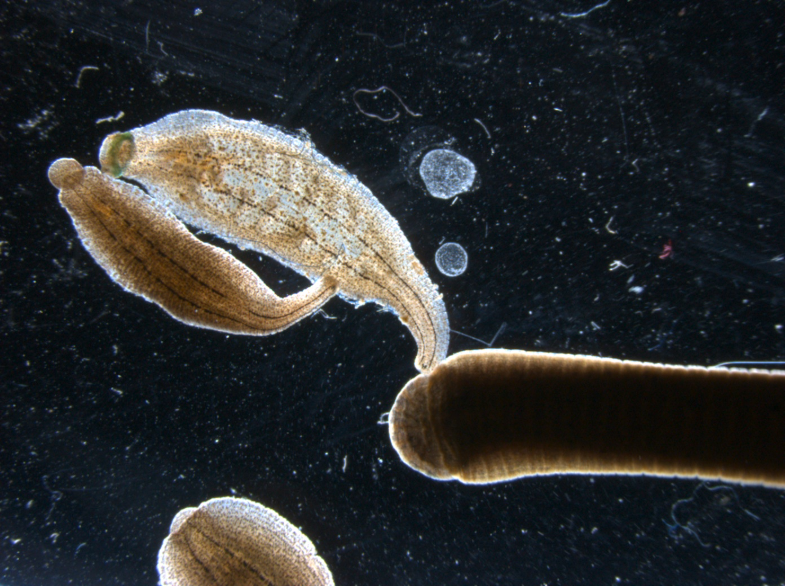

Slide 7
