Slide 1
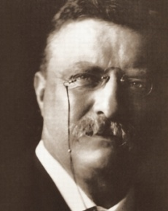
Theodore Roosevelt Digital Library Dickinson State University
NDUS Cyberinfrastructure Conference
By Sharon Kilzer, Project Manager
Theodore Roosevelt Center
March 3, 2011

Slide 2
Presidential Libraries
13 official, administered by National Archives and Records Administration
Documents and artifacts of early presidents are scattered in libraries, museums, and private collections
TR Center is gathering TR’s papers “virtually” – equivalent of a presidential library
Letters, diaries, scrapbooks, speeches, essays, photographs
“Writingest” president

Slide 3
Theodore Roosevelt Digital Library
Library of Congress – largest TR collection
  250,000 documents (485 reels of microfilm)
National Park Service
  Birthplace, Sagamore Hill, Inaugural
  Theodore Roosevelt National Park, Theodore Roosevelt Island, Mount Rushmore
Harvard University – 2nd largest collection
  More than 70,000 documents

Slide 4
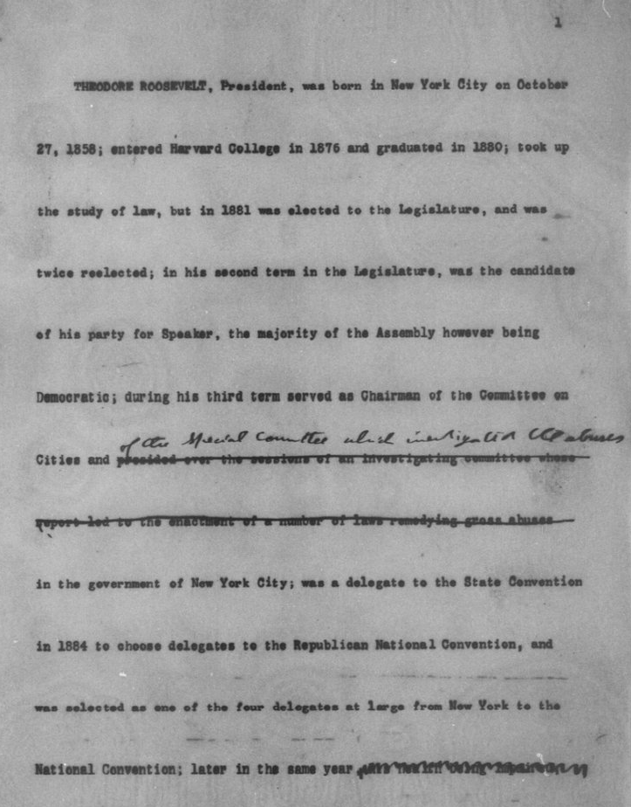

Slide 5
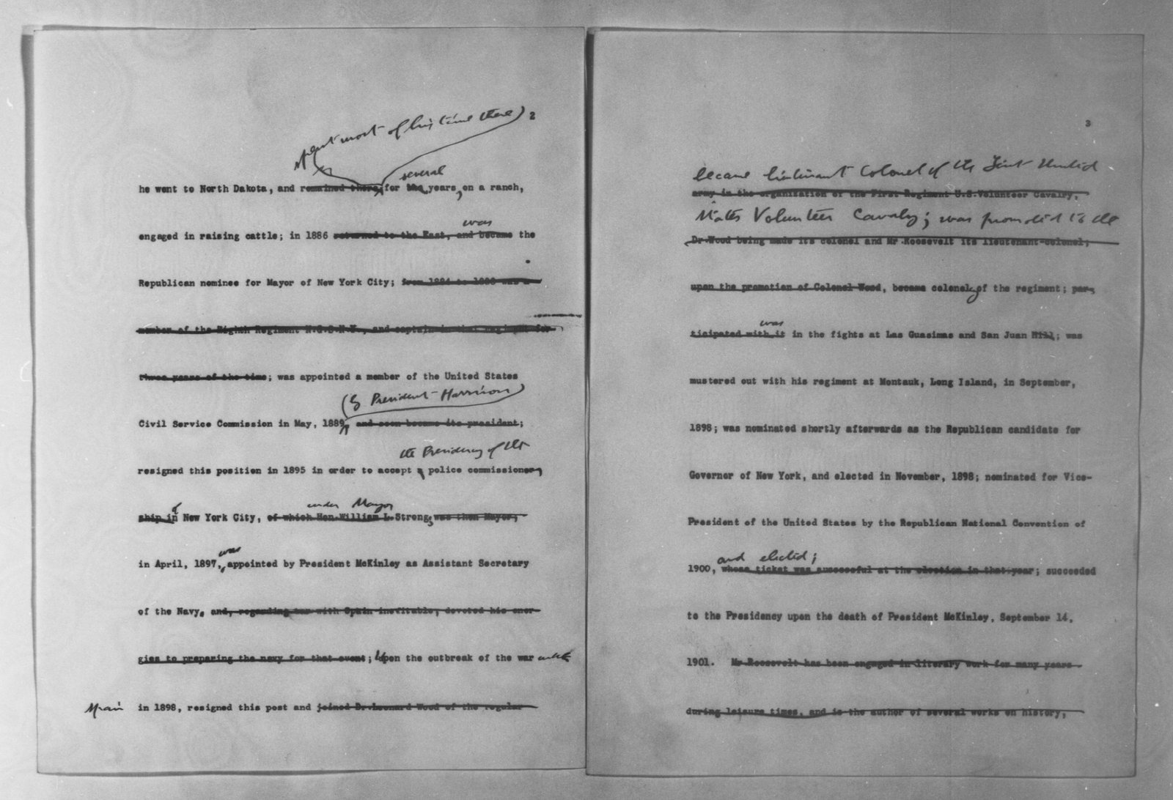

Slide 6
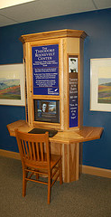
Interactive Kiosks
Theodore Roosevelt National Park
Bowman Regional Public Library
Bismarck State College Library
Grand Forks Red River High School
Future sites
  Mount Rushmore
  Sagamore Hill
  U.S.S. Roosevelt

Slide 7
Cyberinfrastructure for TRDL
Storage for the documents > 4.5 TB to date
  Permanence
  Security
  Partnership with ND ITD
Storage for the digital asset database and the web site
Bandwidth
  Volunteers and interns working around the country
  Users to access the collection (new web site)
Notes:
www.monticello.org nearly 2,000,000 visits and more than 9,000,000 page views in 2010
www.alplm.org

Slide 8
A Revolution…
…in the way historians conduct research, in the way history gets written, in the connections we’ll be able to make that we likely never could have seen before, in the way teachers teach students about our nation’s past, in the way we understand TR.
…that goes far beyond TR—historians and students and interested people will use the TRDL to learn more about Panama, the U.S. navy, American diplomacy, New York state government, conservation, third-party politics…and on and on.
…that goes beyond North Dakota—because people will access this site in Amsterdam and in Algeria, in every place where there’s a computer and access to the worldwide web—and the web design will make plain that the site is the creation of people in North Dakota; in Dickinson; at Dickinson State University.
Stacy Cordery, Visiting Fellow

Slide 9


Learn More…
Web site: www.theodorerooseveltcenter.org
Blog: http://www.blogtrc.org/
Facebook
Twitter
E-newsletter: send an email to krystal.thomas@dickinsonstate.edu
Sharon Kilzer
sharon.kilzer@dickinsonstate.edu
701-483-2814

Slide 10
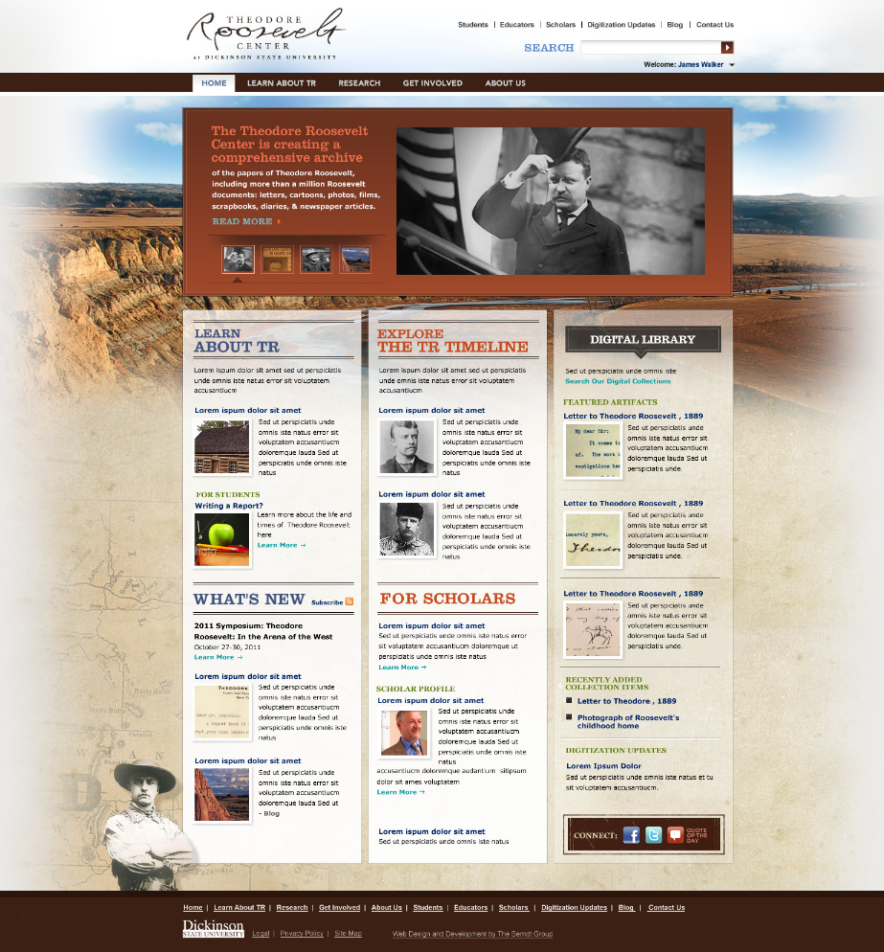
Back

