Slide 1




North Dakota EPSCoR State Cyberinfrastructure Strategic Planning Workshop
Institutional and Statewide
Cyberinfrastructure:
Dollars and Sense
Henry Neeman, Director
OU Supercomputing Center for Education & Research (OSCER)
University of Oklahoma
Thursday March 3 2011

Slide 2
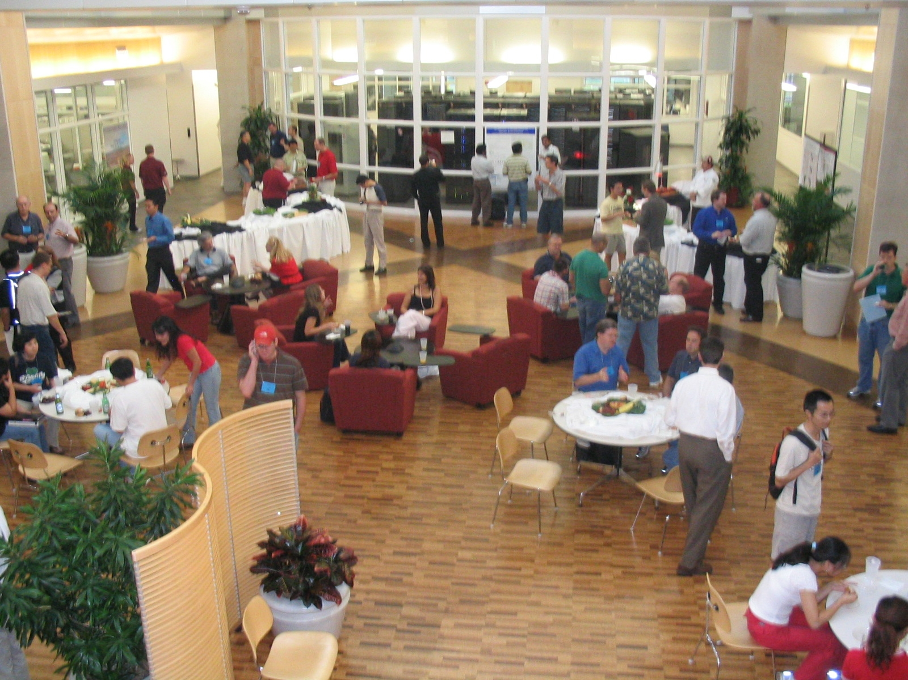
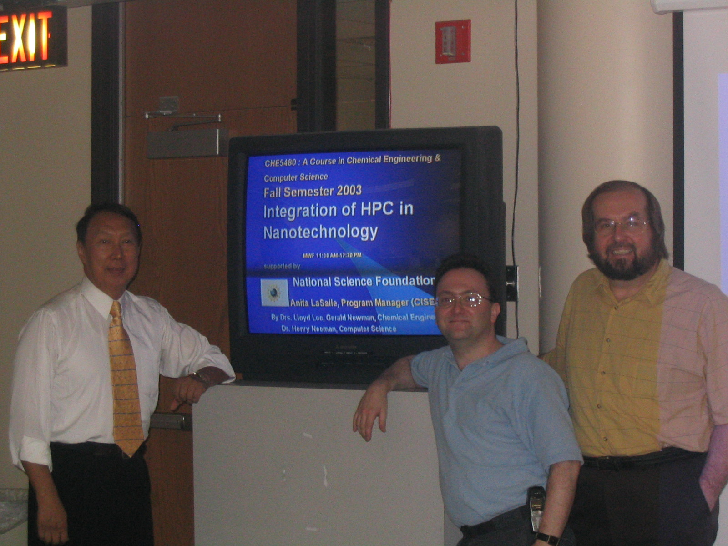
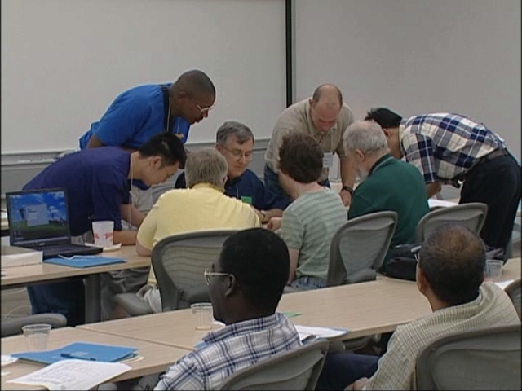
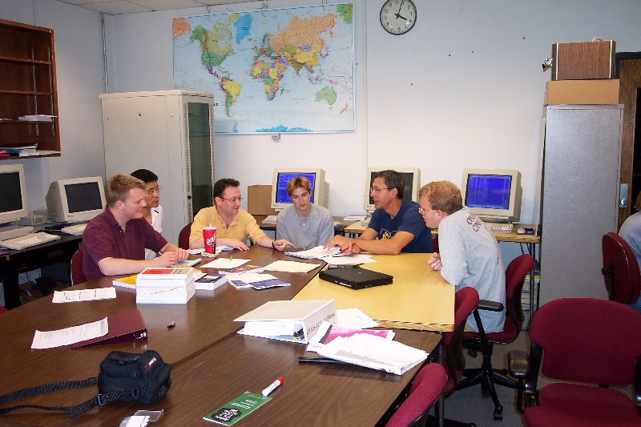
PEOPLE

Slide 3
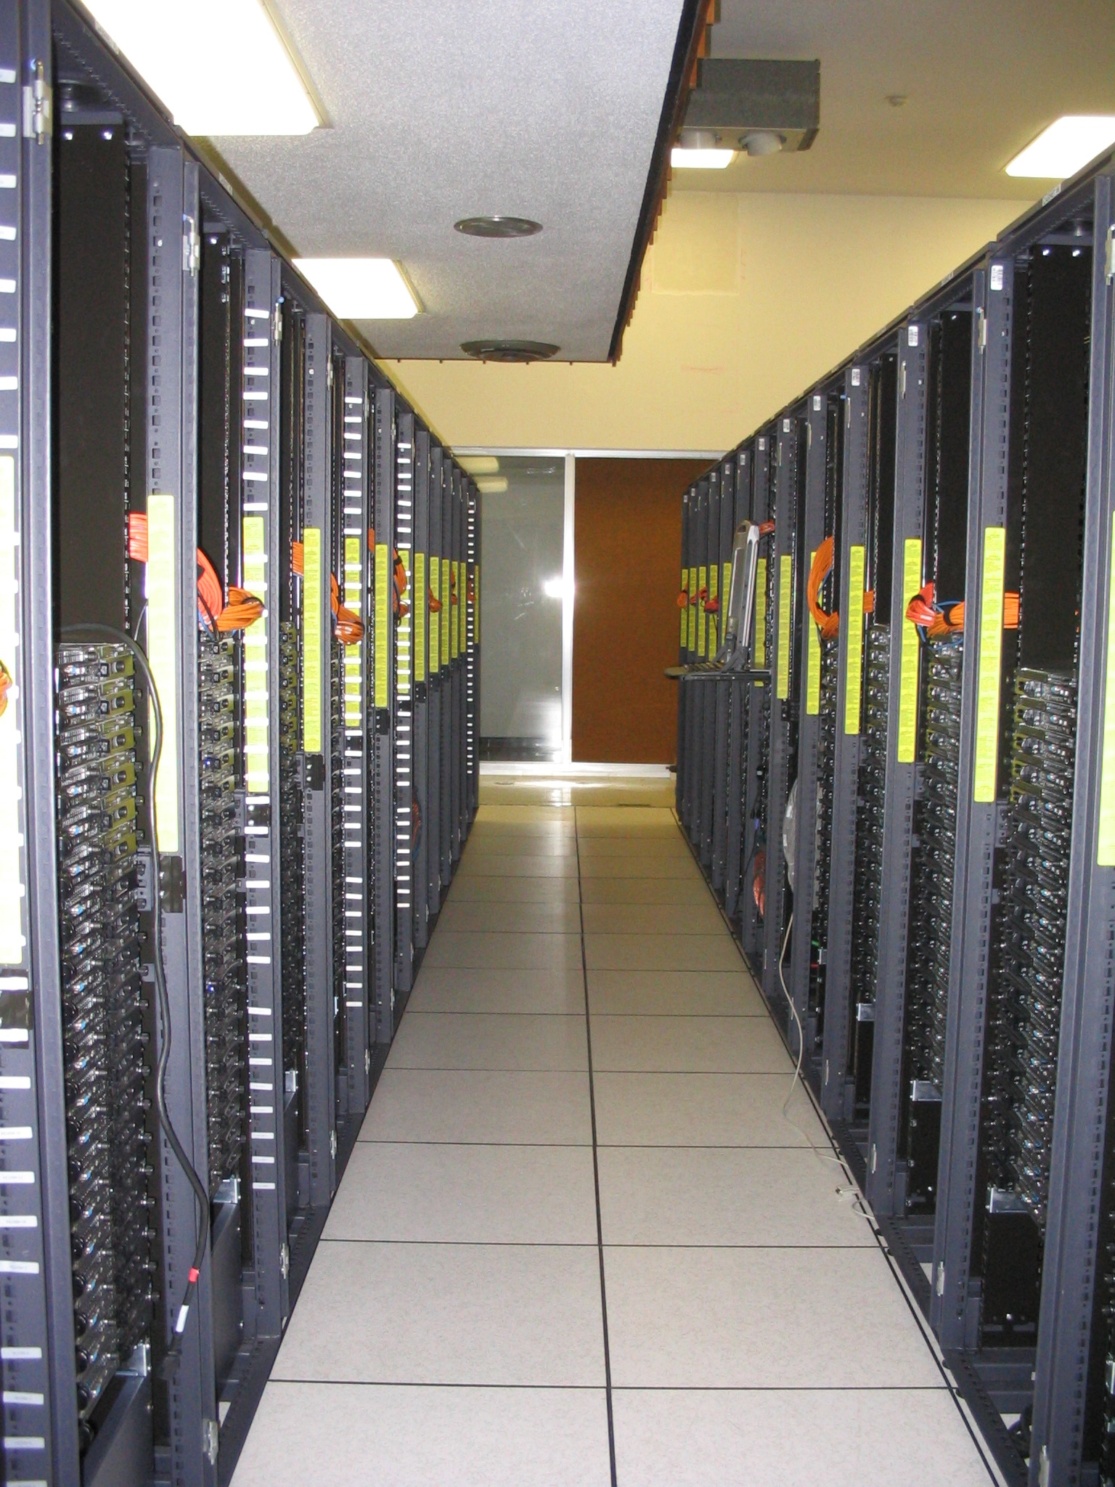
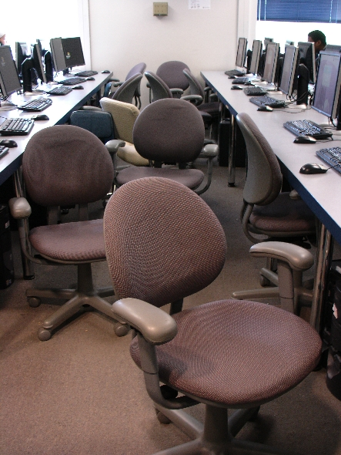
THINGS

Slide 4
What is Cyberinfrastructure?

Slide 5

What is a Ship?
“… [W]hat a ship is … It's not just a keel and hull and a deck and sails. That's what a ship needs. But what a ship is ... is freedom.”
– “Pirates of the Caribbean”

Slide 6
What Cyberinfrastructure NEEDS
High Performance Computing (supercomputing)
  Simulation
  Optimization
  Data Mining
High Performance Networking: moving data fast
High Throughput Computing: harnessing idle PCs to do number crunching
Grid/Cloud/Utility Computing: linking geographically dispersed systems to tackle larger problems
Scientific Visualization: turning a vast sea of data into pictures and movies that a person can understand
Shared Resources: sensor networks, instruments, data collections

Slide 7
What Cyberinfrastructure IS
Information-intensive techniques and technologies that enable our best thinkers, inventors and implementers – academic, government, industry and non-profit – to discover and design new generations of knowledge, products, capabilities and opportunities in science, technology, engineering and mathematics.

Slide 8
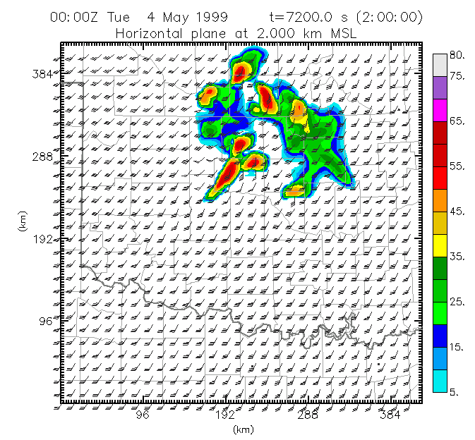
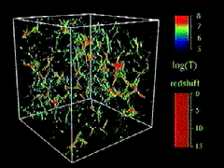
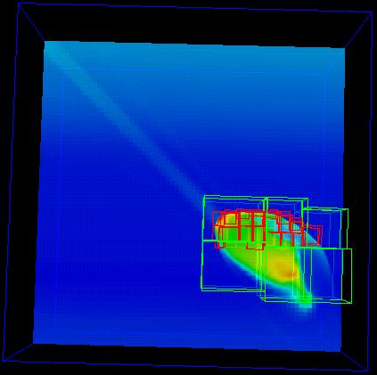
What are HPC & HTC Used For?
Simulation of physical phenomena – things that are too big, too small, too slow, too fast, too expensive or too dangerous to study in real life
  Weather forecasting
  Protein folding
  Energy management
Optimization: picking the best mix of stuff
Data mining: finding needles of information in a haystack of data
  Gene sequencing
  Detecting storms that might produce tornados
Visualization: turning a vast sea of data into pictures that a scientist can understand
Courtesy Greg Bryan &
Mike Norman
Moore, OK
Tornadic
Storm
Courtesy Kelvin Droegemeier
Courtesy Mordecai-Mark Mac Low

Slide 9
Cyberinfrastructure in Oklahoma

Slide 10
OU: Dell Intel Xeon Linux Cluster
1,076 Intel Xeon CPU chips/4304 cores
529 dual socket/quad core Harpertown 2.0 GHz, 16 GB each
3 dual socket/quad core Harpertown 2.66 GHz, 16 GB each
3 dual socket/quad core Clovertown 2.33 GHz, 16 GB each
2 x quad socket/quad core Tigerton, 2.4 GHz, 128 GB each
8,800 GB RAM
~100 TB globally accessible disk
QLogic Infiniband
Force10 Networks Gigabit Ethernet
Red Hat Enterprise Linux 5
Peak speed: 34.6 TFLOPs*
*TFLOPs: trillion calculations per second
sooner.oscer.ou.edu

Slide 11
OU: Dell Intel Xeon Linux Cluster
DEBUTED NOVEMBER 2008 AT:
#90 worldwide
#47 in the US
#14 among US academic
#10 among US academic excluding TeraGrid
sooner.oscer.ou.edu

Slide 12
OU: Dell Intel Xeon Linux Cluster
Purchased mid-July 2008
First friendly user Aug 15 2008
Full production Oct 3 2008
Christmas Day 2008: >~75% of nodes and ~66% of cores were in use.
sooner.oscer.ou.edu

Slide 13
OSU: Several Medium-sized Supercomputers
Pistol Pete: Linux cluster, 64 compute nodes, 512 CPU cores, 1024 GB RAM, 25 TB disk, Infiniband, 5.4 TFLOPs, being deployed now.
Cimarron: Linux cluster, 14 compute nodes, 112 CPU cores, 224 GB RAM, 3.5 TB disk, GigE, 896 GFLOPs, deployed summer 2008.
Spur: Shared memory machine with 4 quad core 2.4 GHz, 128 GB RAM, 1.5 TB disk, deployed spring 2008.
Bullet: Linux cluster, 64 compute nodes, 128 CPU cores, 256 GB RAM, 5 TB disk, Infiniband, 820 GFLOPs, deployed fall 2006.

Slide 14
Fastest Supercomputer vs. Moore
GFLOPs:
billions of calculations per second

Slide 15
OU: Condor Pool
Condor is a software technology that allows idle desktop PCs to be used for number crunching.
OU IT has deployed a large Condor pool (795 desktop PCs in IT student labs all over campus).
It provides a huge amount of additional computing power – more than was available in all of OSCER in 2005.
20+ TFLOPs peak compute speed.
And, the cost is very very low – almost literally free.
Also, we’ve been seeing empirically that Condor gets about 80% of each PC’s time.
OU and OSU have worked together to get a comparable Condor pool set up at OSU.

Slide 16
OSU: Condor Pool
In collaboration with OU IT, OSU IT is deploying a large Condor pool (approx 300 desktop PCs in IT student labs all over campus).
Once deployed, OU’s and OSU’s Condor pools will “flock” together, allowing jobs to migrate invisibly between institutions, but giving each institution’s jobs priority on their own PCs.

Slide 17
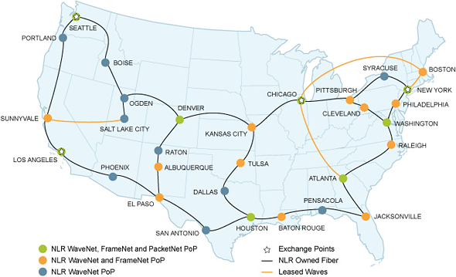
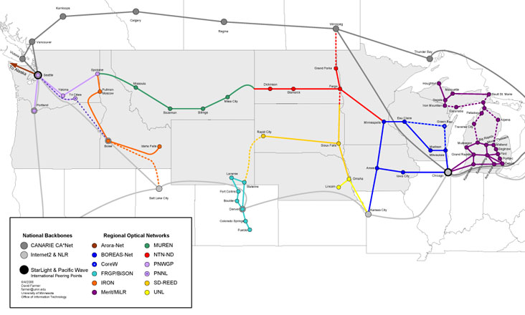
Networking: National LambdaRail

Slide 18
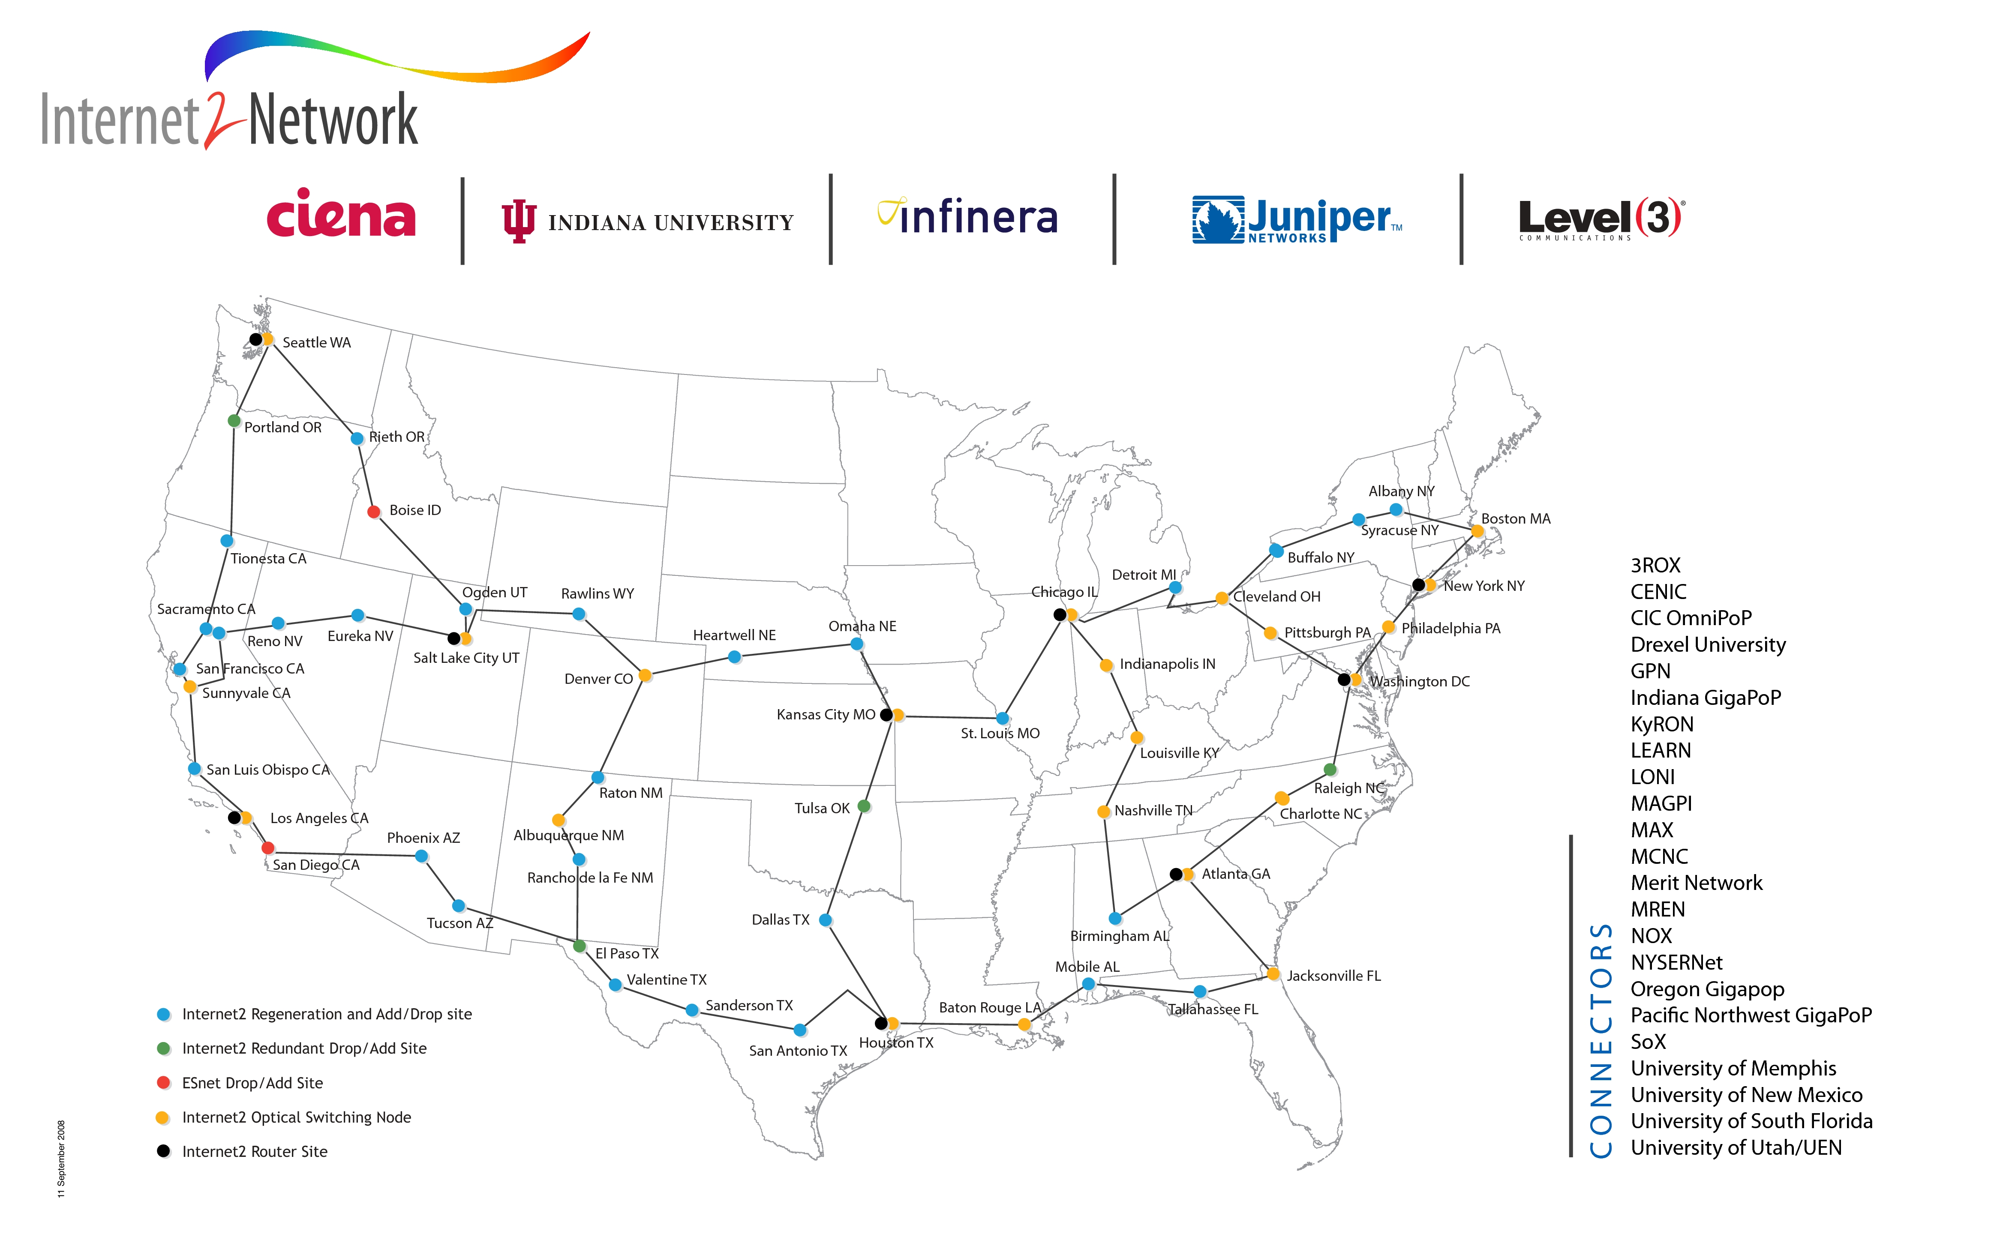
Networking: Internet2
www.internet2.edu

Slide 19
Why High Performance Networking?
Ability to move large datasets rapidly
  Natural hazards prediction & mitigation –OK: tornadoes
  Large scale data-intensive projects – OK: high energy physics
  10 Gigabits per second = 100,000 Gigabytes per day
Telepresence (including, potentially, telemedicine)
A Seat At The Table
  Without high performance networking, we wouldn’t be in the running for major national initiatives.

Slide 20
Oklahoma Cyberinfrastructure Initiative

Slide 21
OK Cyberinfrastructure Initiative (OCII)
All academic institutions in Oklahoma are eligible to sign up for free use of OU’s and OSU’s centrally-owned CI resources.
Other kinds of institutions (government, NGO, commercial) are eligible to use, though not necessarily for free.
Everyone can participate in our CI education initiative (not just in OK).
  UND, Meridian Environmental Technology Inc
Oklahoma Supercomputing Symposium open to all (10th Symposium Oct 11-12 2011).

Slide 22
OCII History
NSF EPSCoR Research Infrastructure Improvement (Track 1)
  Call for Proposals: “Cyberinfrastructure” appears 18 times.
  OK EPSCoR asked for statewide CI plan
  Meeting: OU & OSU CI leads, OU & OSU CIOs, OneNet director, OK EPSCoR director & associate director, science theme leaders
  Sketched out OCII plan
OU helped OSU set up Condor pool.
Providing “Supercomputing in Plain English” overview talk statewide (have visited 11 of 13 public universities, 7 of 12 private universities).

Slide 23
OCII Accomplishments
Other NSF EPSCoR Grants
  Track 2: Ecoinformatics (ecology) with Kansas: $6M ($3M to OK)
  C2: Networking: $1.17M to OK – includes OK’s only HBCU, Tribal Colleges
NSF MRI Grant: Oklahoma PetaStore ($793K to OU)
OCII provides supercomputer accounts to many external users (outside of OU and OSU): 75+ users at 24 academic, government, industry and nonprofit organizations (and counting) – up from 34 users at 15 institutions since Dec 2008.
OCII is directly responsible for $20M in NSF grants to OK since our first meeting in 2006 (Track1, Track2, C2, MRI).

Slide 24
OCII Outcomes

Slide 25
External Funding Outcomes (OU)
External research funding facilitated by OSCER (Fall 2001- Fall 2009): $186M+ total, $100M+ to OU
Funded projects: 162+
102 OU faculty and staff in 19 academic departments and 2 other campus organizations (research centers etc)
Comparison: Fiscal Year 2002-10 (July 2001 – June 2010): OU Norman externally funded research expenditure: $611M
Since being founded in fall of 2001, OSCER has enabled research projects comprising more than 1 / 7 of OU Norman's total externally funded research expenditure, with more than a 7-to-1 return on investment.

Slide 26
Publications Facilitated by OSCER
600+ publications facilitated by OSCER
  2010: 128+ papers
  2009: 105 papers
  2008: 100
  2007: 72
  2006: 85
  2005: 63
  2004: 27
  2003: 9
  2002: 8
  2001: 3
These papers would have been impossible, or much more difficult, or would have taken much longer, without OSCER’s direct, hands-on help.

Slide 27
Education Outcomes
“Supercomputing in Plain English”
  1000+ participants at 167 academic, government, industry and nonprofit groups, including:
    OU, OSU + 12 other OK academic institutions
    5 OK govt agencies (state, federal, military)
    4 OK companies
    1 OK non-governmental agency
    36 other academic institutions in 18 other EPSCoR jurisdictions (including ND)
    Research universities, masters-granting, bachelors-granting, community colleges, high school, middle school; minority-serving
“Supercomputing in Plain English” overview talk
  20 OK academic institutions, several other OK organizations

Slide 28
Lessons Learned
Cooperation between institutions is essential:
  among PhD-granting institutions;
  between PhD-granting and masters- and bachelors-granting;
  between Minority Serving Institutions and others;
  between academic and non-academic.
A CI win for any institution in the state is a win for the whole state.
Providing users across the state with access to centrally-owned resources at PhD-granting institutions costs little but returns a lot.
Help the institutions that you think are your rivals; it turns out that they’re your best advocates.
CI has a huge Return on Investment.

Slide 29
Cyberinfrastructure and Students

Slide 30
Moore’s Law
In 1965, Gordon Moore was an engineer at Fairchild Semiconductor.
He noticed that the number of transistors that could be squeezed onto a chip was doubling about every 18 months.
It turns out that computer speed is roughly proportional to the number of transistors per unit area.
Moore wrote a paper about this concept, which became known as “Moore’s Law.”

Slide 31
Moore’s Law Observed
GFLOPs:
billions of calculations per second

Slide 32
CI and Young North Dakotans
Historically we’ve seen that whatever happens at the high end of computing today will be on your desktop in 10 to 15 years.
So, for North Dakota undergrads to learn about high end Cyberinfrastructure puts them ahead of the curve:
  they’ll be more competitive now;
  they’ll know something important about the future.

Slide 33
The Future is Now
Computing power doubles every 18 months.
Undergrads are about 20 years old.
Life expectancy in the US is about 80 years.
So they have about 60 years left.
How much more powerful will computers be in 60 years?
  15 years = 10 doublings = 1024x ~ approx 1000 times better
  30 years = 20 doublings ~ approx a million times better
  45 years = 30 doublings ~ approx a billion times better
  60 years = 40 doublings ~ approx a trillion times better
The problem with the future: “The future always comes too fast, and in the wrong order.” (Alvin Toffler)

Slide 34
Thanks for your attention!
Questions?
www.oscer.ou.edu
hneeman@ou.edu

