Slide 1
Research Support through
Repository Access @ NDSU
A presentation for the 2019 Annual Symposium of the
North Dakota-Manitoba ACRL Chapter
Jenny Grasto and Rex Hughes, II
Notes:
First, we would like to thank the chapter’s executive board for considering and accepting our presentation proposal, and thank you for joining us for this discussion of research support through repository access.
Today, we would like to discuss researcher partnerships in relation to an institutional repository, using examples from our interactions with the departments and faculty of North Dakota State University. We will be discussing examples of documents in our DSpace platform, including student disquisitions, faculty research, and other forms of digital scholarship. We will also discuss library staff involved in developing the repository platform.
While the following examples only represent one institution’s experience and may be familiar to institutions who have already moved forward with their own repositories, we hope these examples will provide you with ideas regarding your future digital scholarship efforts.

Slide 2
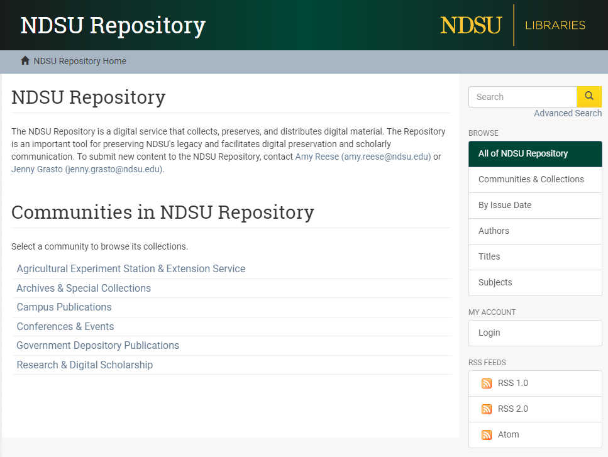
NDSU
Repository
https://library.ndsu.edu/ir/
Notes:
NDSU Libraries currently hosts the Institutional Repository using DSpace. If you would like to view the repository after our presentation, it is currently open access and you will find links in this slide that will take you to the landing page for the repository (https://library.ndsu.edu/ir/). The NDSU Repository has been divided into 6 primary collections, including extension services, special collections, campus publications, government documents, and general research. We’ll be focusing on the “Research & Digital Scholarship” collection during this presentation.
In 2017, the upgrade to DSpace Ver. 6.0 was precluded by hierarchy changes to the collections and sub-collections/communities of the NDSU Repository. Our Head of Systems and Digital Strategies, Amy Reese, guided the restructuring effort in order to give a logical progression to the repository levels. For example, research related to a specific academic department can be located under Research & Digital Scholarship > College Name > Department Name > Type of Document. This information has also been included in the metadata fields of each document.
Using the Browse > Communities & Collections feature to the right, users can view this hierarchy easily by selecting the expansion (+) icons to the left of each collection and sub-collection/community.

Slide 3

Digital Scholarship
Student-Focused, Land Grant, Research University
Making research output available
Strengthen and develop partnerships
Notes:
Dean Mocnik spoke earlier about NDSU Libraries’ digital scholarship initiatives. These initiatives align with the NDSU motto many of us have heard: Student-Focused, Land Grant, Research University. The NDSU Libraries furthers this message by striving to involve students and faculty in an immersive learning environment and providing them with other content-rich resources that allows them to create and share new knowledge.
The NDSU Repository makes the sharing of that new knowledge possible with everyone. Search engines such as Google crawl the site and the records are also made available in our discovery system, Primo. The theses and dissertations in our Repository were also recently indexed in the Networked Digital Library of Theses and Dissertations (NDLTD), which is a global open access ETD database currently containing over 5.7 million records.
Our digital scholarship initiatives will also give us the opportunity to continue to strengthen and develop new partnerships. With the NDSU Repository, we have been able to develop a few strong partnerships over the past ten years.

Slide 4
Researcher Partnerships
Architecture/Landscape Architecture
  Student Design Theses
Graduate School
  Ph.D. Videos and Disquisitions
Faculty Research
Datasets (beginning stages)
Notes:
One of the initial partnerships we had with the repository was with the Department of Architecture and Landscape Architecture. In 2010, the department decided to discontinue having their students produce a print copy of their design thesis document, and they worked with the liaison librarian at the time (Jenny Grasto) and former Digital Initiatives Librarian to have their students submit their theses electronically to the Repository. This was the first department at NDSU to have student research showcased in the IR.
We also had an existing relationship with the Graduate School, as the Libraries processed the commercial binding of the print copies of Masters Papers, Theses, and Dissertations. Near the end of 2011, we worked with the Graduate School to include the Masters Papers in the Repository, as the theses and dissertations were added to ProQuest. A few years later, in 2014, the Graduate School, along with Information Technology Services, approached us again with a new requirement for Ph.D. students to record a brief video summarizing their research for a non-specialized audience, and they wished to have these videos hosted in the Repository.
As we worked with our Systems colleagues to upgrade the Dspace repository platform during 2016 and 2017, we also sought input from the Graduate School on the organizational structure of the content, as we knew we would be continuing to work with them in the future.
We continued working with the Graduate School to bring in all born digital student theses and dissertations, which were published from Fall of 2011 to the present. The completion of this retroactive project in Summer 2018, which involved the addition of over 1,700 disquisitions with related metadata, was followed up with a library article and university news to encourage access. These documents were uploaded in keeping with our university’s intellectual policy (Policy 190.6.2), which states that a graduate student agrees upon enrollment to allow the university to share print or electronic versions of their disquisition:
https://library.ndsu.edu/student-research-now-available-online
In addition to partnering with other units on campus to make student research accessible in the NDSU Repository, we have also worked with faculty researchers to make their works available, including Agricultural Experiment Station and Extension Service documents, journal articles (either by linking out to the published version or including a publisher-approved PDF version in the IR), as well as books and book chapters. Amy Reese, our Head of Systems and Digital Strategies, also created the University Distinguished Professors collection about six months ago. This collection brings together new and existing works in the Repository that are either authored by the professor; theses or dissertations the professor advised; or other campus publications where the professor is mentioned. Becoming a University Distinguished Professor is the highest honor that can be awarded to a faculty member at North Dakota State University, and we wanted to highlight these accomplishments and contributions in the Repository.
We have also started testing the addition of dataset records in the repository over the past few months. Our Digital Scholarship Initiatives Working Group will continue these efforts in the coming months.

Slide 5
Examples from NDSU Repository
Theses and Dissertations
Impact of Climate Change and Weather Variability on North Dakota Agriculture (Mayom)
Architecture Thesis
Sustainability: A Holistic Approach (Rauniyar)
Faculty Research
University Distinguished Professor Collection
Raj Bridgelall Pre-Print Publications
Ronald H.L.M. Ramsay Index (in progress)
Notes:
Examples
Impact of Climate Change and Weather Variability on North Dakota Agriculture (Mayom): https://hdl.handle.net/10365/29717
Sustainability: A Holistic Approach (Rauniyar): http://hdl.handle.net/10365/19992
University Distinguished Professor Collection: https://library.ndsu.edu/ir/handle/10365/28949
Raj Bridgelall Pre-Print Publications: https://hdl.handle.net/10365/28238
Ronald H.L.M. Ramsay Index (submission in progress): https://hdl.handle.net/10365/29405
We wanted to take a few minutes to show you examples of these documents, which are the result of our partnerships with researchers. We won’t have time to go over each of these records, but in short, there is an example of a thesis record, an architecture thesis, the University Distinguished Professor collection, a faculty pre-print research article, and an index project that we completed with one of our architecture faculty members.
We will start with the first thesis record example, which can give you an idea of how we designed most of our thesis records to fit the Graduate School’s access needs. As you can see in the simple item view, most of the core information is prominently displayed for the user. The Graduate School wanted to feature information such as title, creator abstract, and degree fulfilled. You can also see that the work belongs to the collection of its affiliated College. The document itself is also available under the View/Open heading, which will take you to the PDF version of the thesis that has been formatted by the Graduate School and also includes our signature mask to cover committee member signatures (protection from identity theft). If we move back to the record, there is also the option to see more metadata using the Show full item record option to the left, and this includes more creator information, rights statements, and subjects that can be browsed. We worked with the graduate school to determine which fields were important for their records, but we also wanted to allow the students and future users to discover these documents by browsing creators, subjects, and keywords. There is also an award-winning architecture thesis with similar metadata, and it contains multiple files as well as drafted plans for a new library.
The faculty research examples will also display a number of collections and pre-print document examples, but we would like to highlight the index compiled by Ronald Ramsay, one of our architecture faculty members. The record includes several core and enhanced metadata elements, but this document represents a deeper research partnership since we were involved in formatting the document itself. Ron Ramsay had created an index of Great Plains architects for his Geocities website, and as you may know, the Geocities domain is no longer active. Fortunately, Ron had printed the index pages and saved them in a binder, which Jenny was able to scan and use text recognition to build a digital copy. We then formatted the document to include written notes from Ron, an interactive table of contents with architect names, and other features. It has been a wonderful project to work on, because it allows Ron to share his work on a new platform and essentially preserve part of his legacy as a researcher.

Slide 6
Library Discovery
DSpace Platform and Systems (Primo)
Document Submission Process
Metadata and Access Points
Researcher Communication
Notes:
How did these records and document access options come to be? The workflow has been evolving over the past two years at NDSU to enrich the DSpace platform. We have the DSpace platform itself, now on Version 6, and its related system features. Amy Reese, our Head of Systems and Digital Strategies, began working with our earlier version of DSpace back in 2015 and she coordinated much of the restructuring, feature enhancement, and other aspects of repository searching. Our Systems Department has also made it possible to harvest records to our Primo Discovery Layer, which is why it is important that we follow proper metadata standards and subject analysis.
Our submission process has also evolved over the years to include options for researchers to share documents and details over email, external drives, and cloud platforms. Rex Hughes has also worked with our repository group to establish metadata standards for Dublin Core based upon DCMI, proper taxonomies, crosswalks, and other standards. We now keep track of our schema decisions in a group handbook and the DC schema exists within the repository itself.
Finally, we have also made a point of working closely with our researchers and fostering the partnership beyond the submission process. We will follow up with researchers by giving them the permanent link to the finished repository record, and we have stayed in constant communication with the Graduate School as disquisitions are uploaded. A strong partnership with our researchers will enable us to work well with them in the future and continue to strengthen the collections of the NDSU Repository.

Slide 7
Challenges and the Future
Lack of Self-Submission Process
  File Sharing in the Cloud and Email Systems
Faculty Outreach and Acceptance
  Social Media / University News
  Department Meetings
Platform Statistics
  Exploring Google Analytics / Altmetrics / RAMP
Notes:
We have had several successes in partnering with units on campus as well as individual researchers over the past 10 years, and we’ve also faced some challenges along the way.
When we started with Version 1 of DSpace, we allowed NDSU students and faculty to register for an account in the repository; however, this also required further configurations to allow them to submit their items to the appropriate collection, which was a bit cumbersome. When we upgraded to Version 6, we decided not to allow direct submissions. This allowed submissions to be initiated and funneled through the email contacts on the Repository homepage. We still feel this could be a slight barrier for individuals, as the files then have to be shared via email, external drive, Google Drive, or OneDrive; however, it does work nicely in cases where departments share a lot of files with us. We would like to work with our Systems staff to develop a web form that can be used for individual submissions, which will then go to a brief review stage to ensure all the necessary metadata is present and corrected prior to adding the files to the IR.
Another area with which we have struggled has been outreach to and/or buy-in from faculty to obtain their scholarly content. Some faculty are still unaware that the repository exists or they do not know its purpose. In the past two years, we have been working on library discovery systems (Primo harvest), marketing materials, social media postings, and sharing information at department meetings (library liaisons). University news has also helped make the IR more visible. Recently, our university president, Dean L. Bresciani, shared the Teddy Roosevelt Library & Museum Luncheon content on Facebook (https://hdl.handle.net/10365/29451).
The third area where we plan to make improvements in the coming months is with statistics. DSpace lacks file download statistics and other granular details. We’ll be exploring Google Analytics and Altmetrics as supplementary statistics, and we recently just learned about RAMP (Repository Analytics and Metrics Portal) as another possible option.

Slide 8
Goals of the Repository
Enhance the Research Experience
  Preservation: Provide researchers with the ability to preserve their research output
  Access: Provide researchers with the ability to share their research output and provide future researchers with the ability to access this output
Notes:
In conclusion, we wanted to summarize our presentation with ways that we believe the repository can enhance the research process.
First, there is Preservation: it allows researchers to preserve their output in a single location, where it will be preserved on a server and curated by library staff.
Second, it provides a means of Accessing this research output. If future researchers are able to discover documents in the repository based on the system structure, metadata, and document accessibility, this can contribute to the ongoing research efforts of NDSU and researchers around the globe. It allows research output to grow and evolve by contributing to the larger conversation, which is something we should always strive to accomplish in the university setting.

Slide 9
Questions?
Thank you!
Jenny Grasto Rex Hughes, II
jenny.grasto@ndsu.edu rex.hughes@ndsu.edu
701-231-6462 701-231-9677
Notes:
Presenter Contact Information
Jenny Grasto
Email: jenny.grasto@ndsu.edu
Phone: 701-231-6462
Rex Hughes, II
Email: rex.hughes@ndsu.edu
Phone: 701-231-9677

