Slide 1
Abnormal Leech Eyes in the Turtle Mountains
Jenny Houle

Slide 2
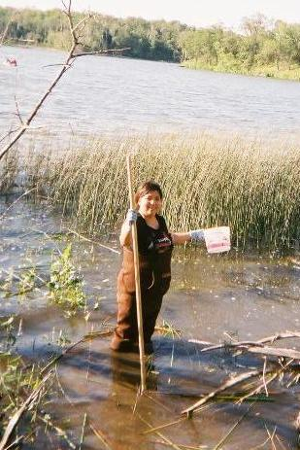
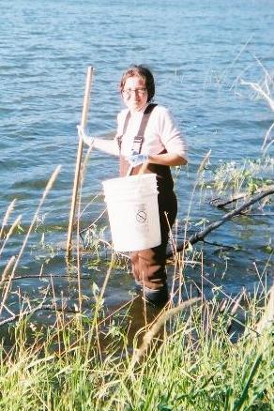
Summer 2010 Leech Collecting

Slide 3
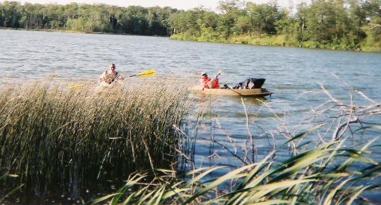
Summer 2010 Leech Collecting

Slide 4
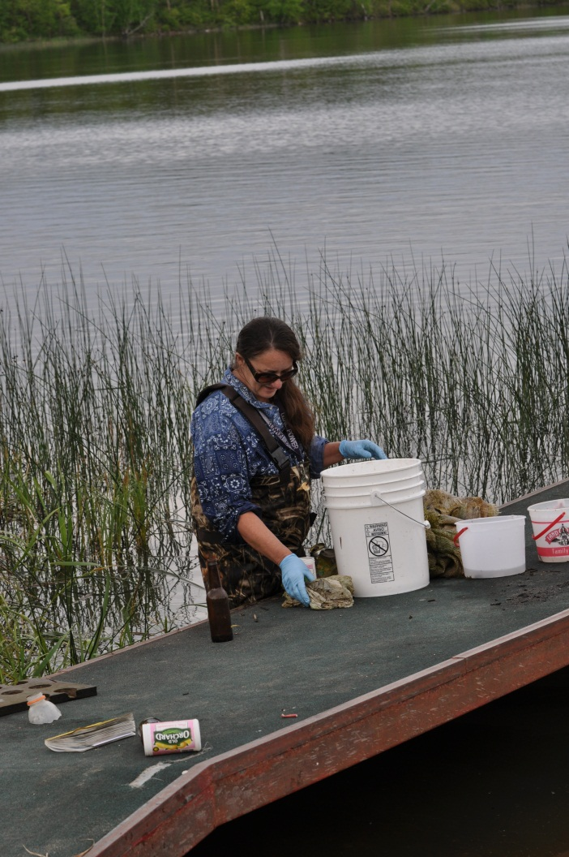
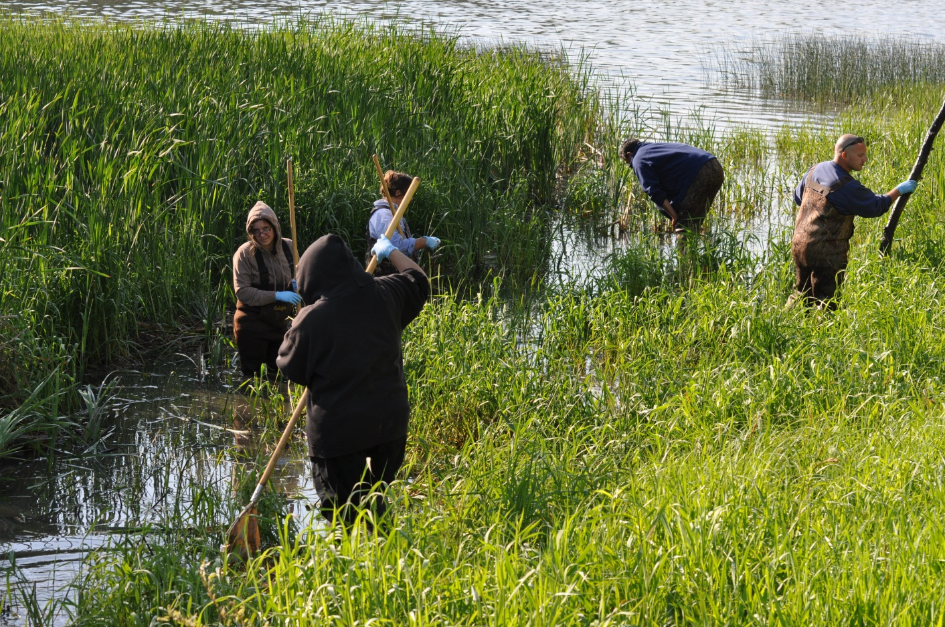
Harvesting and storing the Leeches

Slide 5
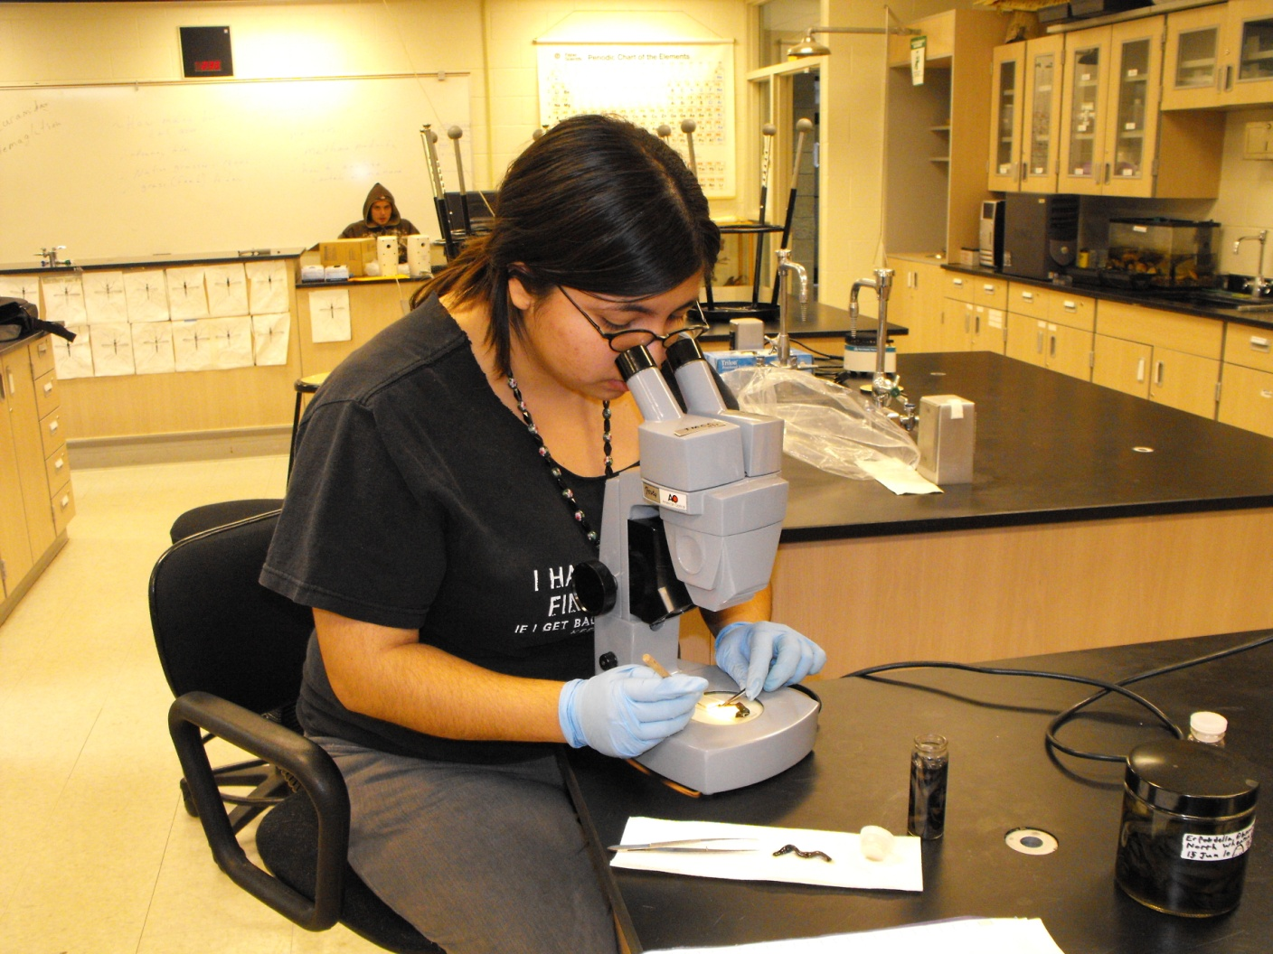
Identifying the Leeches

Slide 6
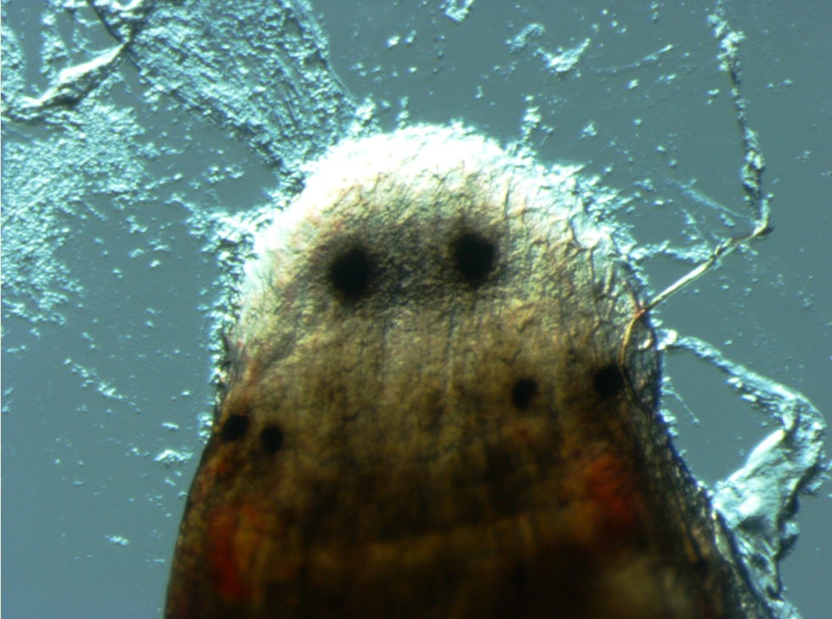
Erpobdella obscura Erpobdella punctata

Slide 7
Erpobdella obscura Erpobdella punctata

Slide 8
Erpobdella obscura Erpobdella punctata

Slide 9
Erpobdella obscura Erpobdella punctata

Slide 10
Abnormal Erpobdella obscura Eye Arrangements

Slide 11
Abnormal Erpobdella obscura Eye Arrangements

Slide 12
Abnormal Erpobdella obscura Eye Arrangements

Slide 13
Abnormal Erpobdella obscura Eye Arrangements

Slide 14
Abnormal Erpobdella obscura Eye Arrangements

Slide 15
Abnormal Erpobdella obscura Eye Arrangements

Slide 16
Abnormal Erpobdella obscura Eye Arrangements

Slide 17
Abnormal Erpobdella obscura Eye Arrangements

Slide 18
Abnormal Erpobdella obscura Eye Arrangements

Slide 19
Abnormal Erpobdella obscura Eye Arrangements

Slide 20
Abnormal Erpobdella obscura Eye Arrangements

Slide 21
Abnormal Erpobdella obscura Eye Arrangements

Slide 22
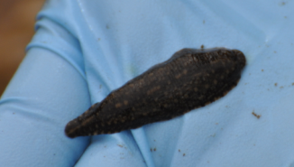
Future Studies

