Slide 1
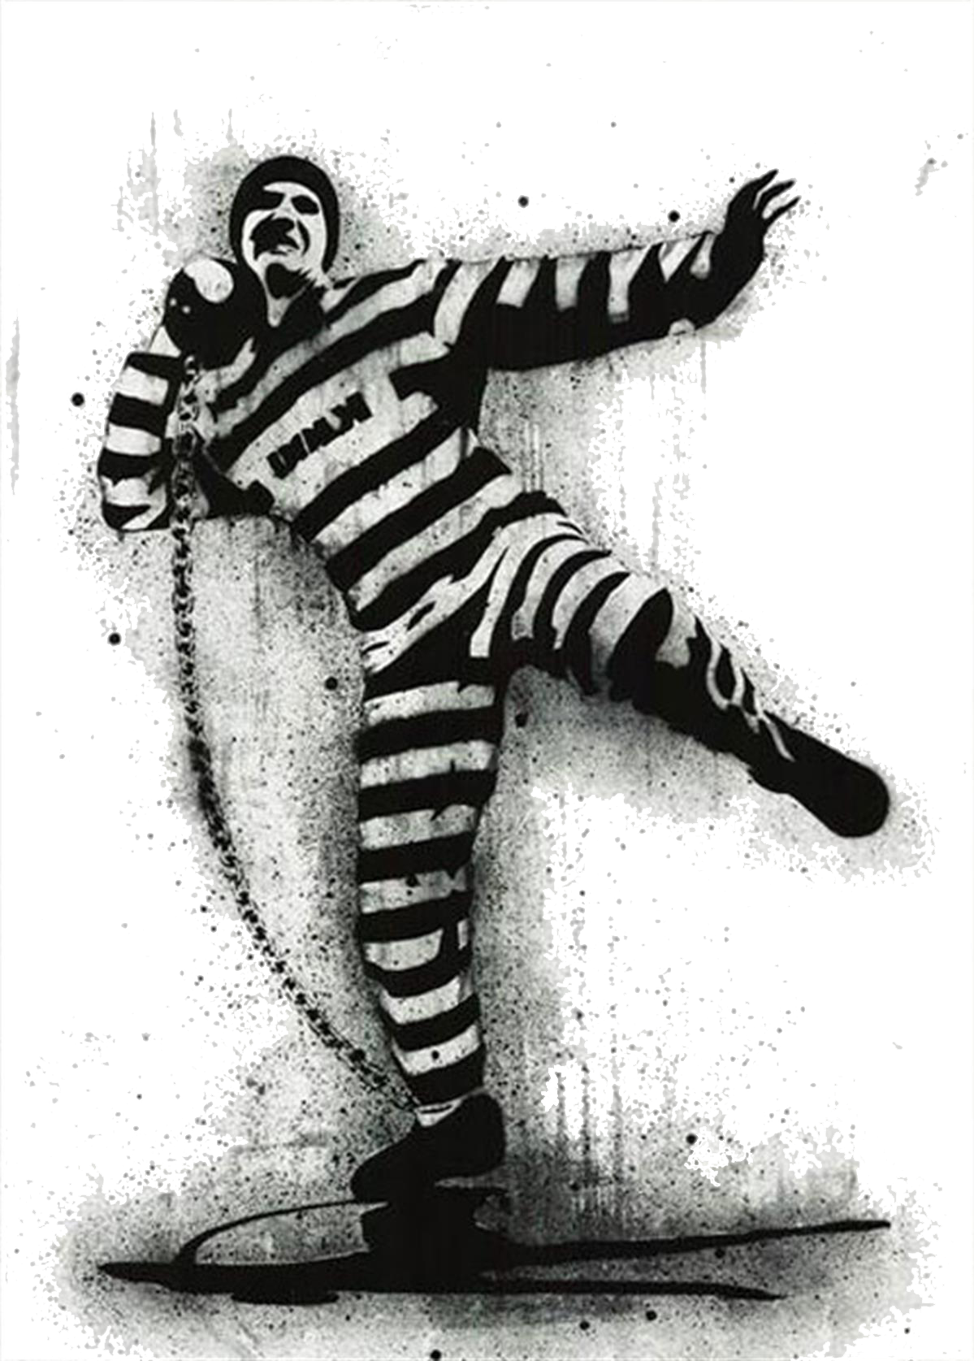
Designing for Humanity
Elizabeth Thordson
Design Thesis, Spring 2018
Notes:
Hello everyone, my name is Elizabeth Thordson.
I have named my project “Designing for Humanity” because that is the core of this project. I believe in the importance of using architecture as a tool to help improve the lives of everyone around us.

Slide 2
How does the architecture of Correctional Facilities impact inmates?
Notes:
One of the ways we can do that is by using evidence based design when planning for a prison. I set out to research this idea and study how the architecture of correctional facilities impacts inmates.
So to take you way back to the beginning, before the school year started, I spent a lot of time thinking about what I would want to design for my thesis. I knew it had to be something interesting and something complicated enough to hold my attention for several months. This would be the longest project we have worked on in our education to date.

Slide 3
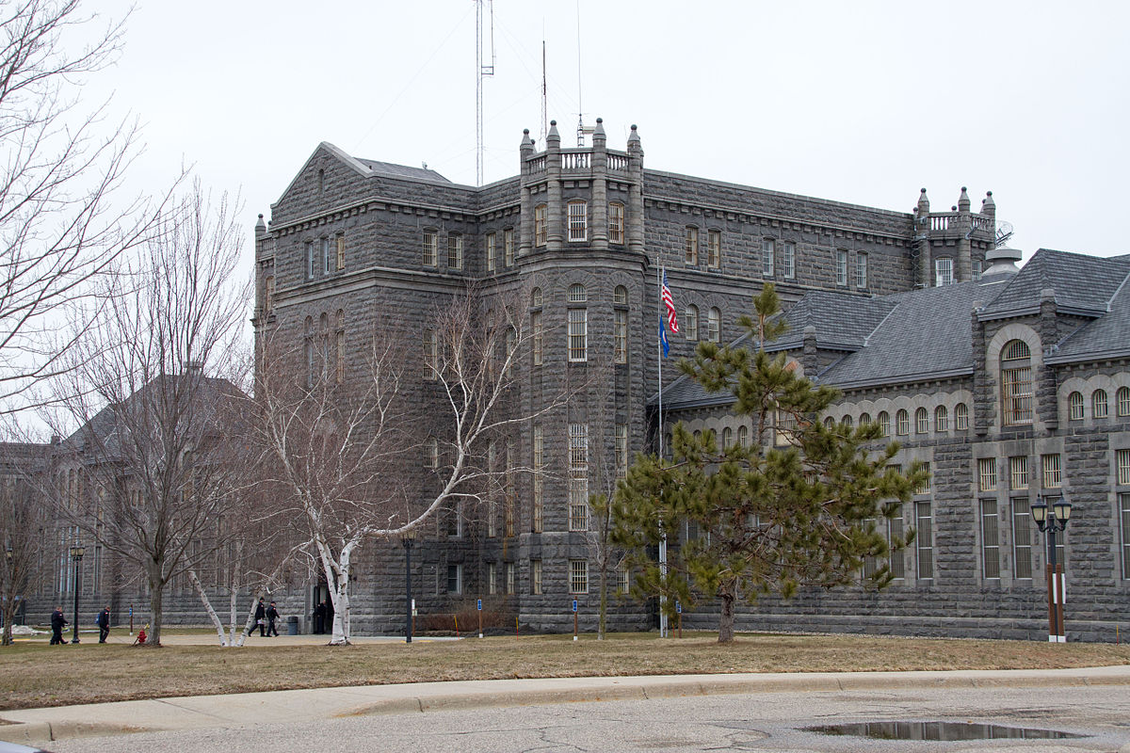
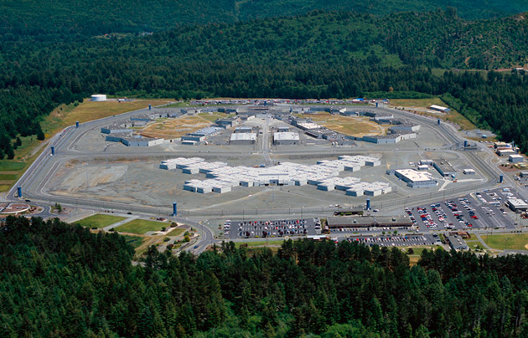
Project Introduction
Saint Cloud Prison (1889)
Pelican Bay (1989)
Notes:
My dad and I were driving through St. Cloud and I was struck by how beautiful the Saint Cloud prison was. I had seen it countless times but this time I really looked at it- the huge old structure looks more like a castle than a prison. This made me wonder why we stopped designing prisons with the same care and craft that goes into other public works projects. It wasn’t a hard question to speculate about - In my opinion, we have started caring too much about what is housed within the building rather than focusing on the actual building.

Slide 4
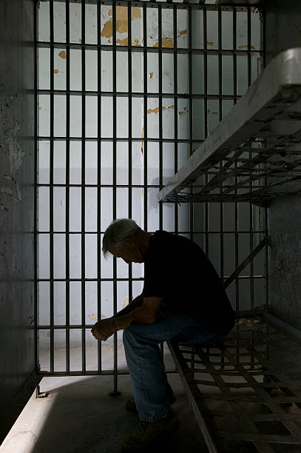
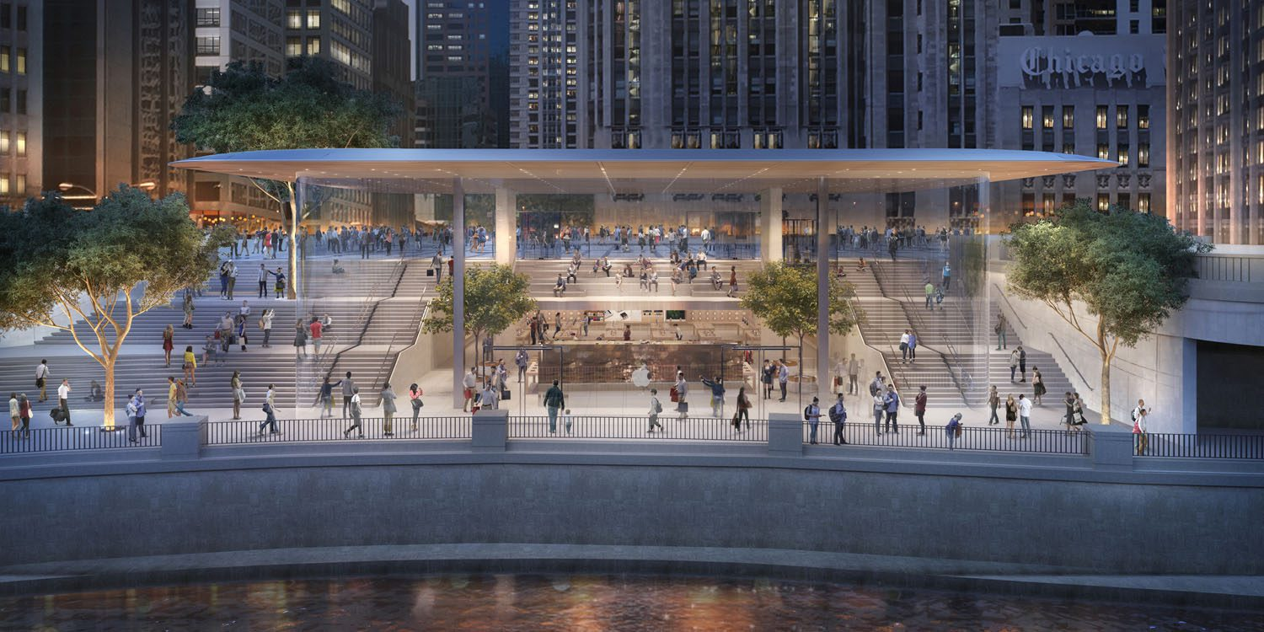
Project Introduction
Apple Store in Chicago
Notes:
For example, an Apple store gets a beautiful building to house the beautiful products that are sold there. Why do we give humans less of a home than we do material goods? This issue goes to show American priorities. We care more about our material goods and precious technology than the millions of people spending time behind bars

Slide 5
Project Introduction
According to the US Bureau of Justice Statistics,
2,220,300
adults were incarcerated in US federal and state prisons, and county jails in 2013
Notes:
I believe that the conversation surrounding prisons needs to change; but it can’t until people realize its importance. How many people do you think really, truly care about the way a correctional center is designed or run? How many people realize the impact that can be made?

Slide 6
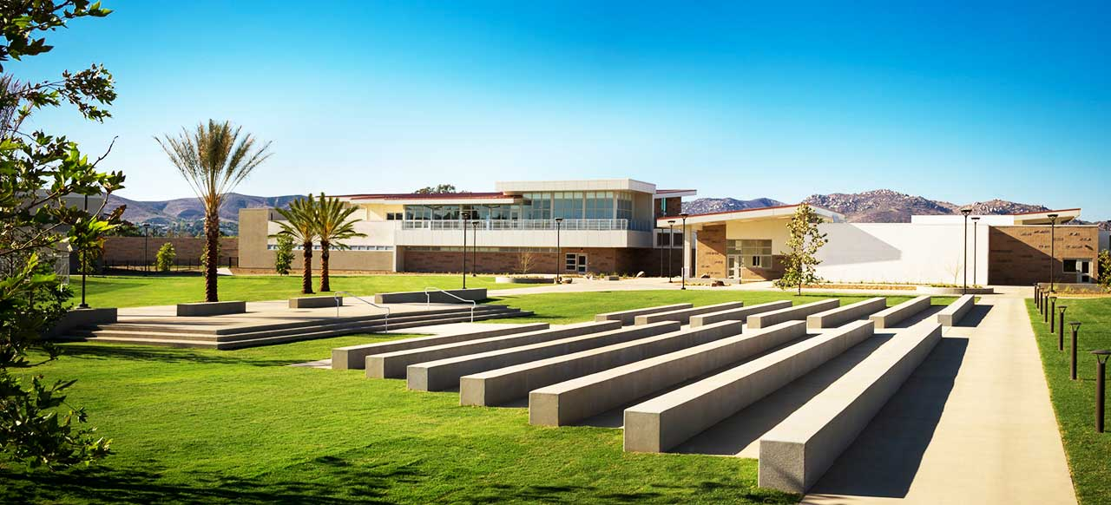
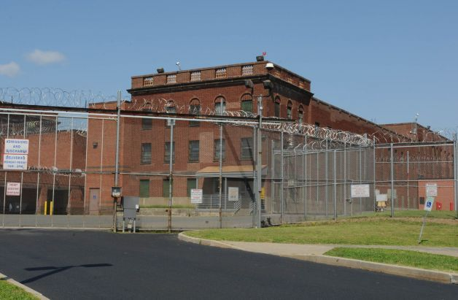
Project Introduction
Las Colinas Detention Center
Typical American Prison
Notes:
It seems as though people only begin to care about the design of correctional facilities when they start looking “too nice”. People often forget or ignore the fact that the way a correctional center is designed can improve staff retention, inmate attitudes, and can actually help to lower the rate of recidivism.

Slide 7
RECIDIVISM
re·cid·i·vism
/rəˈsidəˌvizəm/
noun
the tendency of a convicted criminal to reoffend.
"the prison has succeeded in reducing recidivism"
Notes:
Recidivism is defined as the tendency of a convicted criminal to reoffend. Currently the rate of recidivism in the United States is about 80% within the first 5 years of being released. To compare, the rate of recidivism in Norway is about 20%.

Slide 8
“Design is crucial to creating an environment in which prisoners can live and not become institutionalized. This means providing spaces for staying in contact with families, work, education, and playing sport.”
Notes:
Prison expert Isabel Hight says that architecture sends a silent message to everyone walking into any place. It tells you what to expect and where the limits of behavior are. Prisons are the same. She says: In my view, design is crucial to creating an environment in which prisoners can live and not become institutionalized. This means providing spaces for staying in contact with families, work, education, and playing sport.
I found this article after I had started designing but it aligns directly with what I believe.

Slide 9
PREMISE
Notes:
I stated my theoretical premise to be the research of healthy prison design on a global scale. I aimed to study how the oppressive nature of prisons affects both the inmates and staff. With the results from my research I decided on the best way to redesign an existing facility. I did this by comparing examples from around the world and then evaluating results from each of them.

Slide 10
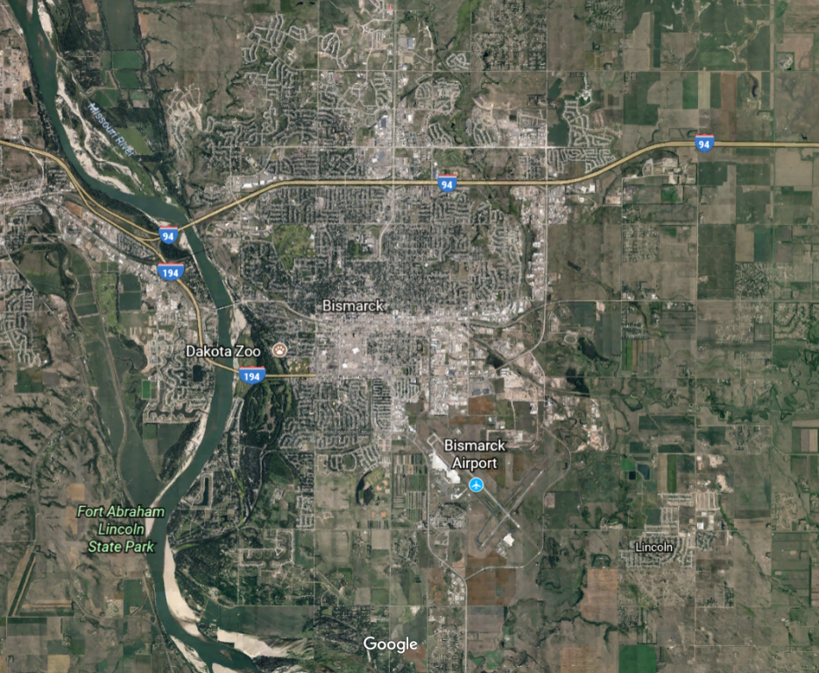
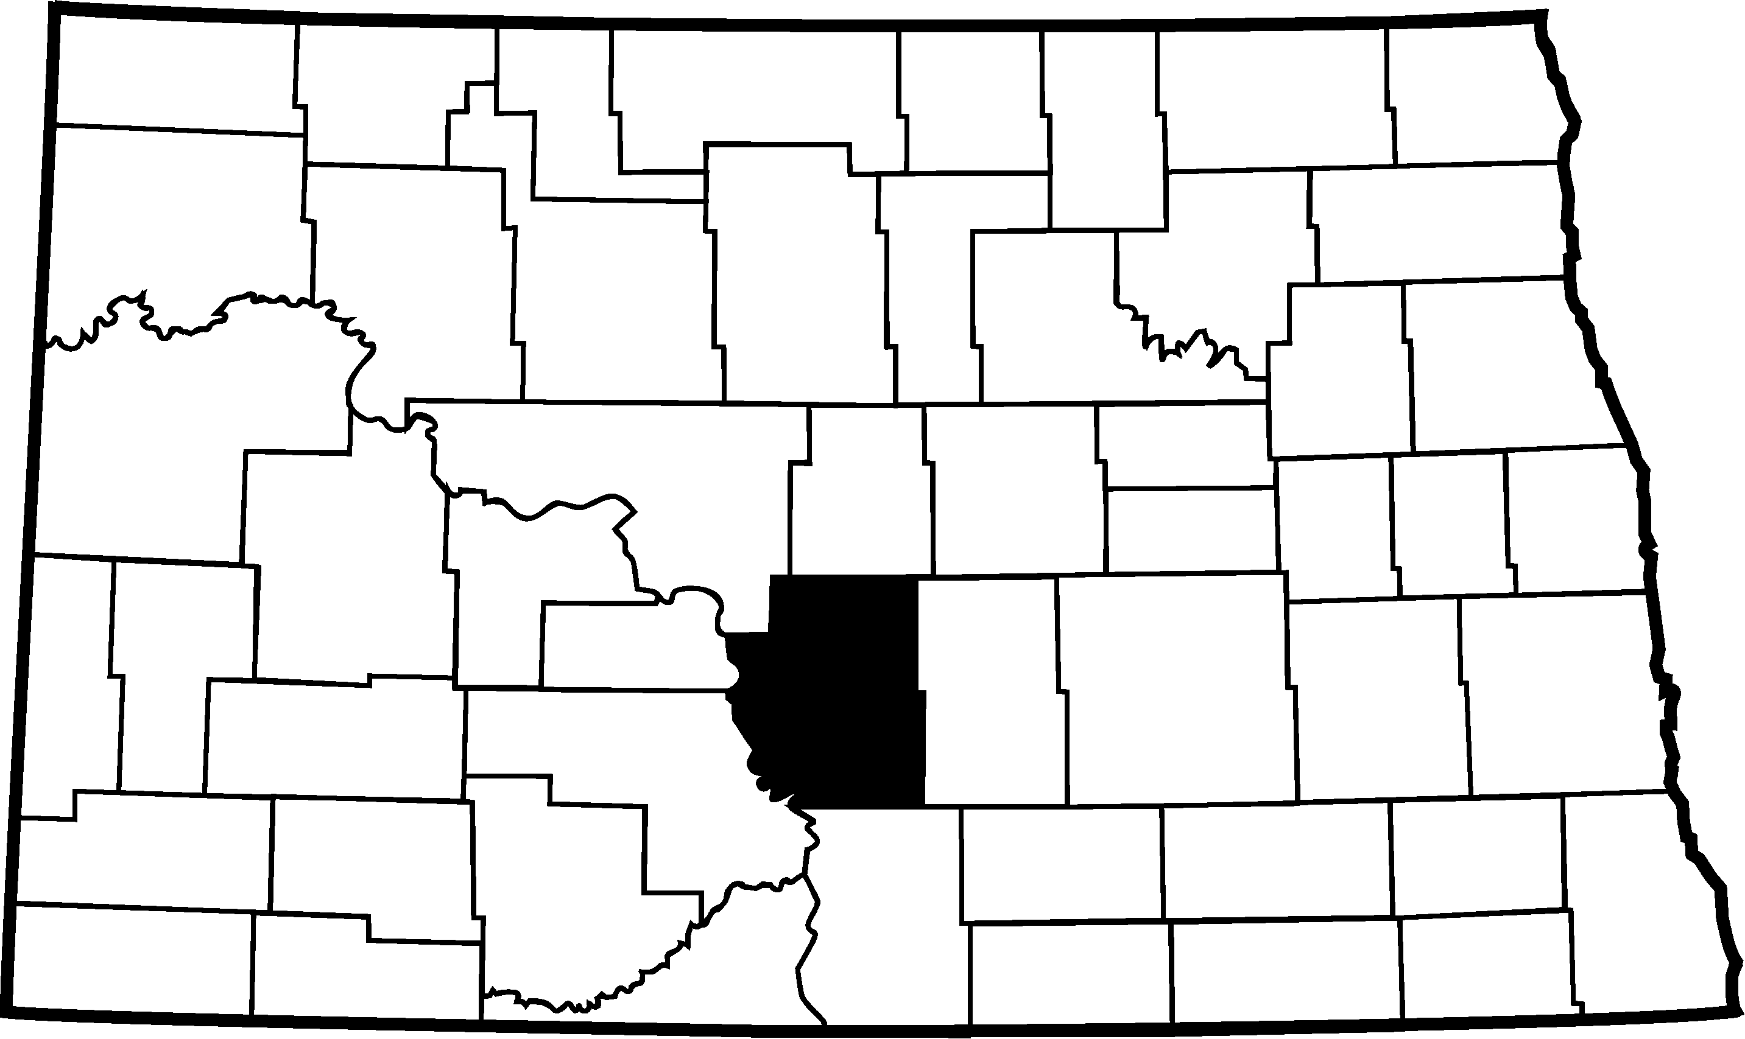
Project Premise
Burleigh County
Bismarck
Notes:
The existing facility I chose to redesign is Missouri River Correctional Center. This specific correctional center is located in Bismarck, ND. I came across the facility through my research for healthy prison design because of their recent policy changes. When I found it, I was going to use it as a case study but I decided to go with this facility after some research into its current standing which I will get into a little later; but first I would like to go over some of my initial research for the project

Slide 11
RESEARCH
Notes:
I researched the main differences between progressive Scandinavian prisons and typical American prisons. It was my intention to discover the main differences between them and deduce why these Scandinavian prisons continuously have lower rates of recidivism and violence. After researching several examples, I came to the conclusion that healthy, holistic design is always a better solution.

Slide 12
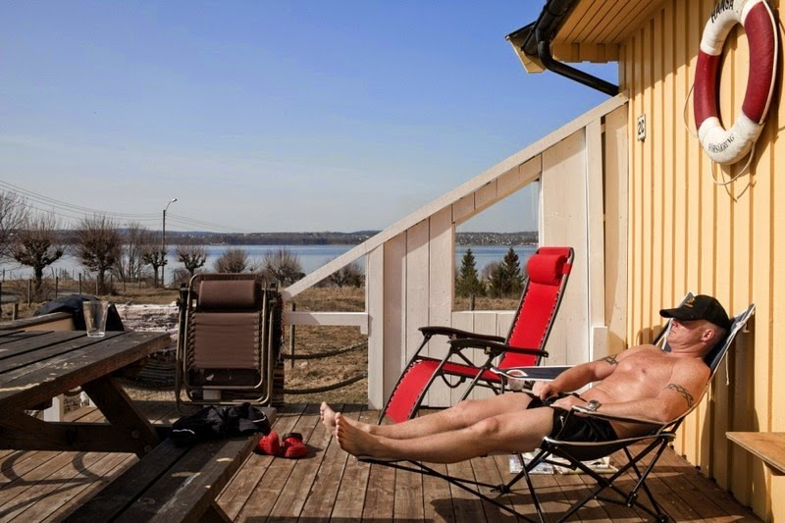
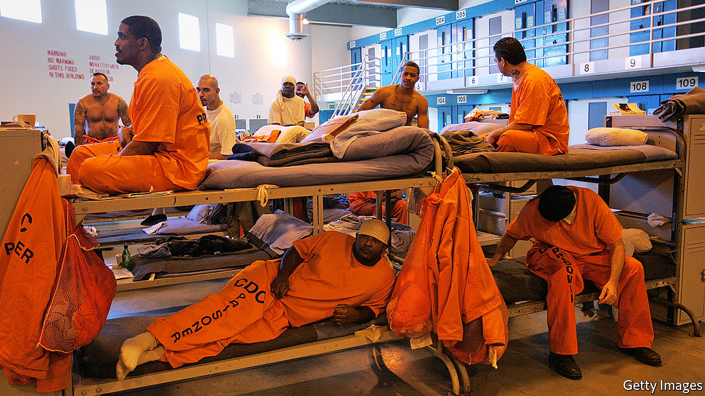
Project Research
Progressive Scandinavian Prison
Typical American Prison
Notes:
These two images show the vast difference between Scandinavian and American prison architecture. Scandinavian inmates are allowed a lot of access to sunlight and nature while American inmates are packed into a room with no views of nature and very little natural light. Exposing people, in any case, to nature is a great way to calm the mind and boost productivity. In fact several people this week have talked about the benefits of nature in your daily life, why should that be any different when talking about the life of an inmate

Slide 13
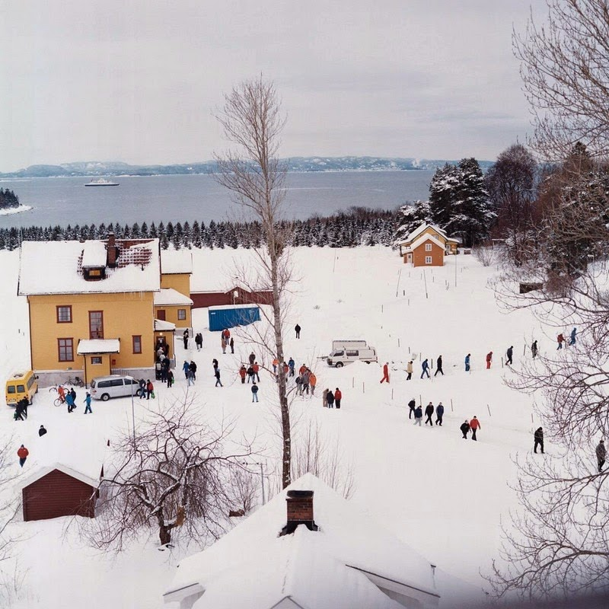
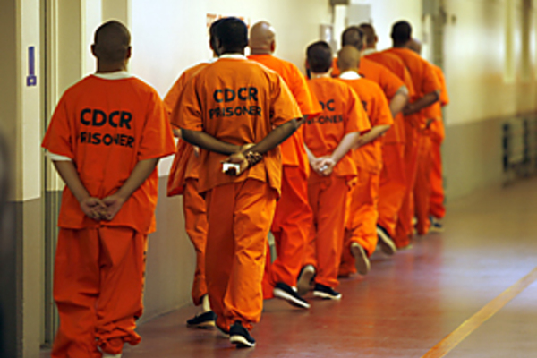
Project Research
Progressive Scandinavian Prison
Typical American Prison
Notes:
On the left we see Bastoy Prison which is a low security prison off the coast of Norway. Bastoy is an island which allows the inmates total freedom to roam about its property. This is not the only open prison in Scandinavia, open prisons are actually quite common. In that picture we are seeing how the inmates move through the landscape on their way to a meal
On the right we see a typical American prison. Men are not handcuffed but expected to hold their hands behind their backs as they move through the facility. As you can see, there is no natural light and any chance to grow a community is greatly diminished

Slide 14
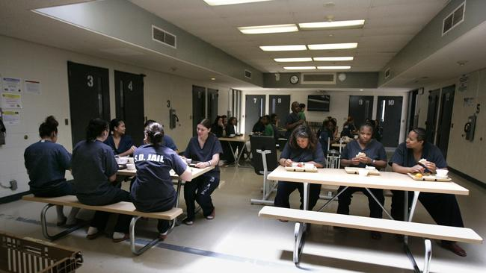
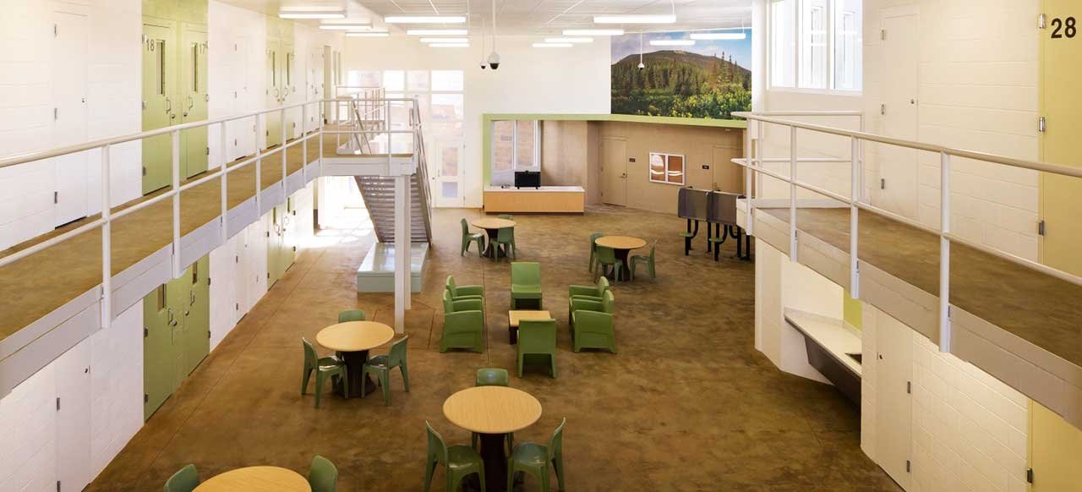
Project Research
Las Colinas pre renovation
Las Colinas post renovation
Notes:
There are even examples of facilities that have undergone the transition from the retributive model to the progression model with positive results. One of those examples is Las Colinas in San Diego, California.
The image shown on the left shows the facility before any renovations were done, the image on the right shows one of the interiors after the renovation was complete. The designers for this project looked at this renovation as a way to build a community aspect within the prison grounds. They looked at what is needed on a day to day level and provided that for the women who inhabit the spaces. This facility functions more as a small community rather than a prison. This offers the opportunity to learn and grow in a safe, secure environment before reentering society.

Slide 15
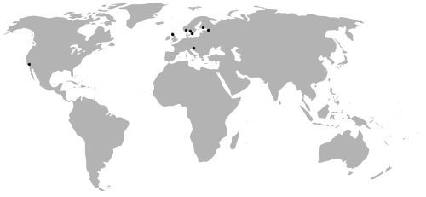
Project Research
Notes:
I looked into examples from Spain, Austria, and the United States but focused most of my time on Scandinavian prisons. Norway is probably the most well known country in terms of progressive prison design which offered the best insight into the positive impact this kind of design can have on a community

Slide 16
DESIGN PROCESS
Notes:
After researching different types of progressive prisons, I worked to design my own version in a low security facility. I decided to remain on the current site of Missouri River Correctional Center because of the established land that is already there. I also thought the landscape was beautiful and offered plenty of room for what I wanted to accomplish.

Slide 17
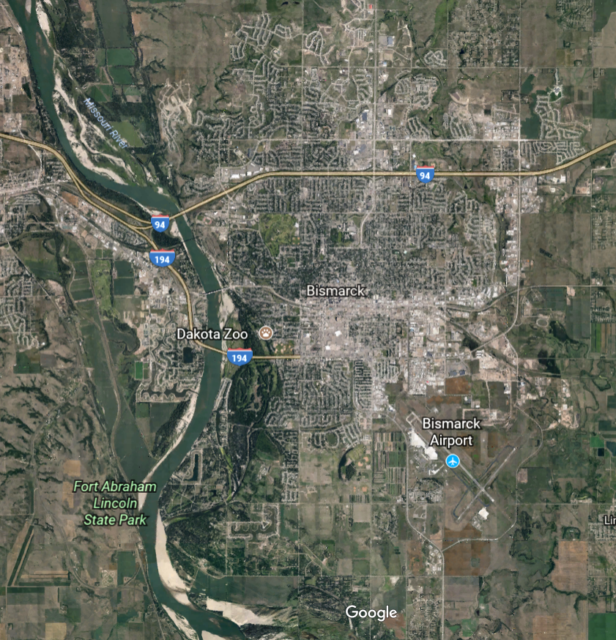
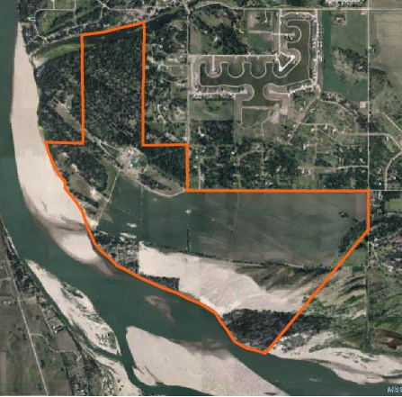
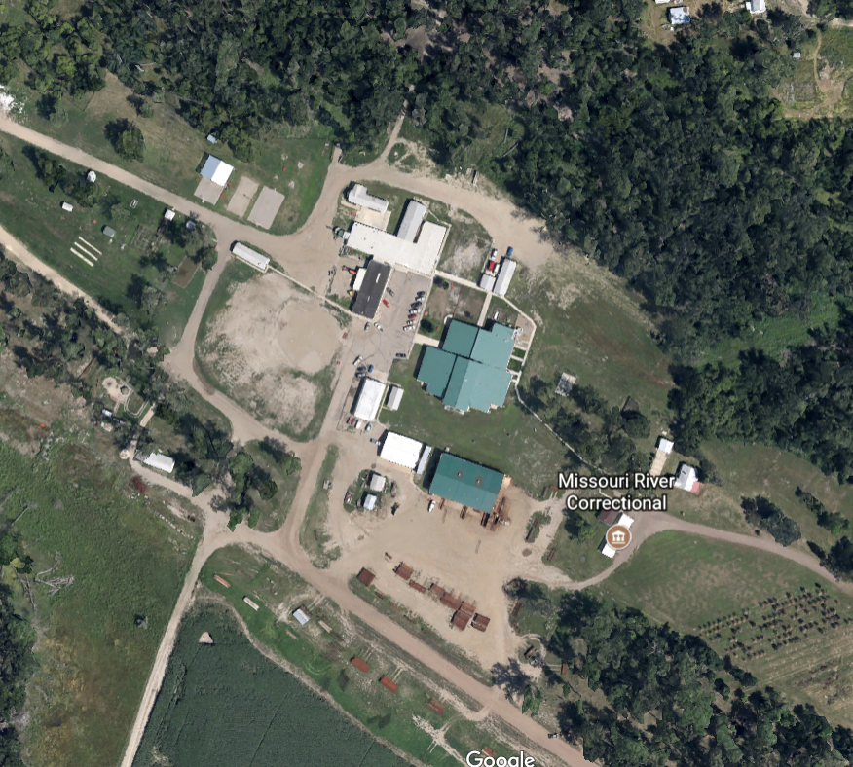
Design Process
City of Bismarck, ND
Site of Missouri River Correctional Center
(MRCC)
Grouping of Buildings on site
Notes:
The site of MRCC is about 900 acres in total and incorporates a lot of aspects that might seem strange when talking about the grounds for a correctional center. There is land for sheep grazing, there is also dog kennels which are used for inmates to train dogs. Along with the animals on campus, there is a large irrigated field that is rented to a farmer who maintains the land on the South Eastern corner of the property.

Slide 18
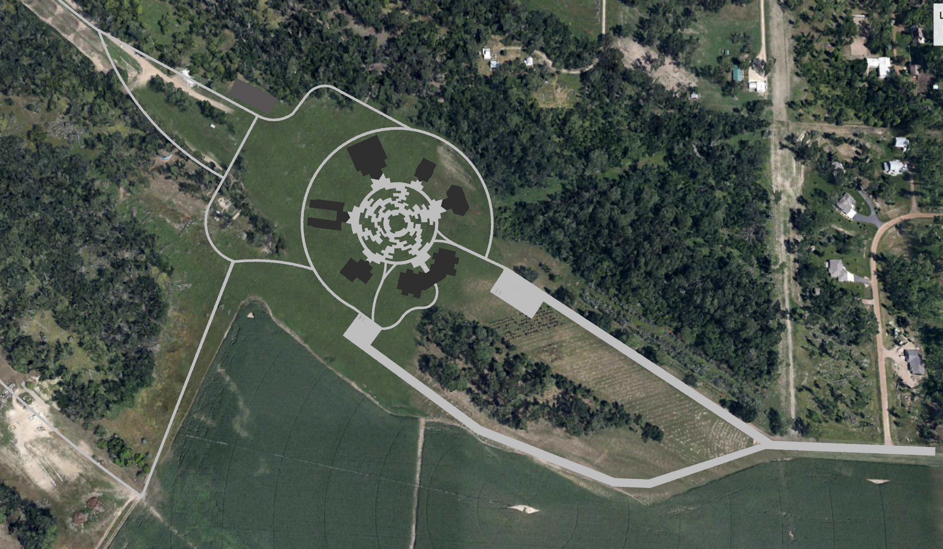
Design Process
Notes:
Because of how large the site is I could have decided to design almost anywhere but I wanted to preserve as many of the old oak trees as possible. Instead, I incorporated paths that wind through the site where inmates and their families can explore the natural landscape of the site.

Slide 19
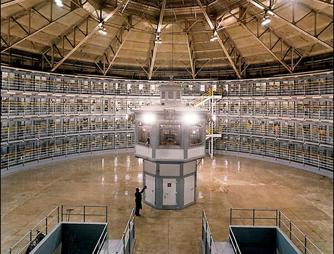
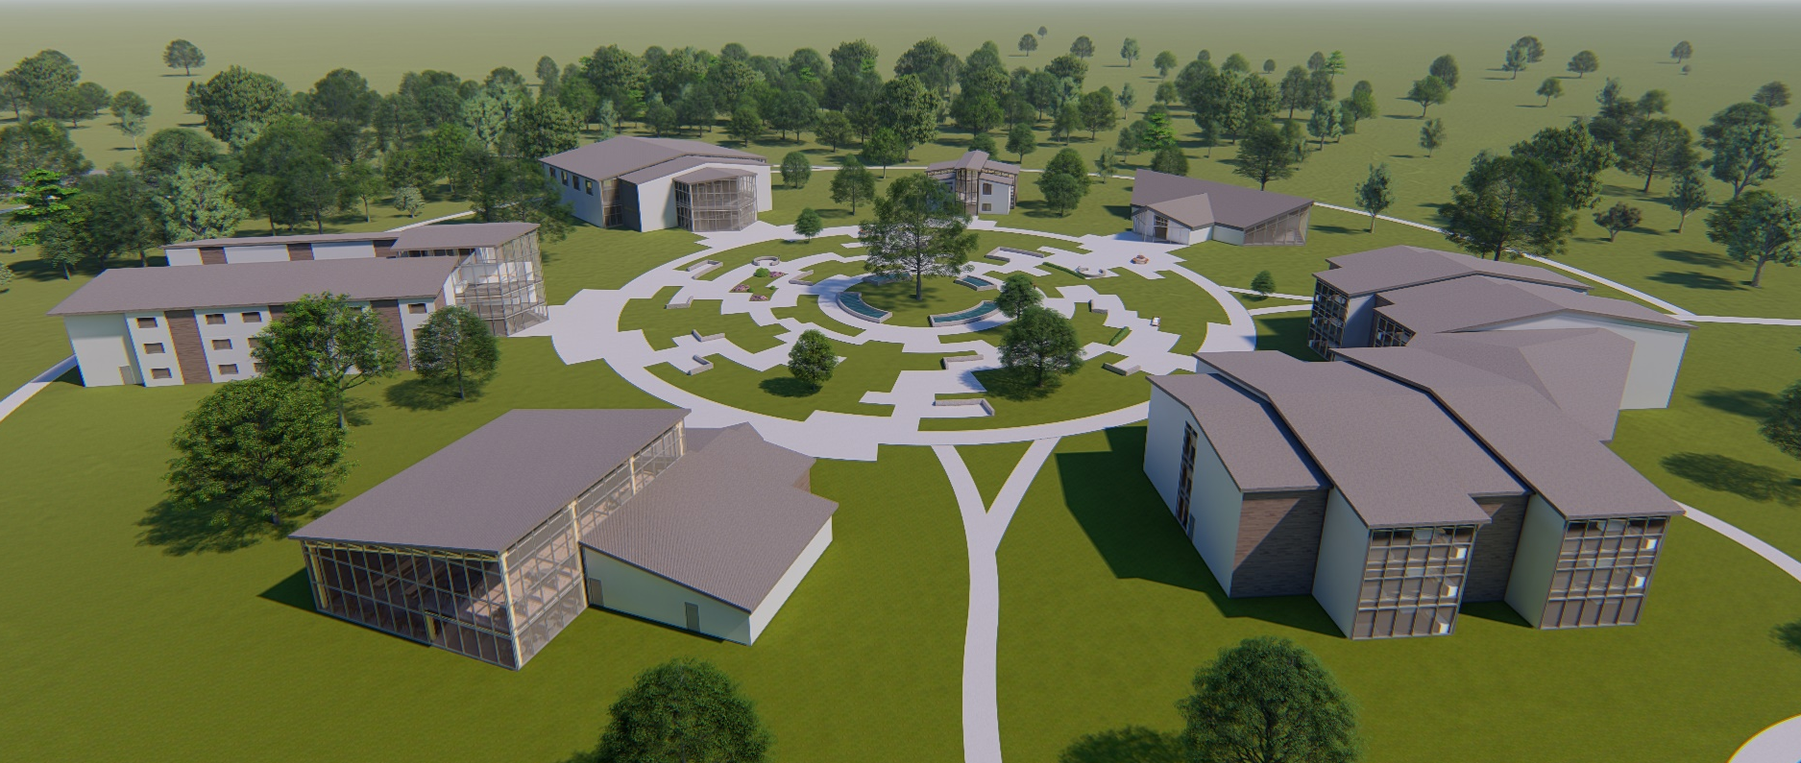
Design Process
Example of Panopticon style prison
Site layout centering around hope
Notes:
The circular layout of the buildings came from some of my initial research into the history of prisons. Panopticon was an idea that allowed the inmates no interaction and no privacy. Everyone was reduced to a cell where they were watched at all times by a central guard tower. The circular layout shows where we came and where we can go from here. Instead of a guard tower in the middle to show intimidation, there is a tree at the center of it all to represent hope and growth.

Slide 20
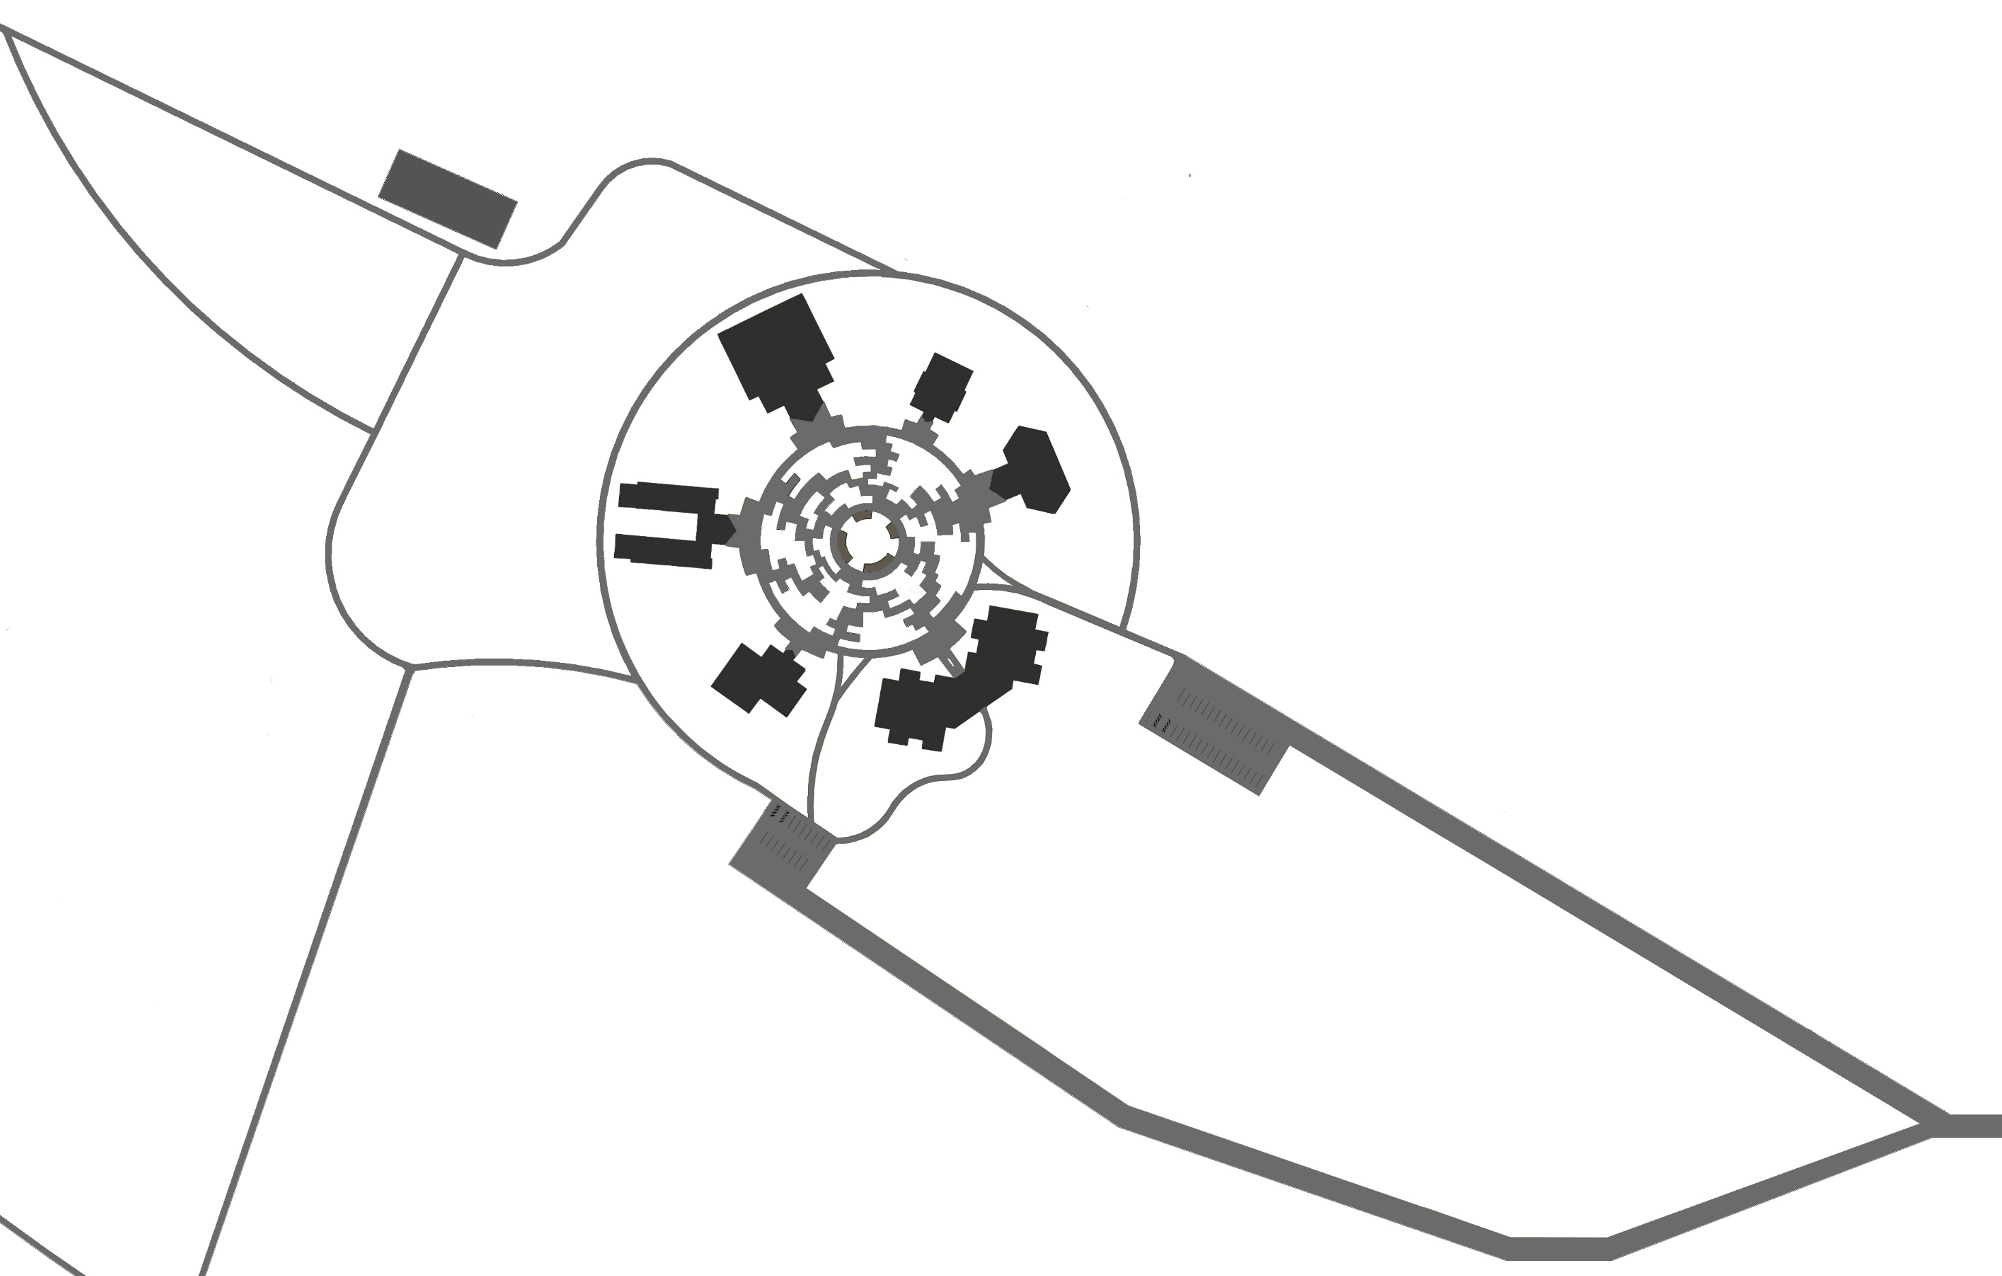
Design Process
Gymnasium
Education
Reflection/ Family Meeting
Single Dorm
Visitor Parking
Cafeteria
Shared Dorm
Employee Parking
Notes:
With that I will walk you through each of the buildings and the steps I took to get to the final solution

Slide 21

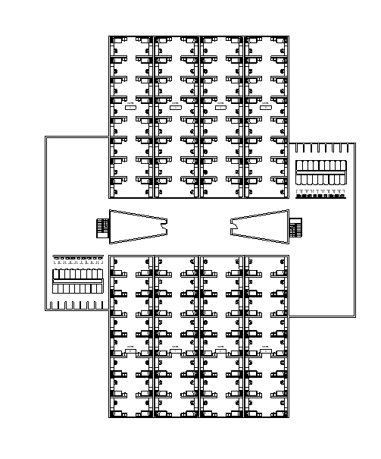
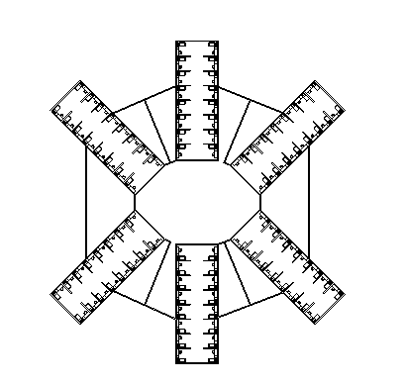
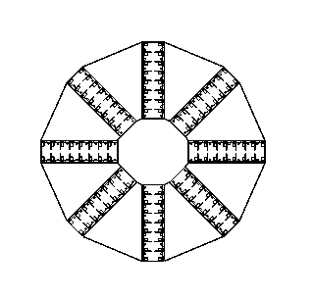
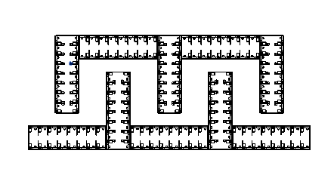
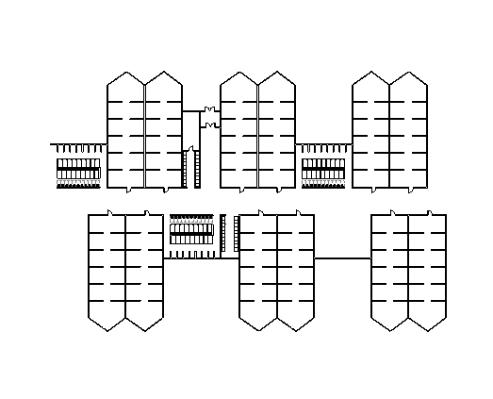
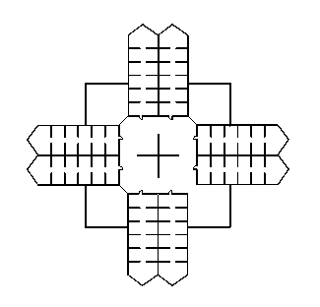
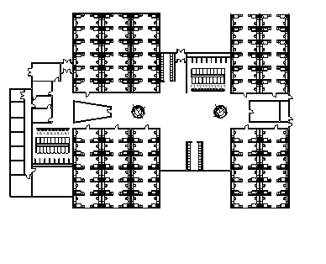
Design Process- Shared Dorm
Notes:
The first building I started designing was the shared dorm space because I knew it would be one of the most complex buildings due to the wide variety of spaces within it. The spaces ranged from staff offices and break rooms to inmate sleeping quarters and day rooms. I went through a lot of different designs before I settled on one that I thought worked best. It allows for a lot of open community spaces while creating a natural barrier to the wings which are more private spaces.

Slide 22
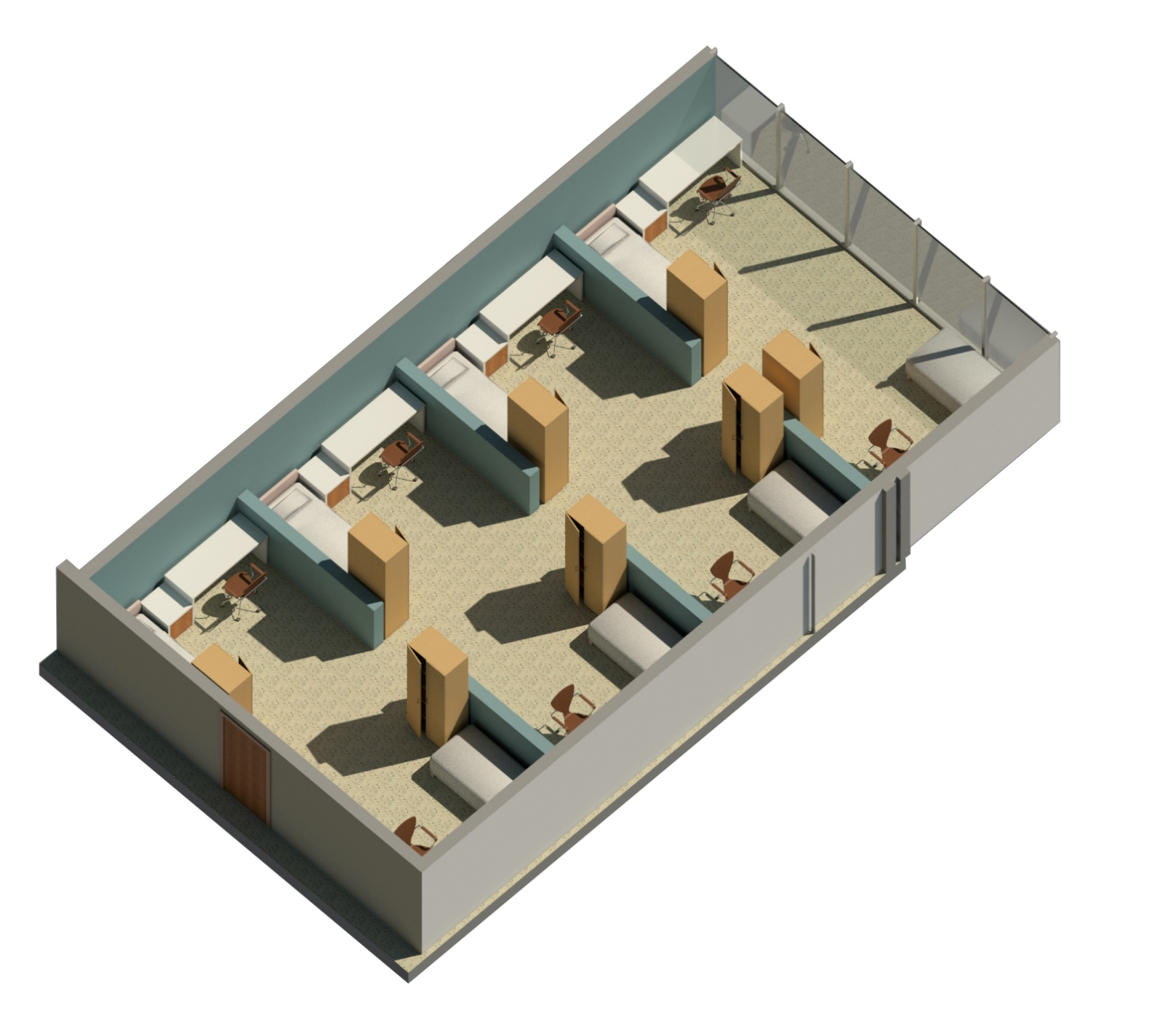
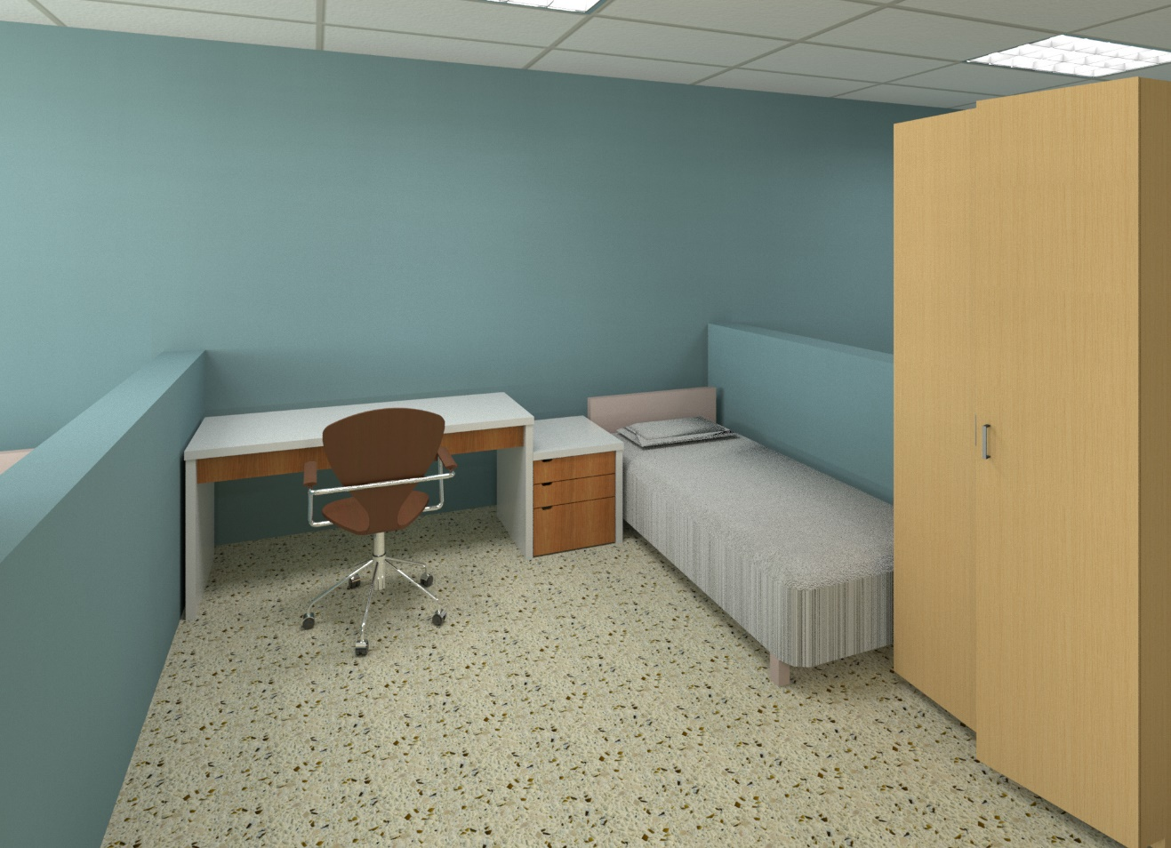
Design Solution- Shared Dorm
Notes:
During the interview process I met with the warden of MRCC to discuss what they would want in a remodel. One of the biggest things I took away from the meeting was their dire need for more staff spaces. They are currently using closets as offices and even that does not provide them with enough space. In my final design I added offices for every staff member along with a conference room and break room. While the main focus for this project is the inmates, staff retention and moral are important factors to consider.

Slide 23
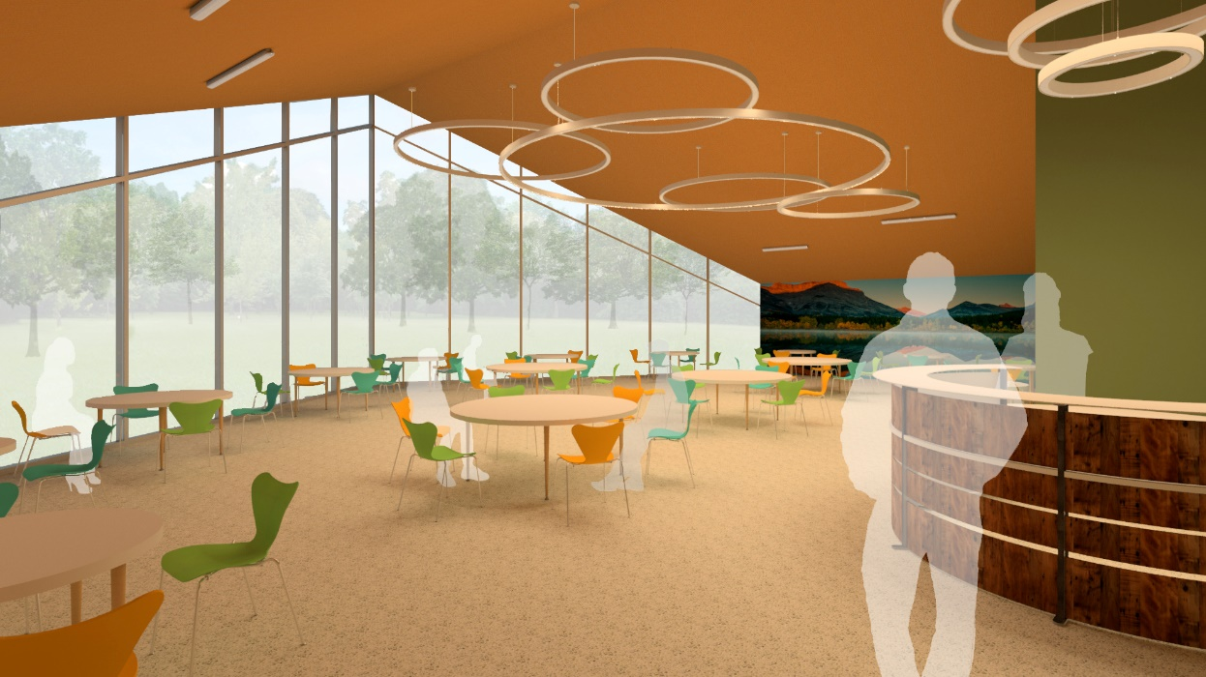
Design Process- Reflection Space
Notes:
I think this is one of the most important buildings on the campus. I read articles about the importance of family interaction while incarcerated but it really struck home listening to a podcast called Ear Hustle. It is recorded from inside San Quintin State Penitentiary and available for the public to listen to. A couple of the episodes talked about the anticipation that is felt by an inmate waiting for a visit with family and the extended feeling of happiness that is felt even after they leave.
I wanted to create a space that was open and inviting. The high ceilings and expansive windows allow for tons of natural light and views of the forest on the edge of campus. This image depicts the family meeting room where inmates can hang out or play board games with their families. Because they do not get any real private moments together I thought of this place as a kind of family room setting. Think of your family sitting around the kitchen table talking or playing games on game night- I wanted to bring that same feeling into this space.

Slide 24
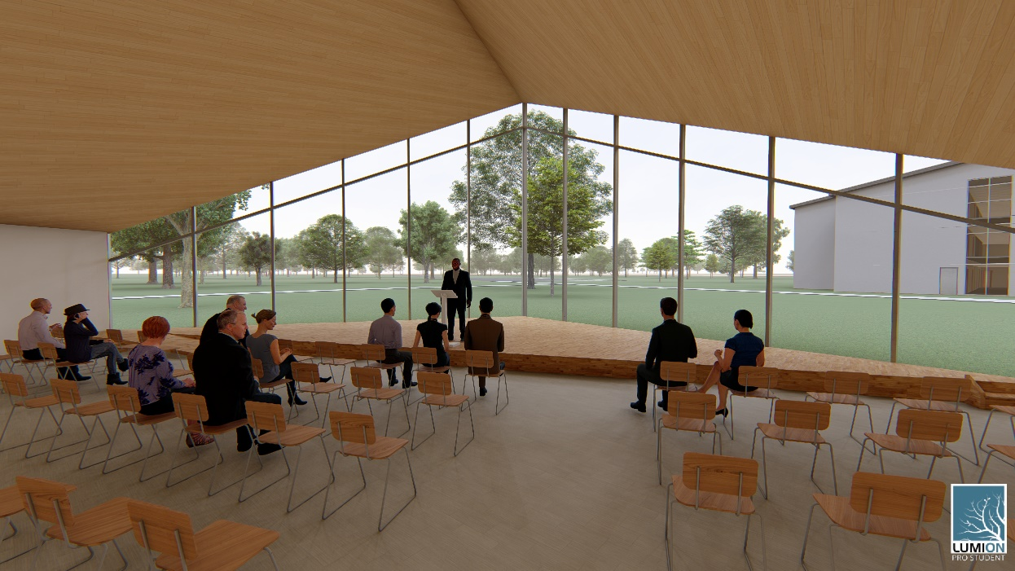
Design Solution- Reflection Space
Notes:
This image shows the reflection space. Incarceration allows for a lot of self reflection and I believe it is important to have a space dedicated to that. This could be used for a church service of any religious denomination or could be used as a large group gathering place for things such as graduation ceremonies

Slide 25
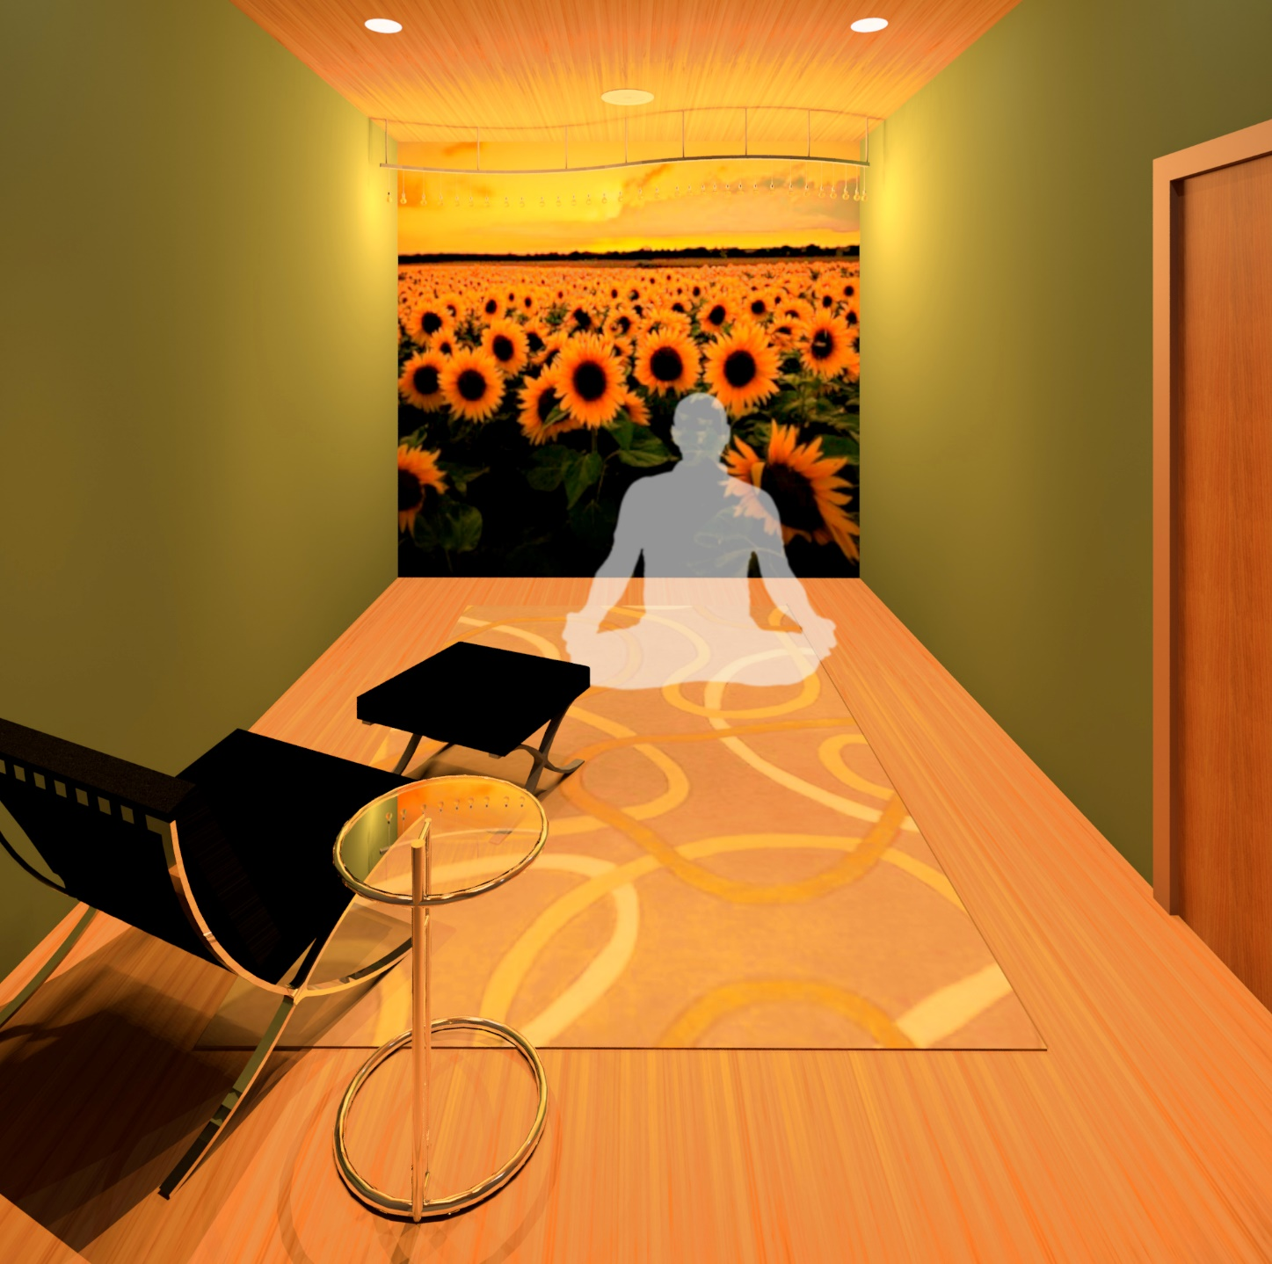
Design Solution- Reflection Space
Notes:
During my talk with the warden at MRCC we discussed his thoughts on solitary confinement. Because this is a low security facility there should be no need for solitary condiment. Instead I included two private “cool down rooms” these are intended for the men to take a few minutes to cool down or collect their thoughts. A large portion of the population here would live in shared dorms which does not allow for a lot of privacy or alone time. These rooms would give them the opportunity to remove themselves from a negative situation.

Slide 26
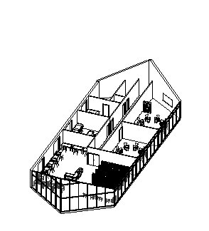
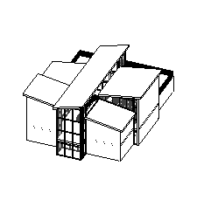
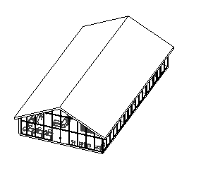
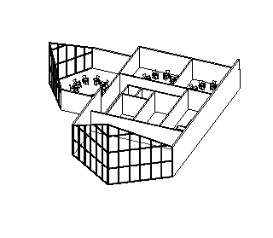
Design Process- Education Building
Notes:
During my research I read a lot about the importance of education in the rehabilitation process. Some prisons offer as much as graduate level courses to inmates who want to further their education. I see no reason why MRCC cant make the move toward offering higher level education courses here.

Slide 27
Design Process- Education Building
Education Rate of General Population
Education Rate of Incarcerated Individuals
Notes:
Studies show that a higher level of education directly correlates with a lower level of crime. If we can work to educate the individuals who have fallen into this cycle of incarceration and release maybe we can break the cycle which will change the future of incarceration

Slide 28
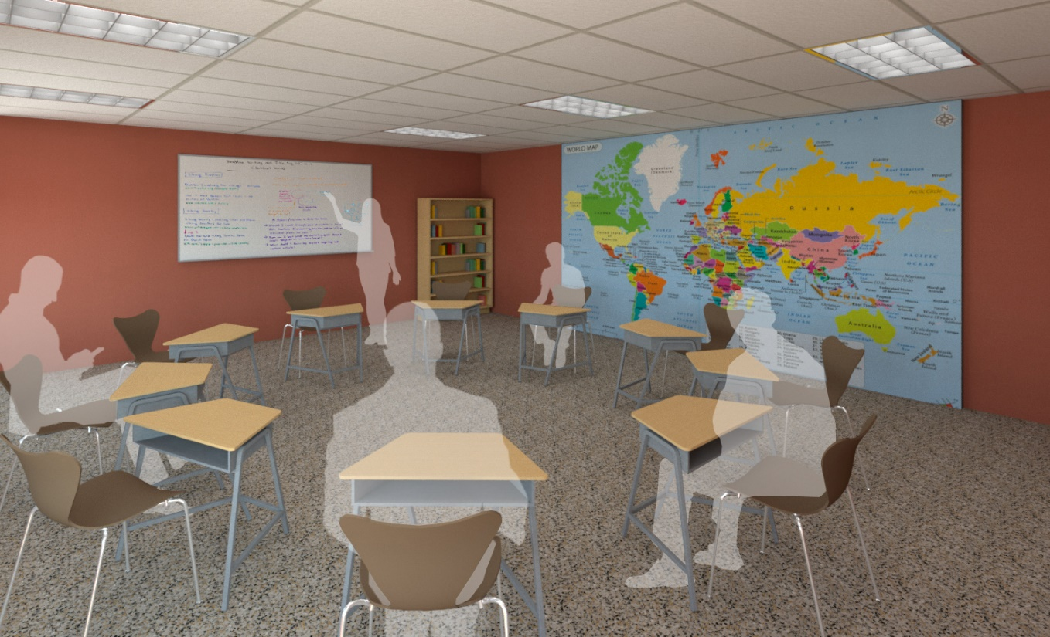
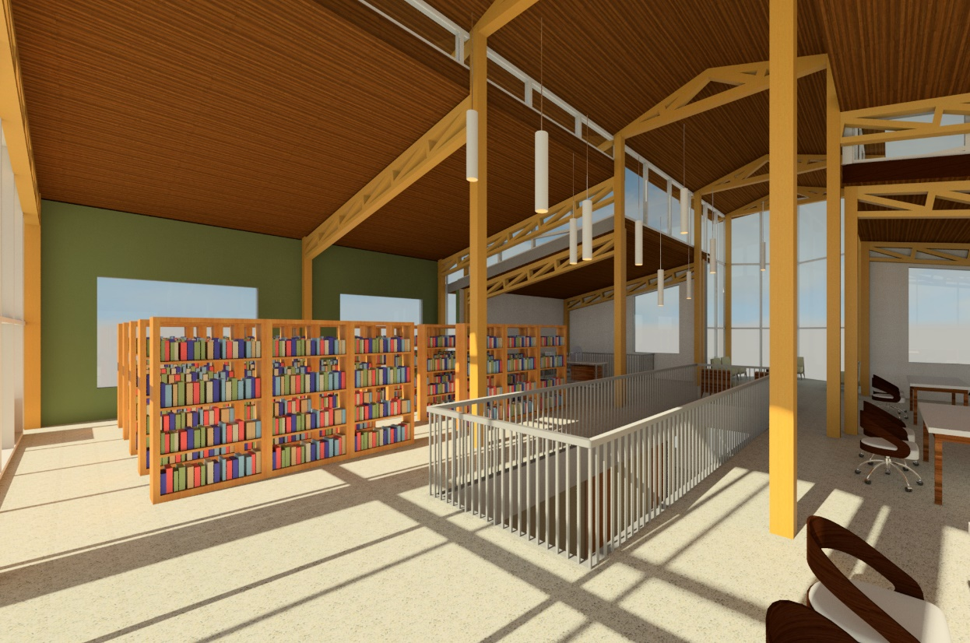
Design Solution- Education Building
Notes:
Including rooms where a typical class can take place allows for the opportunity for advancement in their education. They can work towards getting their GED or use the computer lab to take college courses online. The second floor of the education building is comprised of a library and open study space. This allows for inmates to study and learn together.

Slide 29
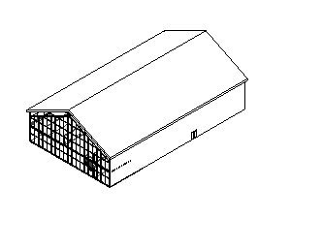
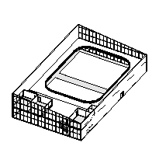
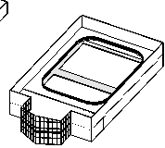
Design Process- Gymnasium
Notes:
The gymnasium really allowed me to play with different ideas of what is possible in this space. In my initial sketches I had a small workout room with little natural light. I quickly moved away from that to give inmates the opportunity to use this space as we use a gym. When we are upset or frustrated we go for a run or blow off some steam with a workout so why do we expect that men in a naturally high stress environment should not be afforded the same opportunities? I included two full size basketball courts with a track on the mezzanine level, free weights, and rooms that can be used for dance class, yoga, meditation, or something else completely.

Slide 30
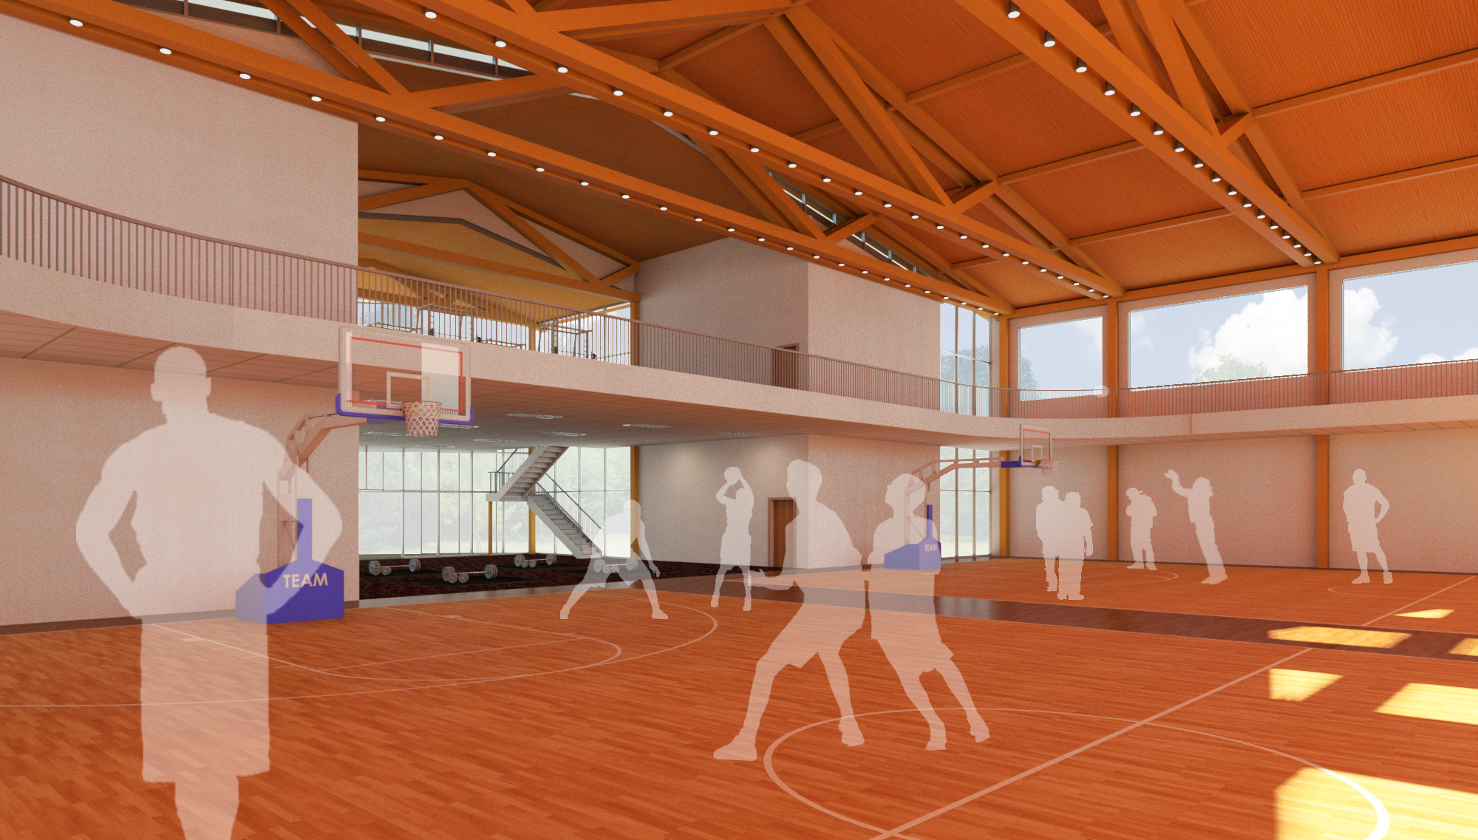
Design Solution- Gymnasium
Notes:
Including basketball courts and a track might seem like a luxury to some, but it was actually very strategic. Playing team sports is a great way to teach team building skills, anger management, and work on problem solving. Each of these things are a part of daily life and can be taught during incarceration. Having an indoor recreation area was important because of the location of this facility. No one should be expected to play a game of basketball outside in North Dakota in January.

Slide 31
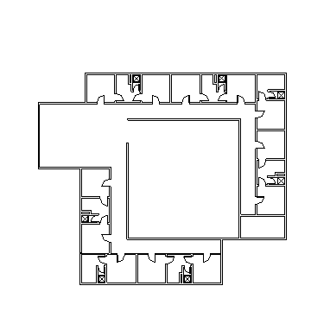
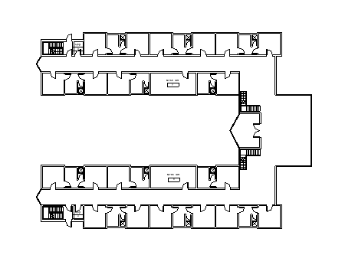
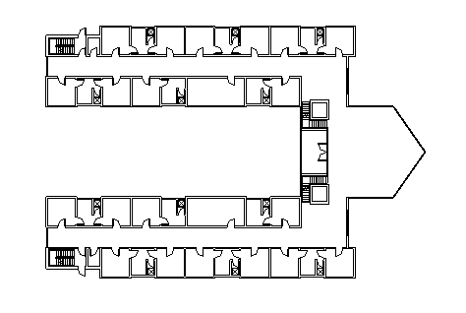
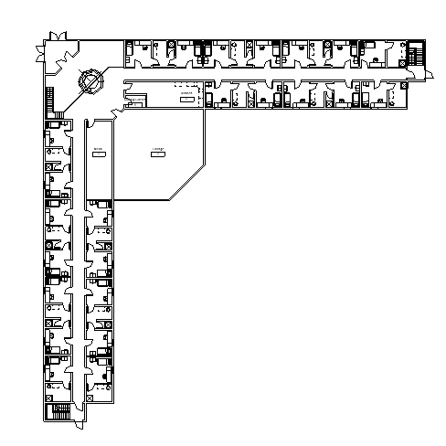
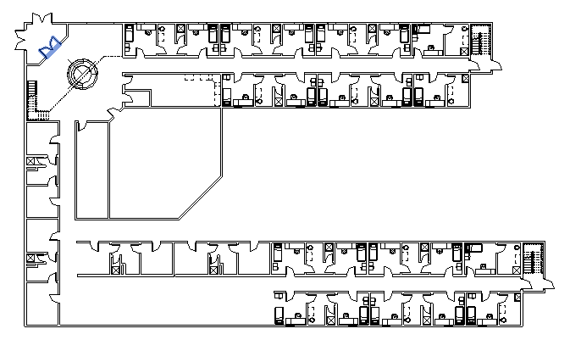
Design Process- Single Dorm
Notes:
When I stared this building, I imagined it to be something like a college dorm. Each person would get a single room with a shared bathroom between and it would be their responsibility to clean them.

Slide 32


Design Solution- Single Dorm
Notes:
A major issue to consider when preparing men to reenter society is how they have lived for the past several years. A lot of men do not know how to deal with the silence they experience when trying to go to bed at night. Imagine living for 5 years with no walls to close off the sound of your neighbors and then one day trying to fall asleep in complete silence. It would be maddening for anyone. Moving from a shared dorm to a single dorm before leaving prison allows for a smooth transition.

Slide 33




Design Solution- Cafeteria
Notes:
I thought of the cafeteria as a place to encompass a few of the ideas I had been studying- I aimed to design it in a way that would encourage the growth of a community as well as allowing for views of nature.

Slide 34


Cafeteria Solution
Notes:
The idea behind the cafeteria was to provide an oasis of sorts. The cafeteria is a place that most inmates will come to at least two times a day so I wanted it to allow for a dream of what life there is to come. Thinking about the summer sun when it is -30 degrees outside or thinking about places they will be able to visit after they leave here promotes a different way of thinking

Slide 35

“The degree of civilization in a society can be judged by entering its prisons”
^{- Fyodor Dostoyevsky}
Notes:
I will end with a quote I found through my research that I believe speaks to what I want to accomplish with my project.

